Slide 2
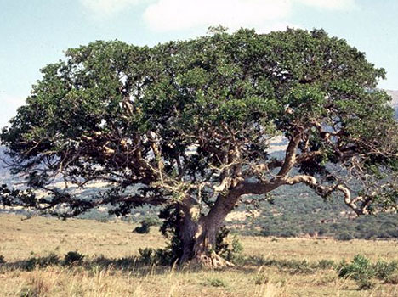
“Then Jesus entered and passed through Jericho. ² Now behold, there was a man named Zacchaeus who was a chief tax collector, and he was rich. ³ And he sought to see who Jesus was, but could not because of the crowd, for he was of short stature. ⁴ So he ran ahead and climbed up into a sycamore tree to see Him, for He was going to pass that way.⁵ And when Jesus came to the place, He looked up and saw him, and said to him, “Zacchaeus, make haste and come down, for today I must stay at your house.” ⁶ So he made haste and came down, and received Him joyfully. ⁷ But when they saw it, they all complained, saying, “He
has gone to be a guest with a man who is a sinner.” ⁸ Then Zacchaeus stood and said to the
Lord, “Look, Lord, I give half of my goods to the poor;
and if I have taken anything from anyone by false
accusation, I restore fourfold.” ⁹ And Jesus said to him,
“Today salvation has come to this house, because he
also is a son of Abraham; ¹⁰ for the Son of Man has
come to seek and to save that which was lost.”
Luke 19.1-10

Slide 3
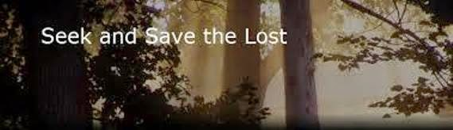
HE DIDN’T EMBARRESS
HE STAYED FOCUS
HE SAW VALUE

