Slide 1


Liberty in Christ
Applications from Galatians

Slide 2


Free to Serve Through Love
Galatians 5:13-15

Slide 3
For you, brethren, have been called to liberty; only do not use liberty as an opportunity for the flesh, but through love serve one another. For all the law is fulfilled in one word, even in this: “You shall love your neighbor as yourself.” But if you bite and devour one another, beware lest you be consumed by one another!
Galatians 5:13-15

Slide 4
For you, brethren, have been called to liberty; only do not use liberty as an opportunity for the flesh, but through love serve one another. For all the law is fulfilled in one word, even in this: “You shall love your neighbor as yourself.” But if you bite and devour one another, beware lest you be consumed by one another!
Galatians 5:13-15

Slide 5
For you, brethren, have been called to liberty; only do not use liberty as an opportunity for the flesh, but through love serve one another. For all the law is fulfilled in one word, even in this: “You shall love your neighbor as yourself.” But if you bite and devour one another, beware lest you be consumed by one another!
Galatians 5:13-15

Slide 6
Love:
“…God is love” (1 John 4:8)
“…through love serve one another” (Gal. 5:13)
‘agape’ involves:
  Faithfulness
  Commitment
  An act of will

Slide 7
Illustration of God
Divine Love
  Foreordained
  Foretold
  Fulfilled

Slide 8
Illustration of God
Divine Love
  Foreordained
  God “chose us in Him before the foundation of the world” (Ephesians 1:4)
It was determined beforehand, foreordained or predestined, that those who trust in Christ will obtain an inheritance according to the purpose of Him who works all things according to the counsel of His will (Re: Ephesians 1:11-12)

Slide 9
Illustration of God
Divine Love
  Foreordained
  Foretold
Foretell: to tell about or announce something before it happens (Merriam-Webster Dictionary)
Psalm 22; Psalm 118:22-24; Jeremiah 31:31; Isaiah 53; Isaiah 61:1-2

Slide 10
Illustration of God
Divine Love
  Foreordained
  Foretold
“Of this salvation the prophets have inquired and searched carefully, who prophesied of the grace that would come to you, searching what, or what manner of time, the Spirit of Christ who was in them was indicating when He testified beforehand the sufferings of
Christ and the glories that would follow”
(1 Peter 1:10-11)

Slide 11
Illustration of God
Divine Love
  Foreordained
  Foretold
  Fulfilled
Fulfill: to put into effect (Merriam-Webster Dictionary)
“those things which God foretold by the mouth of prophets, that the Christ would suffer, He has thus fulfilled” (Acts 3:18)

Slide 12
Illustration of God
Divine Love
Divine Service
Service can be defined as a “contribution to the welfare of others; a helpful act” (Merriam-Webster)
God gave all for the love of mankind!
  He gave His only begotten Son
Jesus gave all for the love of mankind!
  He totally surrendered to the Father’s will

Slide 13
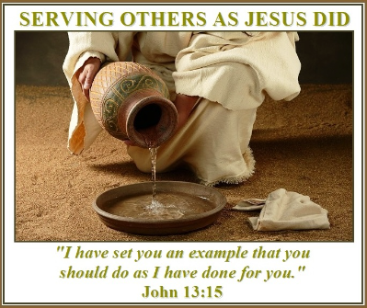
Illustration of God
Divine Love
Divine Service revealed
Jesus revealed three characteristics of a servant heart:
Surrender: John 6:38
Determine to serve: Mark 10:42-45, Luke 22:27
Demonstrate humility: Luke 22:27,
John 13:2-17

Slide 14

Illustration of God
Divine Love
Divine Service
Divine Sacrifice
“But God demonstrates His own love toward us, in that while we were still sinners, Christ died for us” (Romans 5:8)

Slide 15
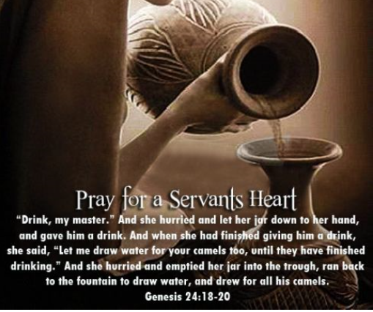
Make me a Servant
Man is made in the image of God (Gen. 1:7)
It is therefore important for man to try and emulate the characteristics of God in his life.
“Let this mind be in you which was also in Christ Jesus…” (Phil. 2:5)

Slide 16
Make me a Servant
Jesus taught three ways how I can serve Him today:
Deny Yourself and take up your cross and follow Christ: Matthew 16:24
Whoever wants to save their lives must lose their lives: Matthew 16:25
Whoever wants to be great amongst yourselves must become a servant: Matthew 20:26

Slide 17
Make me a Servant
Our hearts must be conditioned to be:
When our attitude is under the control of Christ, our actions and speech will be filled with love, service, and sacrifice!
Cleansed of our iniquities: Psalm 51:2; 1 Peter 2:1;
Eph. 4:31
Created anew: Psalm 51:10; Romans 12:1-2
Capitulated (cease resisting): Galatians 2:20; Isaiah 64:8; Eph. 4:2
Consent ready: Psalm 27:11; Psalm 119:33
Courageous: 2 Tim. 1:7; 1 Chronicles 28:20,
Hebrews 13:6; Romans 8:31
Compassionate: 1 Peter 3:8; Colossians 3:12,
1 John 3:17

Slide 18
Make me a Servant
Practicing in God’s presence:
Our service to each other should not be a burden, but a blessing!
His love is complete when He leads you to step out in faith serving one another through love:
A cup of cold water: Matthew 10:42
Acts of Love: Matthew 25:34-36
Serving orphans and widows: James 1:27
Serving our families: Proverbs 31:10-31; 1 Tim. 5:8
Serving our church families: Romans 12:5-16

Slide 19

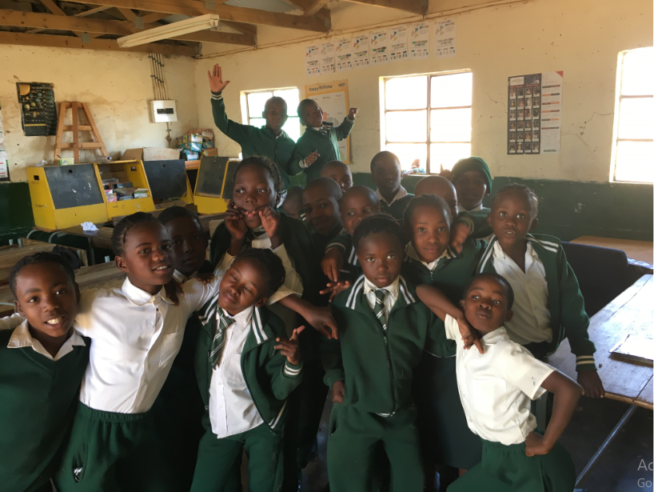
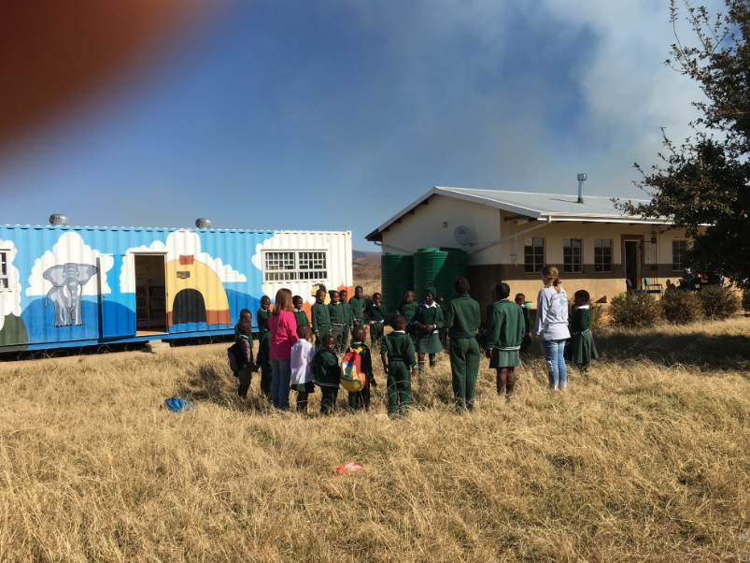

Slide 20

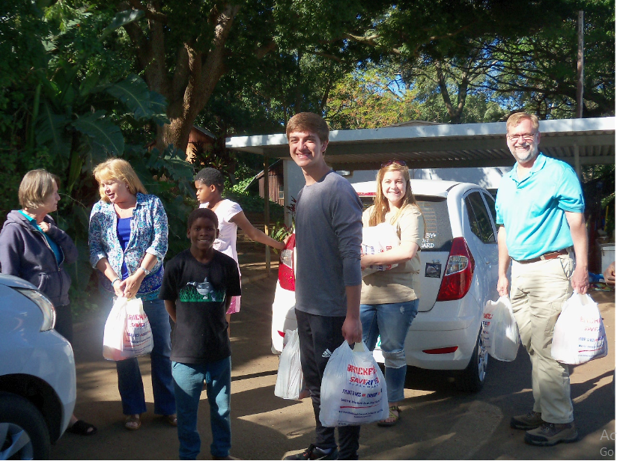
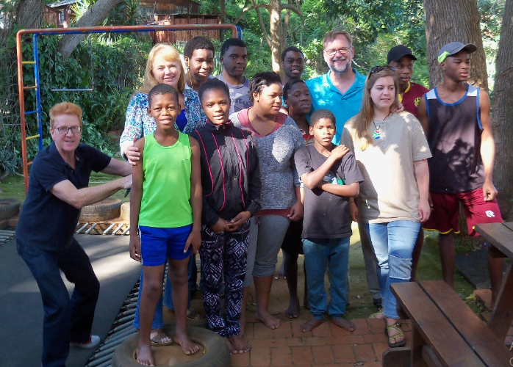
Our service should bring joy, and exemplify J.O.Y.
Jesus
Others
Yourself

Slide 21
Make me a Servant
Women who served one another through love
Biblical examples: Anna, Elizabeth, Mary, Mary Magdalene, Lydia, Dorcas, Tabitha, Mary the mother of John Mark, Priscilla, Phoebe, Joanna, and Susanna.
Greatest example of serving is found in motherhood:
Lois and Eunice: choosing to serve
and teach your children. 2 Tim 1:5

Slide 22
Make me a Servant
Men who served one another through love
Biblical examples: Paul, Timothy, Epahroditus, Tychicus, Onesimus, Aristarchus, Mark, Justus, Epaphras, Luke
Greatest example of serving: Jesus Christ

Slide 23
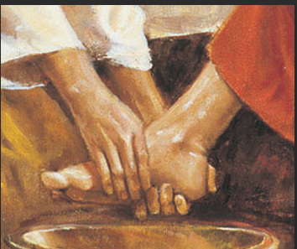
Make me a Servant
He died to set me free; therefore, as His child, I follow in His footsteps…

