Slide 1


Liberty in Christ
Applications from Galatians

Slide 2


Free to Bear Fruit
Galatians 5:16-26

Slide 3
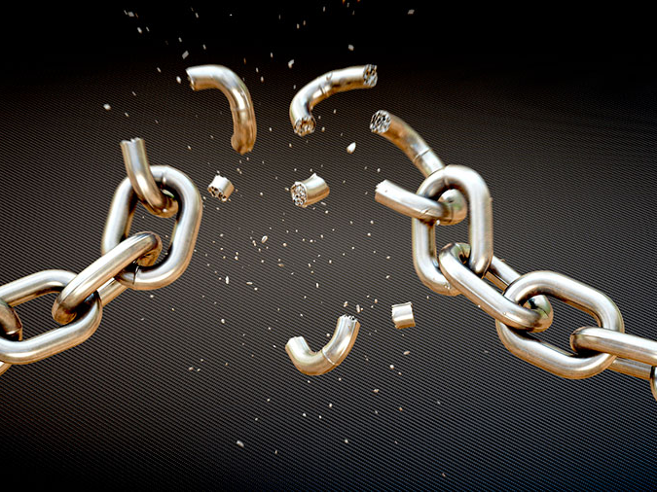
“It was for freedom that Christ set us free; therefore keep standing firm and do not be subject again to a yoke of slavery.”
- Gal 5:1
Image from https://stream.org/wp-content/uploads/Breaking-Free-of-Chains-900.jpg

Slide 4
Free from Sin,
NOT free from Obedience
We can be what God created us to be
We bear fruit!
Image from https://stream.org/wp-content/uploads/Breaking-Free-of-Chains-900.jpg

Slide 5

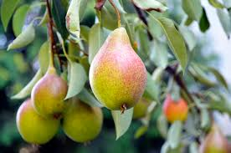
Matt 7:15-20
The fruit you bear is the ultimate determiner of what kind of tree you planted
Apple Tree

Slide 6
The fruit we bear is a clear indication of what kind of “tree” we are to:
The world
Other Christians
God

Slide 7
The Fruit of the Spirit
Galatians 5:16-26

Slide 8

Observations about the Fruit
The fruit is one, not many (Gal 5:22)
The fruit is a fruit
The fruit requires work (Gal 5:22; 2 Pet 1:5-7, 8-9; Gal 5:1)
The fruit of the Spirit is contrasted to the deeds of the flesh (Gal 5:17; 5:19-21)

Slide 9
Fruit of the Spirit VS. Deeds of the flesh
FRUIT OF
THE SPIRIT
DEEDS OF THE FLESH

Slide 10
Fruit of the Spirit - Traits
Love – agape (Rom 5:8; Matt 22:37-38; 1 Cor 13:4-8a)
Joy – not the same as happiness (Phil 1:8, 2:17, 4:4)
Peace – shalom (Rom 5:1; Phil 4:7)
Patience – longsuffering / endurance (1 Pet 3:20; 2 Pet 3:15; see 1 Cor 13:4)
Kindness (or gentleness) (Col 3:12-13)
Goodness – being righteous (See 1 Pet 2:12)
Faithfulness (1 Cor 10:13; Hab 2:4)
Gentleness – echoes “Kindness”
Self-control (Gal 5:17; 1 Cor 9:27)

Slide 11
“…let us walk by the Spirit”
(Gal 5:16, 25)
FRUIT OF
THE SPIRIT
“Those who belong to Christ Jesus have crucified the flesh…”
(Gal 5:24)
DEEDS OF
THE FLESH
“Those who practice such things will not inherit the kingdom of God” (Gal 5:21)

Slide 12
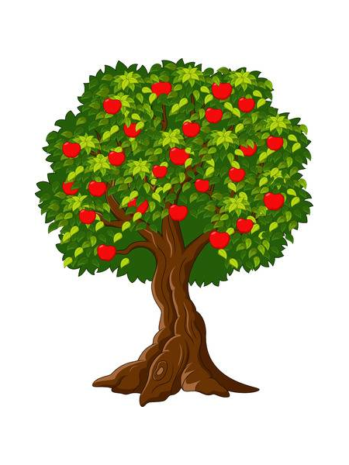
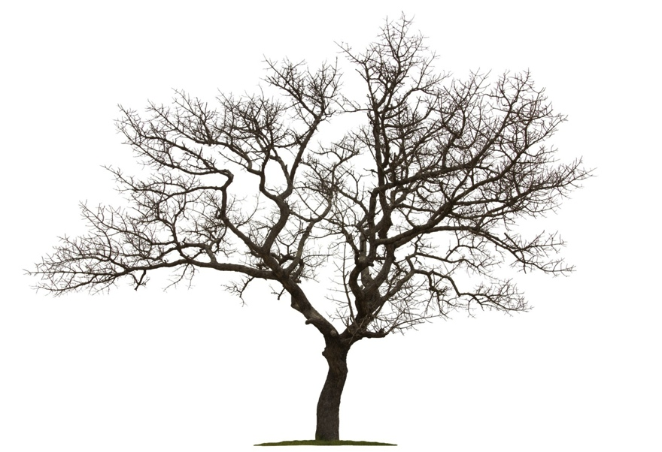
When we truly walk by the Spirit it may seem that…
ME
…and a few people of God
EVERYONE
The majority
The “intelligent”
The knowledgeable
All those around us

Slide 13
…however:
EVERYONE
The majority
The “intelligent”
The knowledgeable
All those around us
GOD,
His people
and me

Slide 14
We are called to freedom!
NOT freedom from obedience
NOT “IF” we serve, but “WHO” we serve
Image from https://stream.org/wp-content/uploads/Breaking-Free-of-Chains-900.jpg

Slide 15
We are free to bear fruit, so…

Slide 16
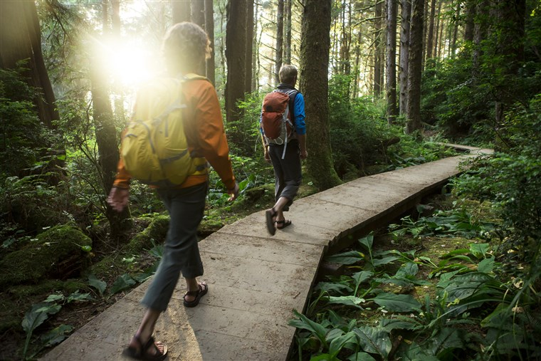
…walk by the Spirit
- Gal 5:16, 25
https://media2.s-nbcnews.com/j/newscms/2017_35/2136986/170829-better-two-people-walking-path-se-612p_6d6afec319c42d9fb5944ba0d1697617.fit-760w.jpg

