Slide 1
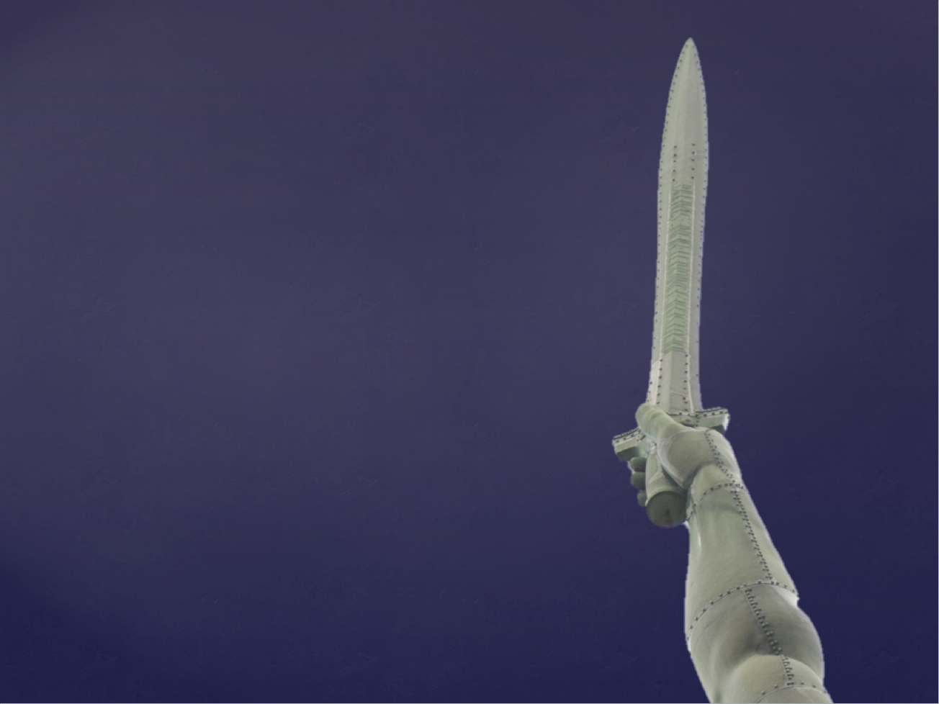
By Many
or by Few
The faith of Jonathan

Slide 2
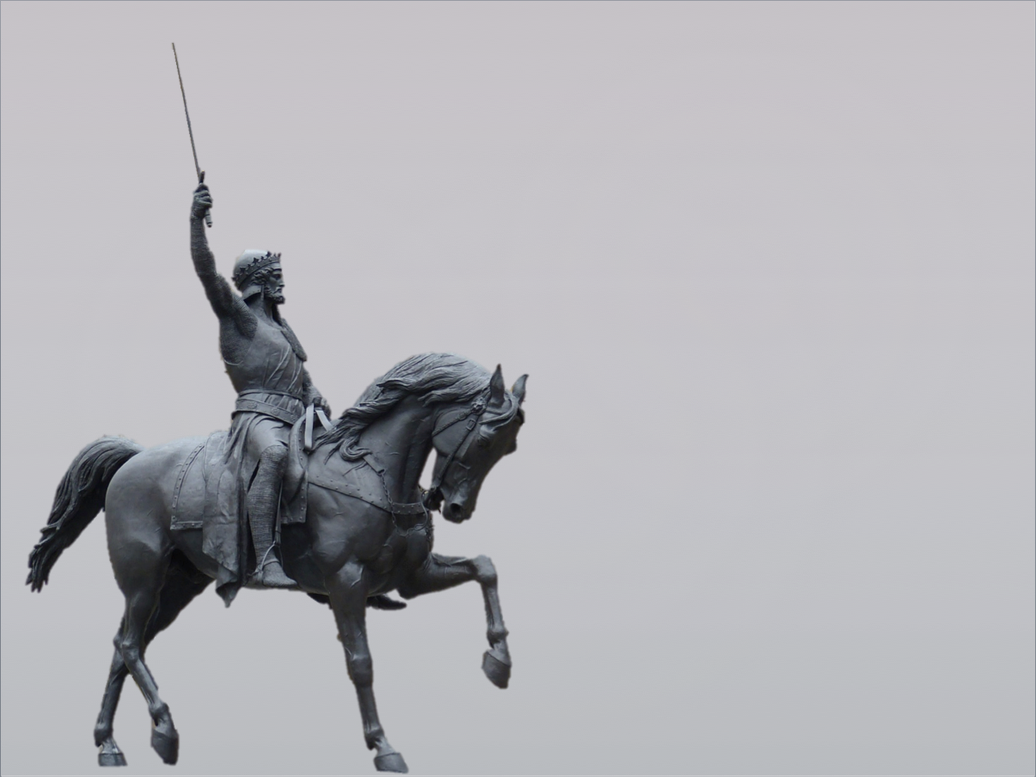
Give us a king!
Deut. 20:1-4 “When you go out to war against your enemies, and see horses and chariots and an army larger than your own, you shall not be afraid of them, for the Lord your God is with you, who brought you up out of the land of Egypt. ² And when you draw near to the battle, the priest shall come forward and speak to the people ³ and shall say to them, ‘Hear, O Israel, today you are drawing near for battle against your enemies: let not your heart faint. Do not fear or panic or be in dread of them, ⁴ for the Lord your God is he who goes with you to fight for you against your enemies, to give you the victory.’
ESV

Slide 3
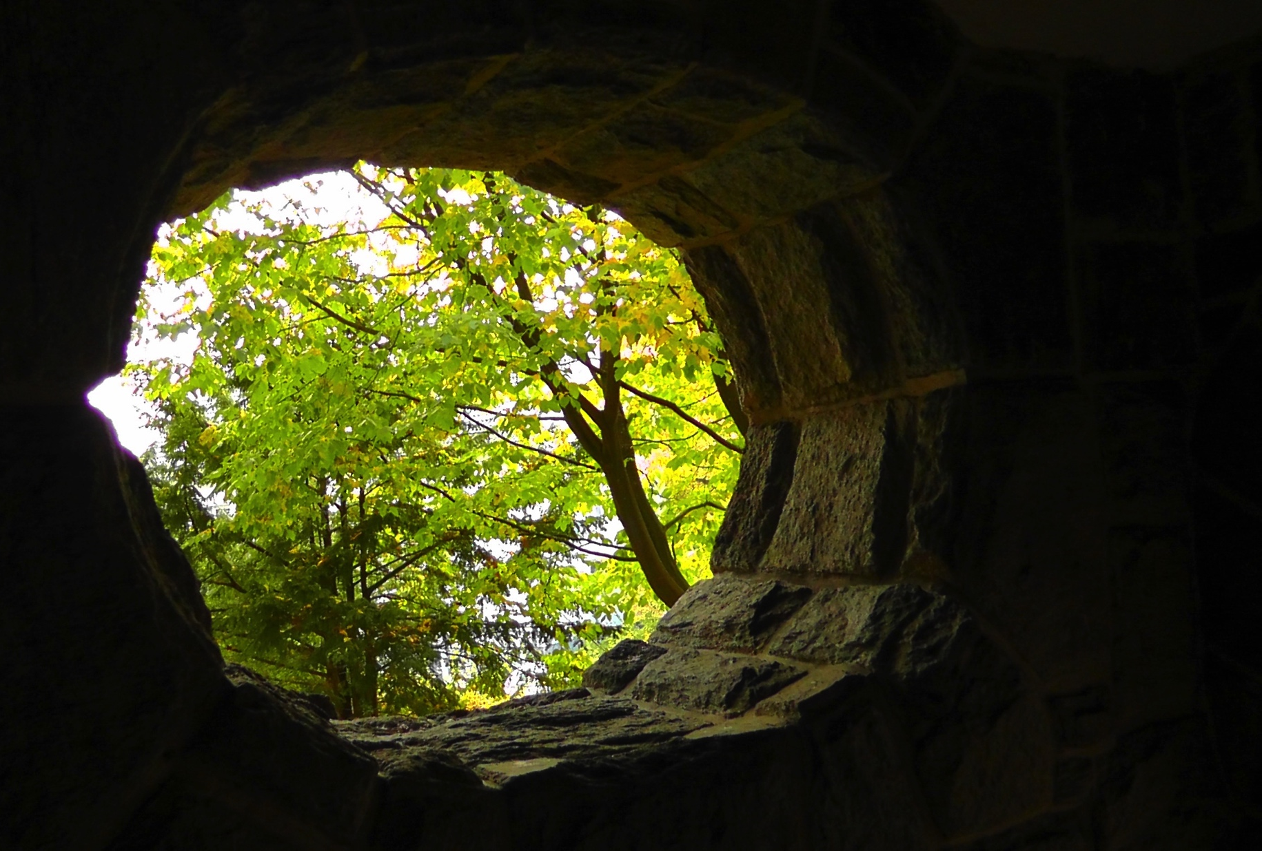
Hiding in caves and holes

Slide 4
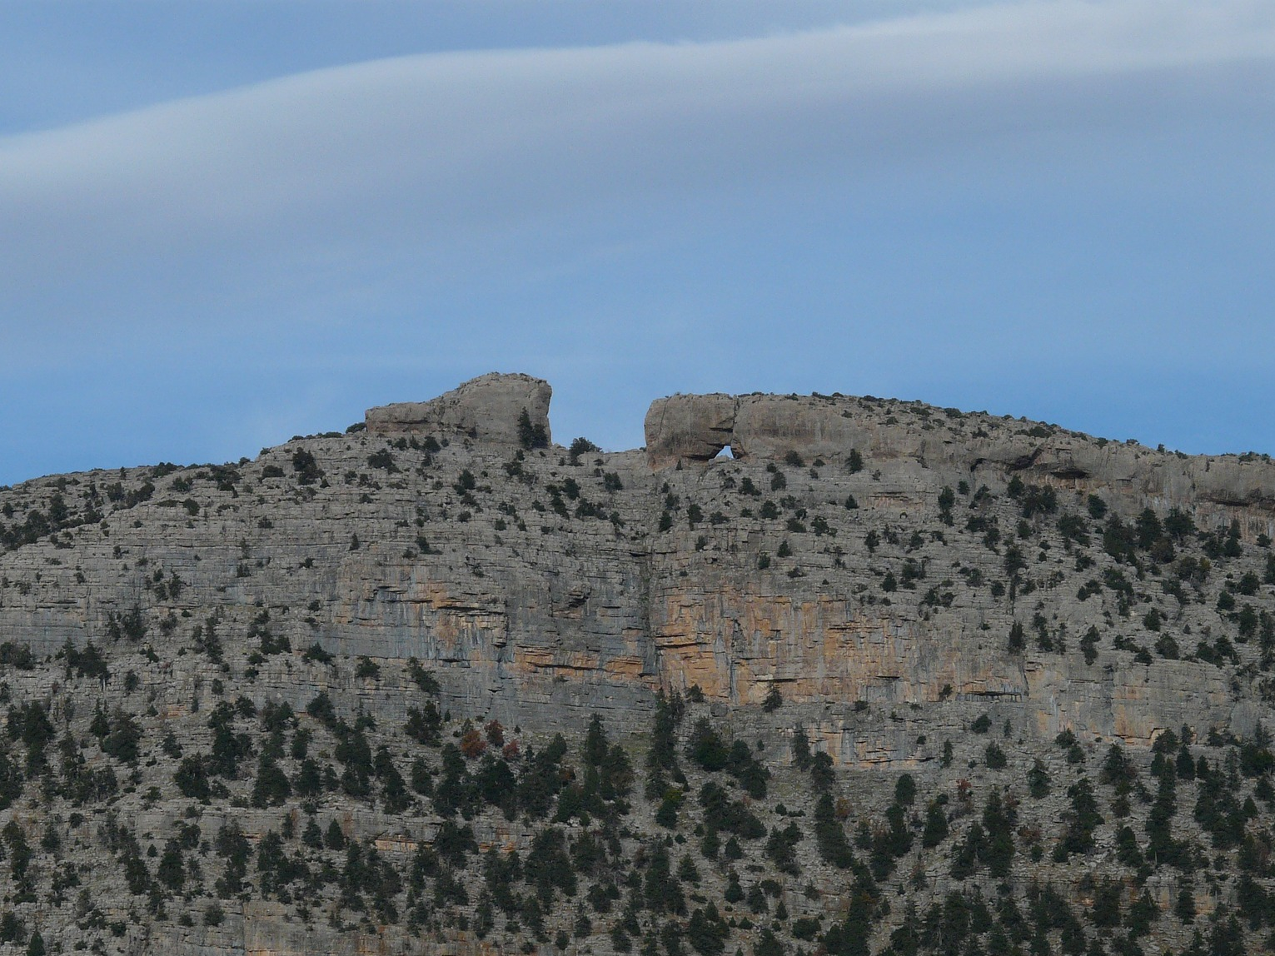
Jonathan’s faith in action

Slide 5
ESV

Slide 6
Faith sees the unseen
Heb. 11:27 By faith he left Egypt, not being afraid of the anger of the king, for he endured as seeing him who is invisible.
ESV

Slide 7
Faith sees the unseen
2 Cor. 4:17-18 For this light momentary affliction is preparing for us an eternal weight of glory beyond all comparison, ¹⁸ as we look not to the things that are seen but to the things that are unseen. For the things that are seen are transient, but the things that are unseen are eternal.
ESV

Slide 8
Faith sees the unseen
Faith trusts when the outcome is unknown
1 Sam. 14:6 Jonathan said to the young man who carried his armor, “Come, let us go over to the garrison of these uncircumcised. It may be that the Lord will work for us, for nothing can hinder the Lord from saving by many or by few.”
ESV

Slide 9
Faith sees the unseen
Faith trusts when the outcome is unknown
Dan. 3:16-18 Shadrach, Meshach, and Abednego answered and said to the king, “O Nebuchadnezzar, we have no need to answer you in this matter. ¹⁷ If this be so, our God whom we serve is able to deliver us from the burning fiery furnace, and he will deliver us out of your hand, O king. ¹⁸ But if not, be it known to you, O king, that we will not serve your gods or worship the golden image that you have set up.”
ESV

Slide 10
Faith sees the unseen
Faith trusts when the outcome is unknown
Faith glorifies God and encourages others
14:7 And his armor-bearer said to him, “Do all that is in your heart. Do as you wish. Behold, I am with you heart and soul.”
ESV

