Slide 1
Being
Holy
in
an
unholy
Land
Daniel: When Conscience and Culture Collide

Slide 2
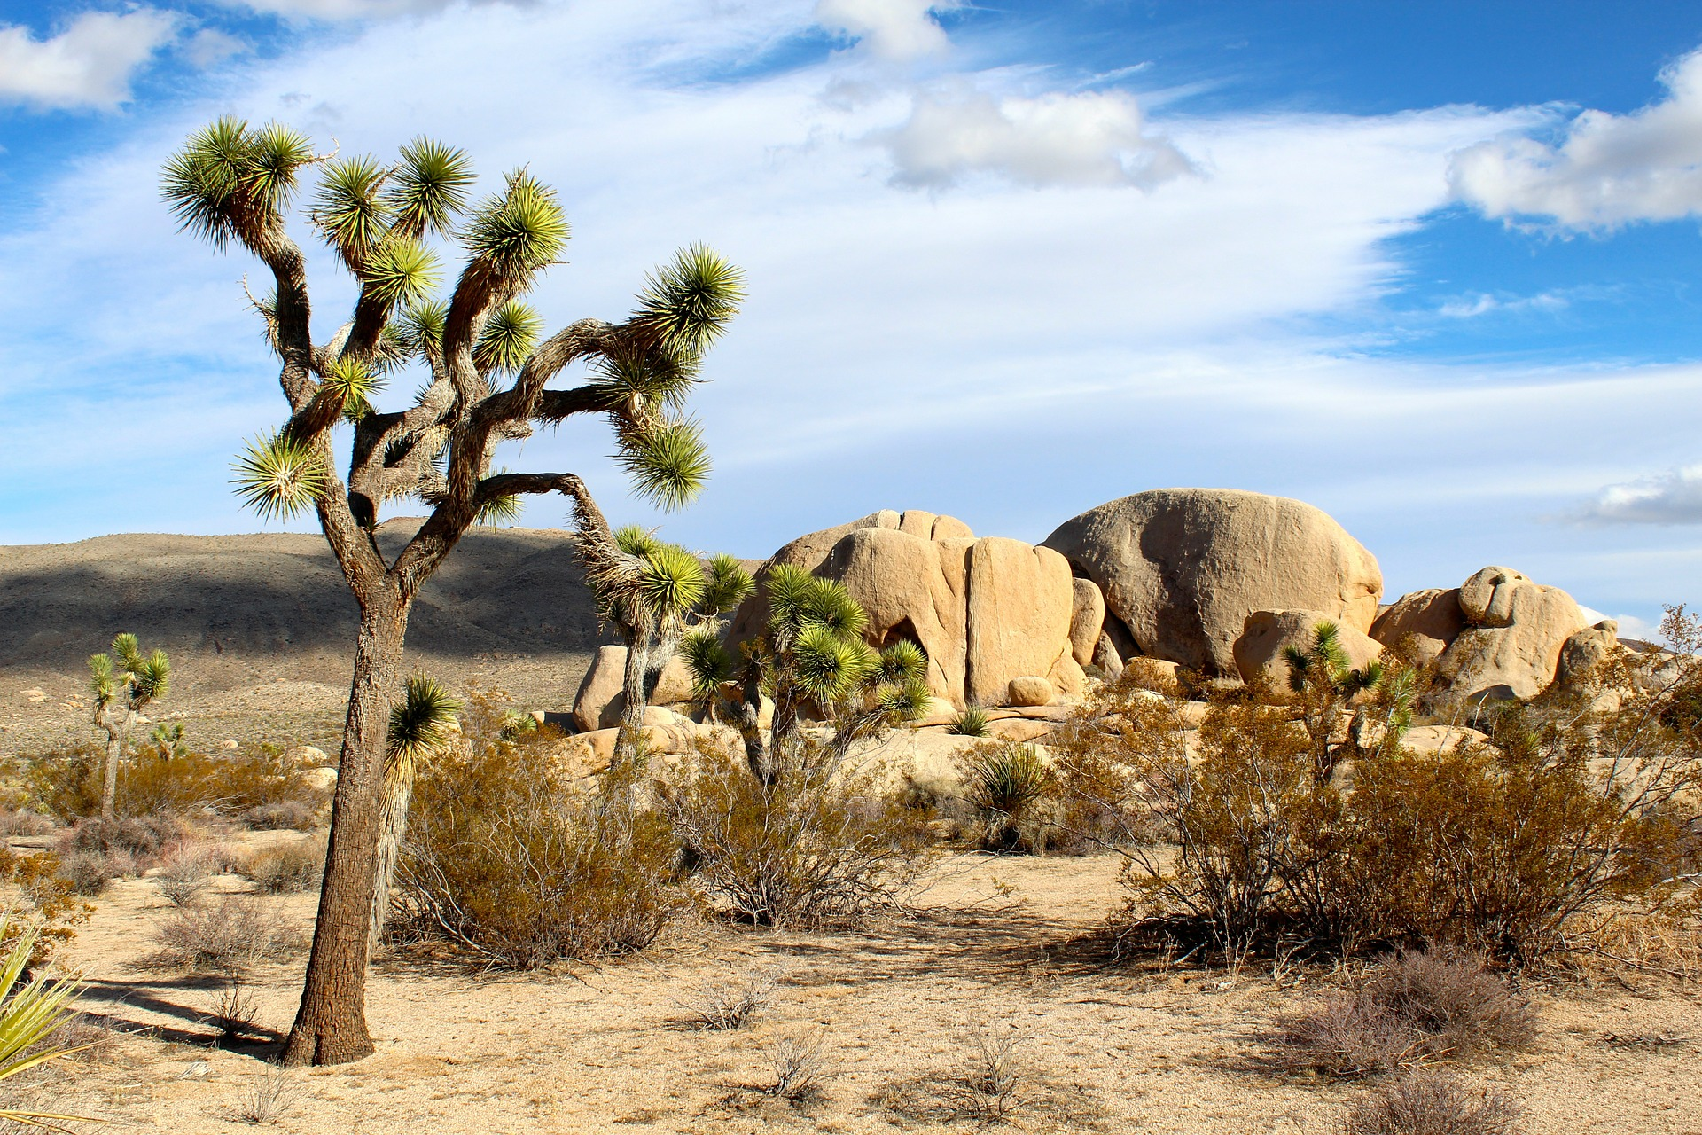
Being
Holy
in
an
unholy
Land
Daniel: When Conscience and Culture Collide

Slide 3
Culture vs. Conscience
Taken captive 1:3-4
From the king’s table 1:5
Daniel resolved 1:8, 1 Kings 18:21
Daniel asked 1:8
Daniel negotiated 1:9-14
Blessed by God 1:15-17
1 Kings 18:21 And Elijah came near to all the people and said, “How long will you go limping between two different opinions? If the Lord is God, follow him; but if Baal, then follow him.” And the people did not answer him a word.
ESV

Slide 4
Culture vs. Conscience
Resolve not to be defiled
Guard your heart
Be meek and humble
2 Cor. 6:17-18 Therefore go out from their midst, and be separate from them, says the Lord, and touch no unclean thing; then I will welcome you, ¹⁸ and I will be a father to you, and you shall be sons and daughters to me, says the Lord Almighty.”
ESV

Slide 5
Taking a stand
Daniel’s success 6:1-3
A trap set 6:4-5
Undeterred 6:10
Praying toward Jerusalem 2 Chron. 6:36-39
Praying in private Matt. 6:5-6
Facing the consequences 6:11-18
Safe with the lions 6:19-22
God glorified 6:25-27
2 Chron. 6:36-39 “If they sin against you—for there is no one who does not sin—and you are angry with them and give them to an enemy, so that they are carried away captive to a land far or near … ³⁸ if they repent with all their mind and with all their heart in the land of their captivity to which they were carried captive, and pray toward their land, which you gave to their fathers, the city that you have chosen and the house that I have built for your name, ³⁹ then hear from heaven your dwelling place their prayer and their pleas, and maintain their cause and forgive your people who have sinned against you.
ESV

Slide 6
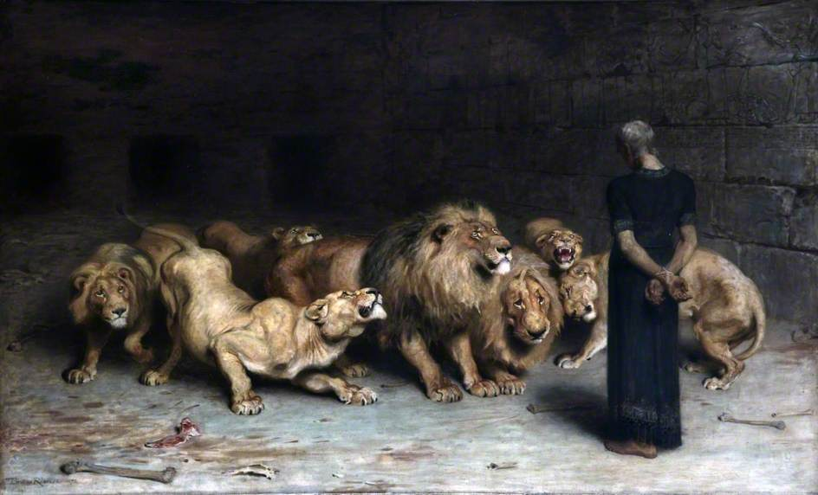

Slide 7
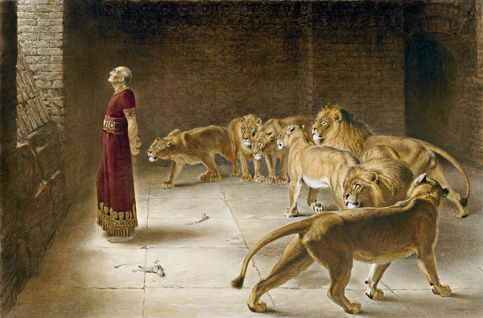

Slide 8
Taking a stand
Daniel’s success 6:1-3
A trap set 6:4-5
Undeterred 6:10
Praying toward Jerusalem 2 Chron. 6:36-39
Praying in private Matt. 6:5-6
Facing the consequences 6:11-18
Safe with the lions 6:19-22
God glorified 6:25-27
ESV

