Slide 1
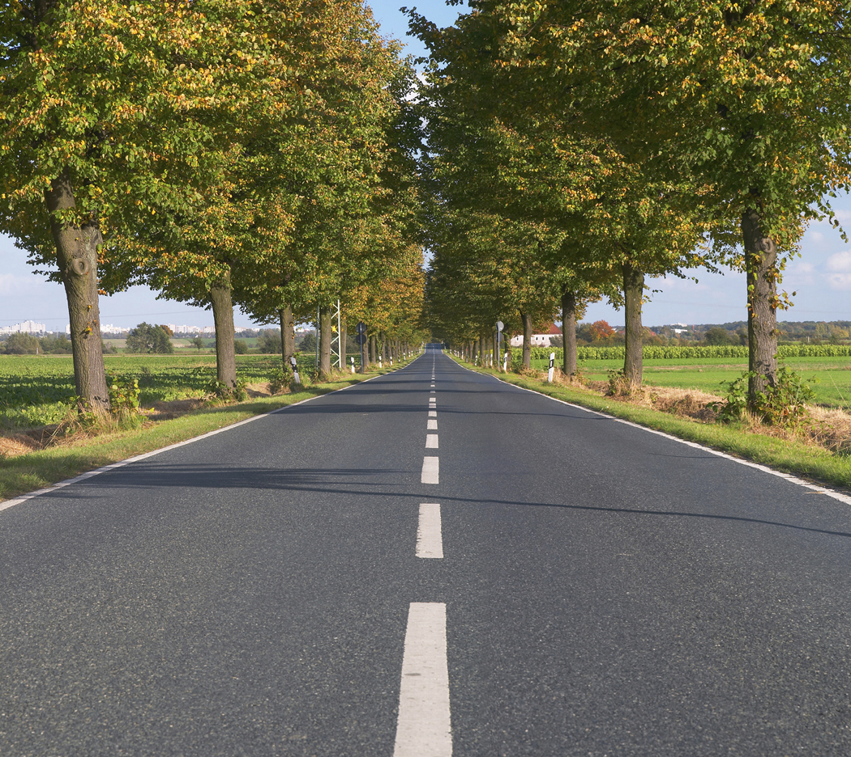

Slide 2
The Kings of Judah
2013 Eastside in Athens

Slide 3
1 Kings
2 Kings
2 Samuel
1 Samuel
931 BC
722 BC
Northern Kingdom:
ISRAEL
20 Kings in the North and South
586 BC
Saul
David
Solomon
40 yr
40 yr
40 yr
Southern Kingdom:
JUDAH
1 Chronicles
2 Chronicles

Slide 4
Rehoboam | 17 yr
Abijah | 3 yr
Asa | 41 yr
Jehoshaphat | 25 yr
Jehoram | 8 yr
Ahaziah | 1 yr
Athaliah | 7 yr
Joash | 40 yr
Amaziah | 29 yr
Uzziah | 52 yr
Jotham | 16 yr
Ahaz | 16 yr
Hezekiah | 29 yr
Manasseh | 55 yr
Amon | 2 yr
Josiah | 31 yr
Jehoahaz | 3 mo
Jehoiakim | 11 yr
Jehoiachin | 3 mo
Zedekiah | 11 yr

Slide 5
Rehoboam | 17 yr
Abijah | 3 yr
Asa | 41 yr
Jehoshaphat | 25 yr
Jehoram | 8 yr
Ahaziah | 1 yr
Athaliah | 7 yr
Joash | 40 yr
Amaziah | 29 yr
Uzziah | 52 yr
Jotham | 16 yr
Ahaz | 16 yr
Hezekiah | 29 yr
Manasseh | 55 yr
Amon | 2 yr
Josiah | 31 yr
Jehoahaz | 3 mo
Jehoiakim | 11 yr
Jehoiachin | 3 mo
Zedekiah | 11 yr

Slide 6
Rehoboam | 17 yr
Abijah | 3 yr
Asa | 41 yr
Jehoshaphat | 25 yr
Jehoram | 8 yr
Ahaziah | 1 yr
Athaliah | 7 yr
Joash | 40 yr
Amaziah | 29 yr
Uzziah | 52 yr
Jotham | 16 yr
Ahaz | 16 yr
Hezekiah | 29 yr
Manasseh | 55 yr
Amon | 2 yr
Josiah | 31 yr
Jehoahaz | 3 mo
Jehoiakim | 11 yr
Jehoiachin | 3 mo
Zedekiah | 11 yr

Slide 7
#1 | David: Priorities
#2 | Jehoshaphat: Associations
#3 | Jehosheba: Significance
#4 | Uzziah: Pride
#5 | Hezekiah: Devotion
#6 | Manasseh: Grace
#7 | Josiah: Word

Slide 8
Hezekiah
Devotion: Restoring True Worship

Slide 9
Joash
40 yr
Amaziah
29 yr
Uzziah
52 yr
Jotham
16 yr
Ahaz
16 yr

Slide 10
The urgency of restoration!
In the first year of his reign, in the first month… 29:3
“Hear me, Levites! Now consecrate yourselves…” 29:4
“My sons, do not now be negligent…” 29:11
Then Hezekiah the king rose early… 29:20
And Hezekiah and all the people rejoiced because God had prepared the people, for the thing came about suddenly. 29:36

Slide 11
Halfway is not restoration!
The priests went into the inner part of the house of the Lord to cleanse it, and they brought out all the uncleanness that they found in the temple… 29:16
“We have cleansed all the house of the Lord, the altar of burnt offering and all its utensils, and the table for the showbread and all its utensils. All the utensils that King Ahaz discarded in his reign when he was faithless, we have made ready and consecrated, and behold, they are before the altar of the LORD.” 29:18-19

Slide 12
A matter of the heart!
“Now it is in my heart to make a covenant with the LORD…” 29:10
all who were of a willing heart brought burnt offerings. 29:31
The hand of God was also on Judah to give them one heart to do what the king and the princes commanded by the word of the Lord. 30:12
“May the good Lord pardon everyone who sets his heart to seek God…” 30:19

Slide 13
A matter of the heart!
Thus Hezekiah did throughout all Judah, and he did what was good and right and faithful before the LORD his God. And every work that he undertook in the service of the house of God and in accordance with the law and the commandments, seeking his God, he did with all his heart, and prospered. 30:21

Slide 14
Formula for restoration:
Return.
Yield.
Come.
Serve.

Slide 15
A joyful thing!
And the people of Israel… kept the feast… with great gladness… 30:21
the Levites and the priests praised the Lord day by day, singing with all their might to the Lord. 30:21
So they kept it for another seven days with gladness. 30:23
the sojourners who lived in Judah, rejoiced. 30:25
So there was great joy in Jerusalem. 30:26

Slide 16
Restoration invites trouble!
Attack (32:1)
Ridicule (32:12)
Intimidation (32:13-14)
Challenge (32:15)
Contempt (32:16-19)

Slide 17
Restoration creates faith!
Strength and courage (32:7-8)
Victory through prayer (32:20-23)

