Slide 1
Revelation 2:12-17
(Pergamos – “Faithful in the Midst of Evil”)
Revelation
Satan had dominion in Pergamos.
  Christians were persecuted and pressured to deny their faith.
  The Lord commends them for holding fast.
The problem in Pergamos was doctrinal.
  The doctrine of the Nicolaitans (Balaam) allowed for eating things sacrificed to idols and committing sexual immorality (Numbers 25:1-2; 31:16)
  This doctrine was hated in Ephesus (2:6), held by some at Pergamos (2:14-15) and practiced by the some in the church in Thyatira (2:20).

Slide 2
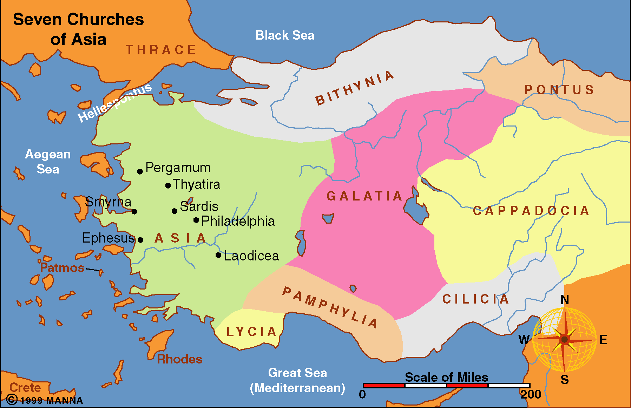

Slide 3
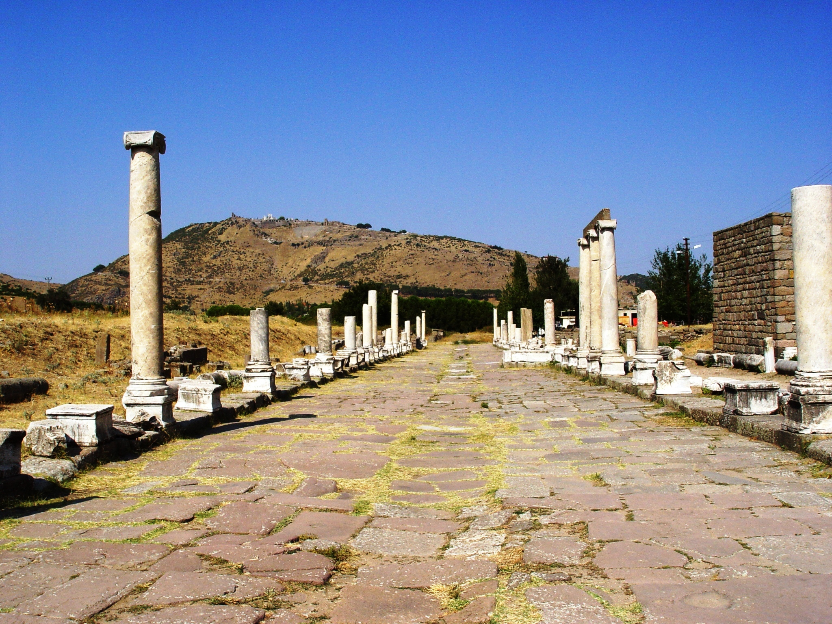
The site of Pergamum was first settled prior to 2000 B.C. From 547-334 B.C. it was under Persian rule until Alexander the Great conquered Asia minor (334 B.C.).
Notes:
Historical Background
The site of Pergamum was first settled in the third millennium B.C. From 547-334 B.C. it was under Persian rule, until Alexander the Great conquered Asia minor (ca. 334 B.C.) and Pergamum gained importance. Upon his death his general Lysimachus turned the small town of Pergamum into a military base. He also built Ephesus during this period, a city which would be Pergamum’s main rival for power for centuries to come. When Lysimachus was killed in battle, his successor, Philetarus, inherited the city. Philetarus left the city to his adopted son, Eumenes I, founder of the Pergamene dynasty:
Under the reign of Eumenes I (263-241 B.C.), Pergamum became a leading cultural center, especially in art and science. The acropolis underwent massive restoration and the Aesculapium, a cultic healing center, was founded. When Eumenes I died, he bequeathed the city to his nephew, Attlos I.
Ruling from 241-197 B.C., Attlos’ first task was to defeat the Galatian Gauls who were demanding taxes from the city. His victory brought the establishment of the kingdom of Pergamum, which stretched from the Sea of Marmara to the Troas mountains. To celebrate his victory, he built the temple of Athena, the famous library, and the Altar of Zeus. Attlos I is also noted for his alliance with Greece and Rome.
Eumenes II succeeded Attlos I (197-159 B.C.) and extended the borders of the kingdom to Bythinia and Cappodoccia. These years were considered the first golden age of Pergamum; the city became the center for the arts and sciences, the library was enlarged, and construction on the Altar of Zeus was completed.
During the reign of Attlos II, from 159-138 B.C., Prusias, king of Bithynia, attacked the city and sacked the lower city. Because Pergamum had the support of Rome, the two rulers formed a treaty.
Attlos II was succeeded by Attlos III (138-133 B.C.), a hypochondriac more interested in chemistry than politics. He tested poisons on prisoners and the elderly in order to find antidotes. When his mother and wife died, he believed them to have been poisoned and went mad in his search for the antidote. He died in 133 B.C. and willed Pergamum to Rome.
Pergamum came under Rome’s jurisdiction between 133-40 B.C. The first state in Asia Minor was established (Provincia Asia), and Pergamum was ruled by many proconsuls. While Julius Caesar was in power of Rome, Pergamum enjoyed a second golden age. Upon his death the city was given to Marc Antony (40 B.C.-14 A.D.), who gave all 200,000 books from the library to Cleopatra. Augustus Caesar defeated Antony and gained power of the city, during which time the first temple of the Imperial cult was constructed.
During the reign of Tiberius (14-37 A.D.), the city suffered a great earthquake. Because the emperor rebuilt and repaired the city, a temple was erected here in his honor. Pergamum was to become the center for imperial veneration in Asia. Temples were built to emperors Trajan (98-117 A.D.) and Hadrian (117-138 A.D.) and to Faustina, Marcus Aurelius’ wife (157-180 A.D.). Marcus Aurelius gave a medal to Claudius Galenus, a famous doctor from the Aesculapium and personal physician of Aurelius and his son Commodus’ (of Gladiator fame). Emperor Caracalla recovered the Aesculapium and called the city “Proto Metropolis,” meaning “number one.” Under the rule of Decius (249–251 A.D.), intense persecution of Christians broke out in Pergamum. The city suffered much destruction in the years of 253-260 A.D.
The Edict of Milan (313 A.D.) declared Christianity legal and by 379 A.D. it had become the state religion; pagan temples were converted into churches. Power in the city transferred to East Roman rule in 395 A.D., to the Byzantine empire (395-1306 A.D.), to the Ottoman Turks (1306-1917), to Greece (1919), and finally to the Turks (July 14, 1922).

Slide 4
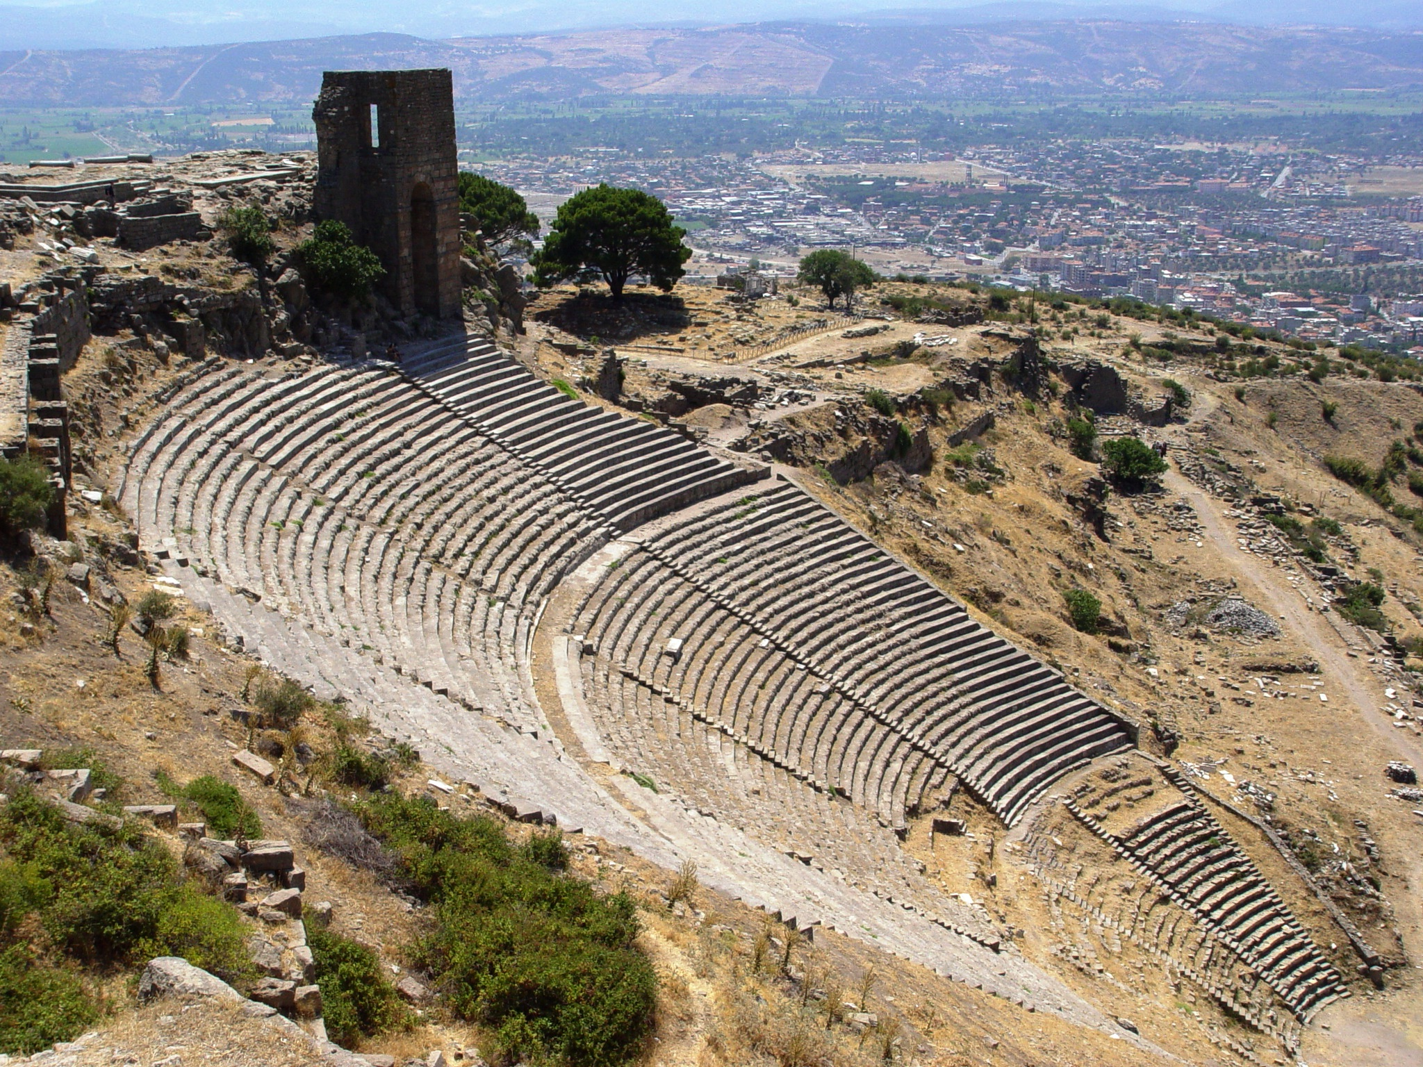
Built on a very steep slope, the Theater at Pergamos seated about 10,000 people

Slide 5
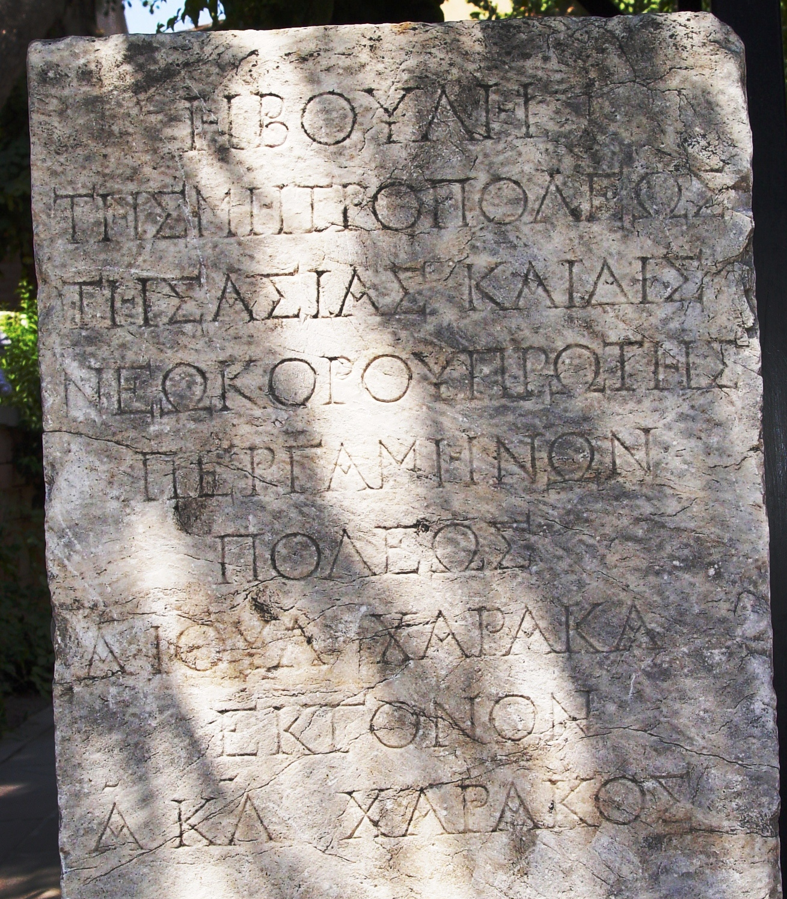
Neokoros Inscription
at Pergamum

Slide 6
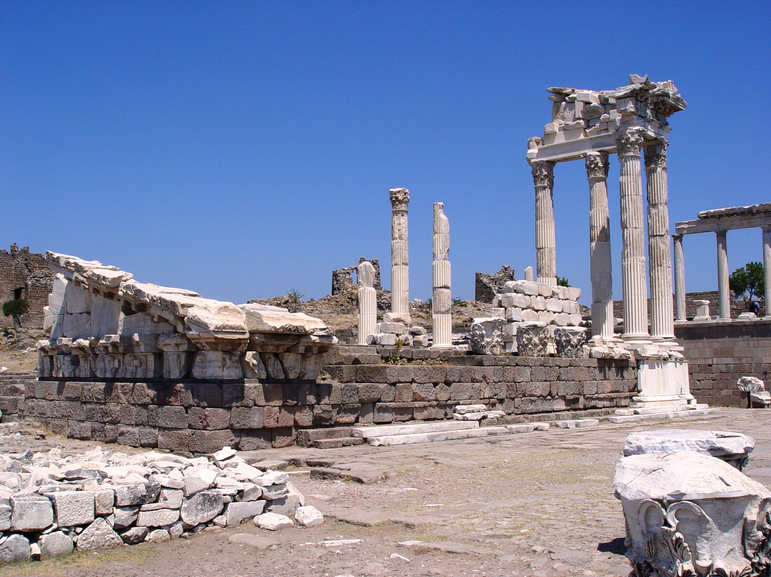
The Trajan temple was the jewel of Pergamum. Built in Roman times, it sat on a terrace in the mountainside. The temple was dedicated to Emperor Trajan and his heir Hadrian, whose statues once stood here.
Notes:
The Trajan temple was the jewel of Pergamum. Built in Roman times, it sat on a terrace in the mountainside. The temple was dedicated to Emperor Trajan and his heir Hadrian, whose statues once stood here. It was made of white marble and was supported by colonnades in Corinthian style. A team of German archaeologists are presently working to restore the Trajan temple.

Slide 7
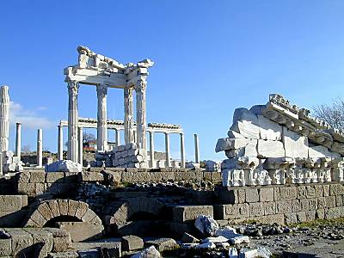

Slide 8
Lessons to be Learned from Pergamos
Revelation
We can be faithful Christians even where Satan’s throne is.
  They held fast His name (Colossians 3:17)
  Had not denied His faith even in the days of the martyr Antipas (Matthew 10:32-33)
Some may be unfaithful even in a faithful church if worldly influences are allowed to creep in (1 Peter 4:1-4)
Repent or be condemned by the Word (John 12:48)
He who overcomes will receive…
  Hidden manna (John 6:35)
  A white stone – judged innocent (Acts 13:38f.)
  A new name – a new relationship (Rev. 21:7; 22:4)

Slide 9
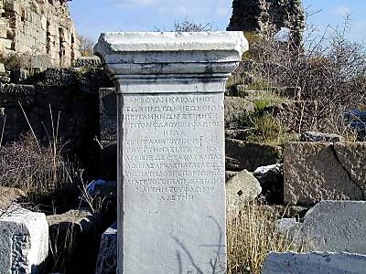
Names inscribed on a white stone at Pergamos

Slide 10
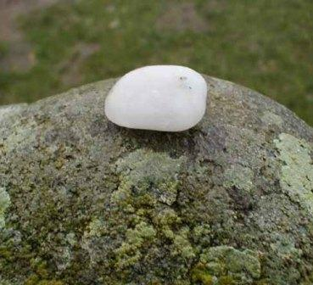
The Greek word for “stone” in Revelation is ψῆφος (psēphos) which Thayer defines as:
a small worn smooth stone, a pebble
  1a) in the ancient courts of justice the accused were condemned by black pebbles and the acquitted by white
2) a vote (on account of the use of pebbles in voting)

Slide 11
Revelation 2:18-29
(Thyatira – “Compromised with Evil”)
Revelation
Thyatira is commended because her last works were more than the first (2:19)
Thyatira is condemned because it allowed Jezebel “to teach and seduce my servants” to practice the doctrine of the Nicolaitans.
  The name Jezebel calls to mind the wife of Ahab (1 Kings 16:31-33; 18:4, 19; 19:1-2)
  Note again the progression of this problem: It was hated in Ephesus (2:6), held by some at Pergamos (2:14-15) and practiced by the some in the church in Thyatira (2:20).

Slide 13
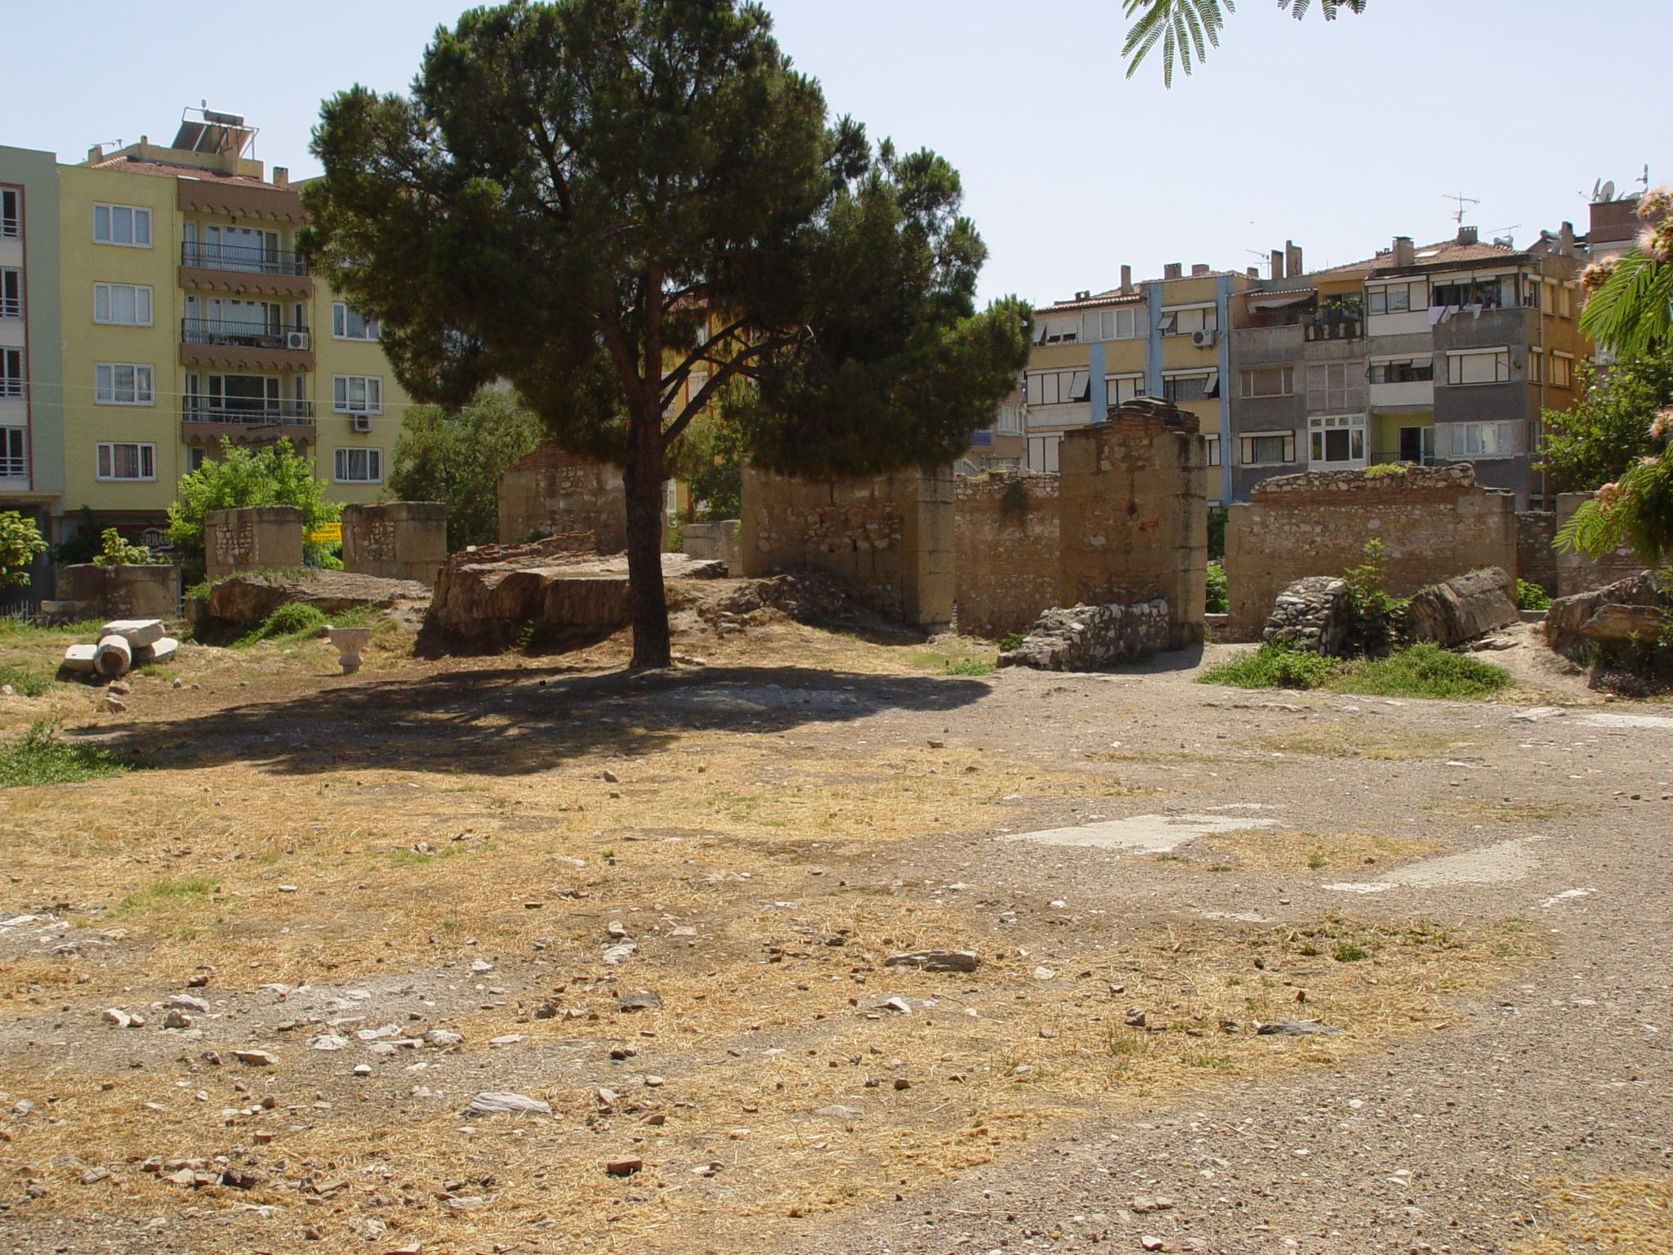
Ancient Thyatira in Modern Akhisar

Slide 14
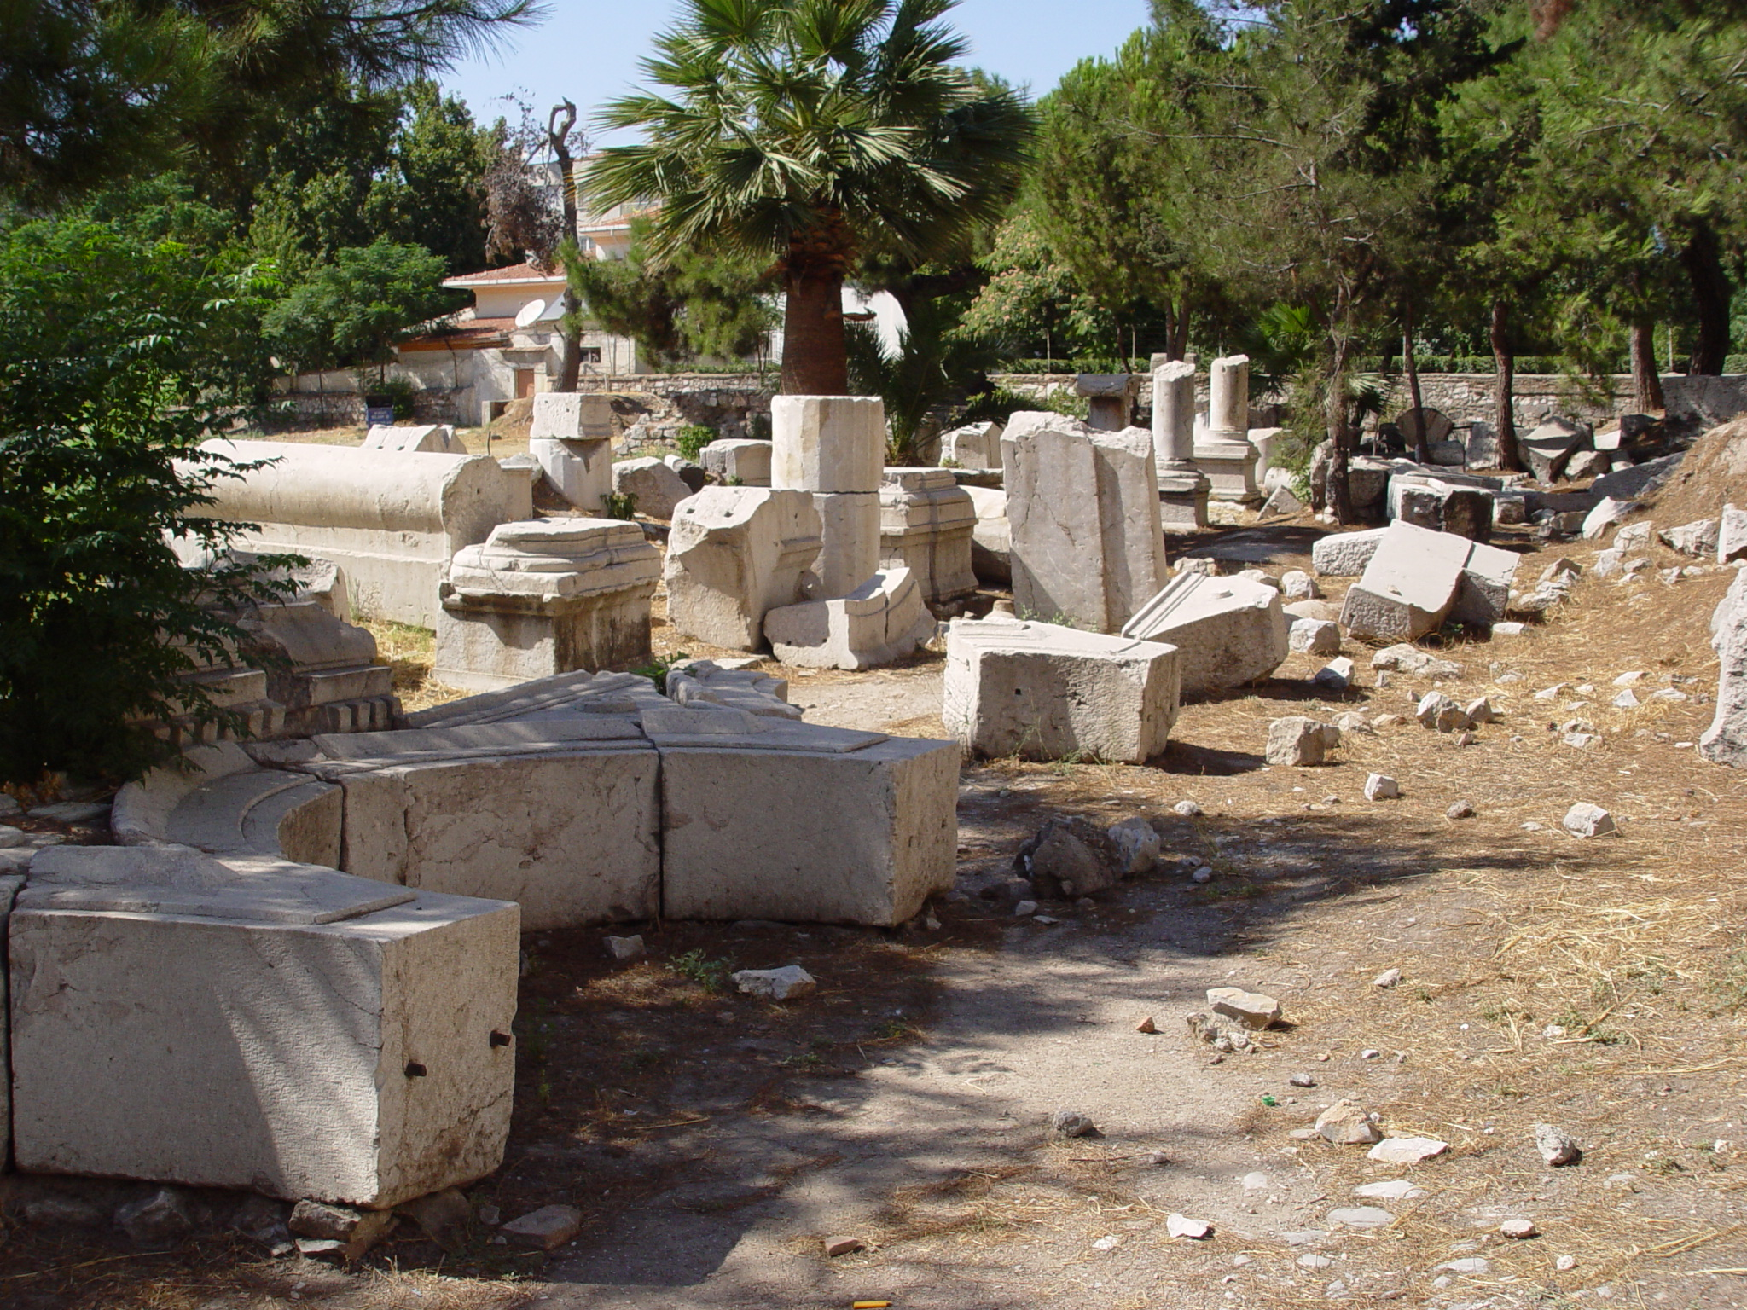
Notes:
Roman Street with marble fragments. Note street level on right.

Slide 15
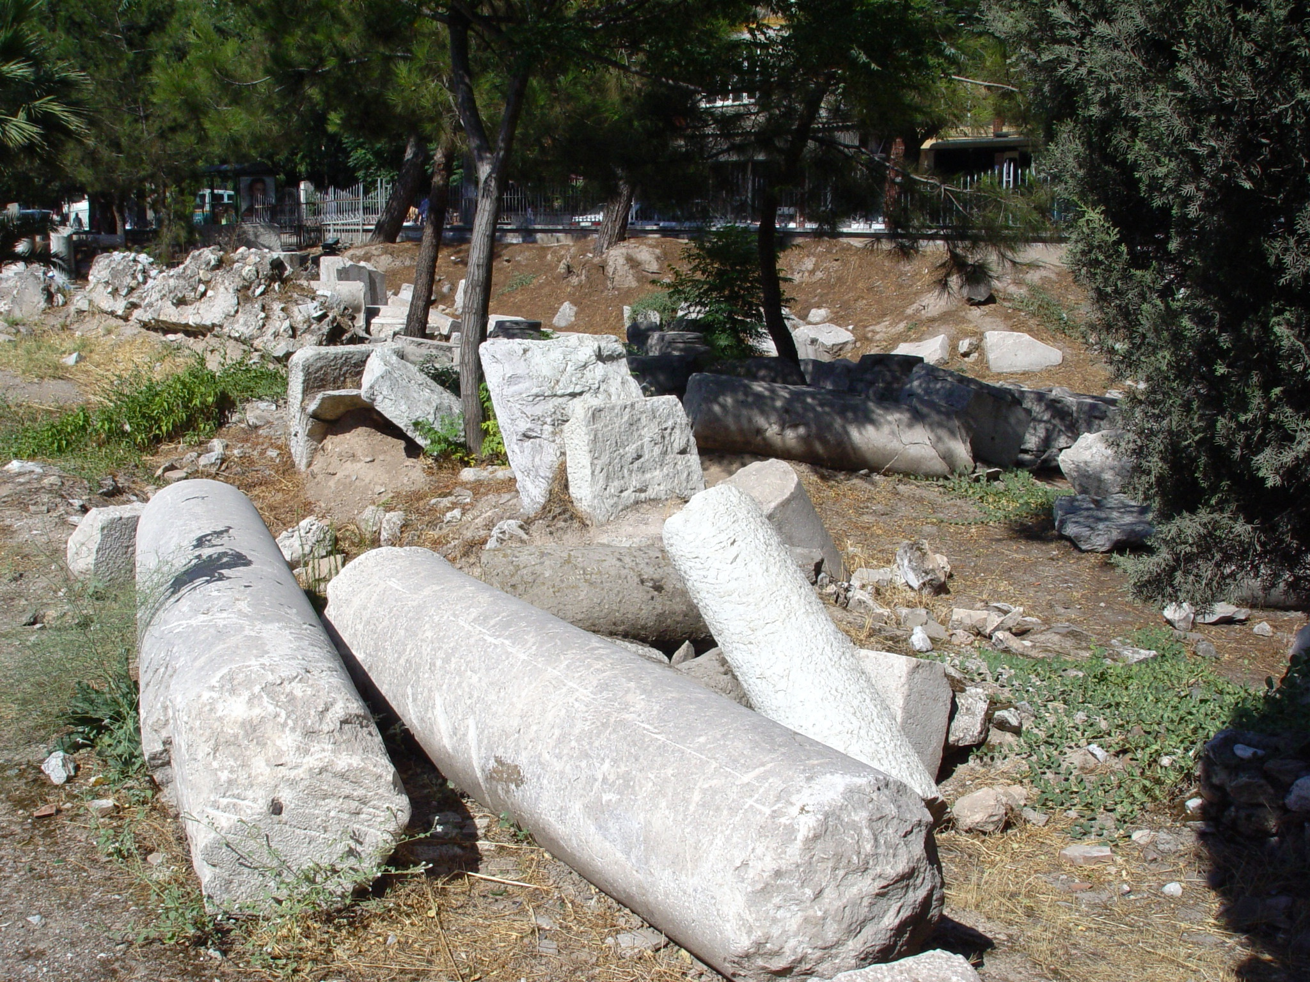

Slide 16
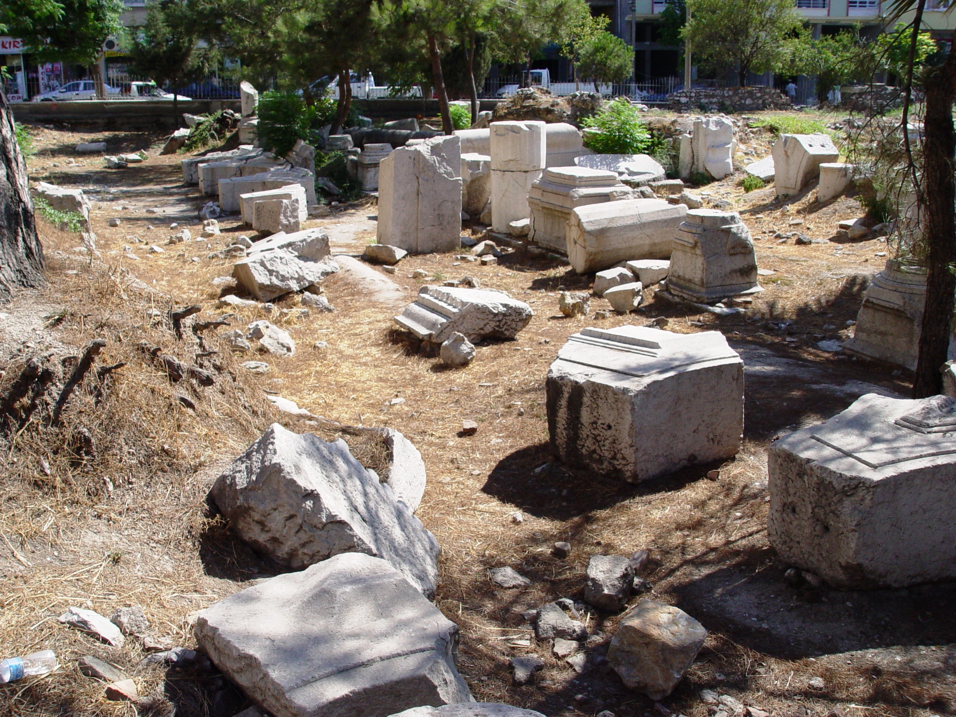

Slide 17
Lessons to be Learned from Thyatira
Revelation
Thyatira had characteristics of strength that are worthy of imitation
  Love, Service, Faith, Patience and Progress.
  Its last works are more than the first (1 Cor. 15:58)
A church that fails to reprove evil is wrong.
  It “allowed” Jezebel to teach and seduce!
  A faithful church must exercise discipline (2 Thessalonians 3:6; 1 Corinthians 5)
Jesus gives time for repentance
  But if correction is not made, He knows our minds and hearts, and consequences are coming (sickbed, tribulation, death)
Individual Christians can remain pure
  even when disciples around them are defiled.

Slide 18
Lessons to be Learned from Thyatira
Revelation
He who overcomes will receive…
  The Morning Star (2 Peter 1:18-19; Revelation 22:16)
  Power over the nations (Psalm 2:8-9; Revelation 12:5; 19:15)

Slide 19
Revelation 3:1-6
(Sardis – “The Living-Dead Church”)
Revelation
Sardis was a great city of commerce.
  Five major roads intersected.
  It is the birthplace of modern money (the first coins were minted there)
The church had a name for being alive, but it was dead.

Slide 21
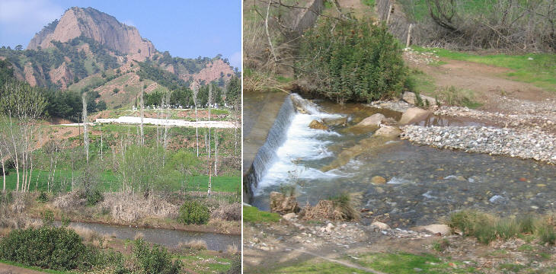
The Pactolus River
A River of Gold!
Sardis was located on the banks of the Pactolus River. The Pactolus was rich in gold bearing sands, enabling the kings of Lydia to mint gold coins of guaranteed weight and purity.

Slide 22
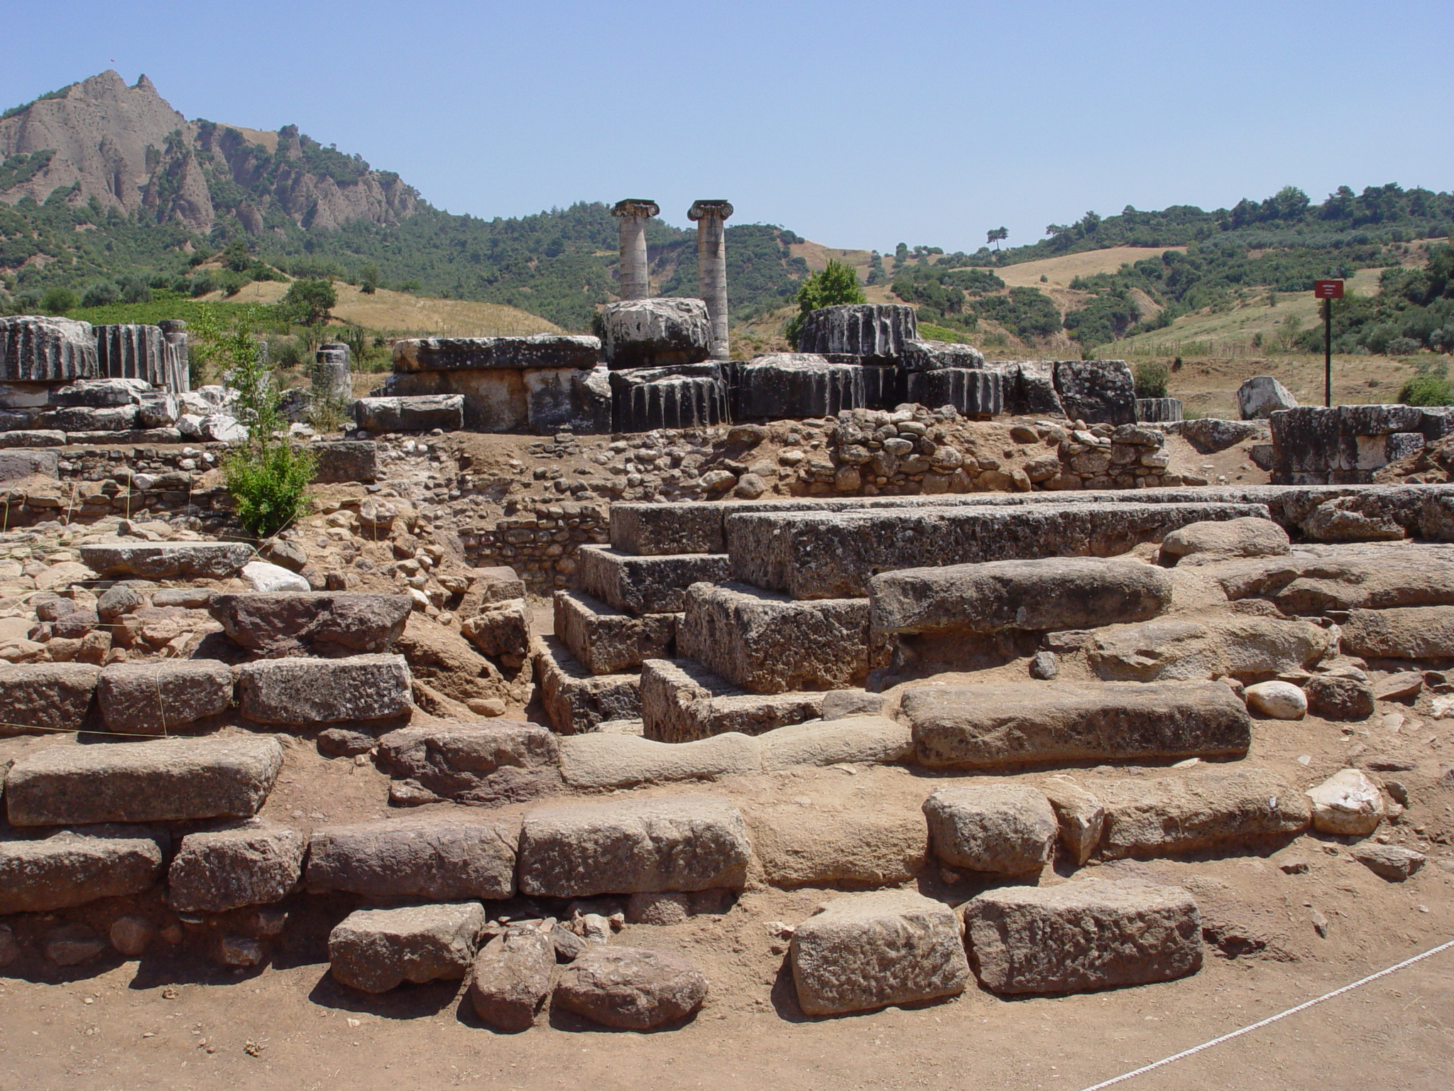
Temple of Artemis in Sardis

Slide 23
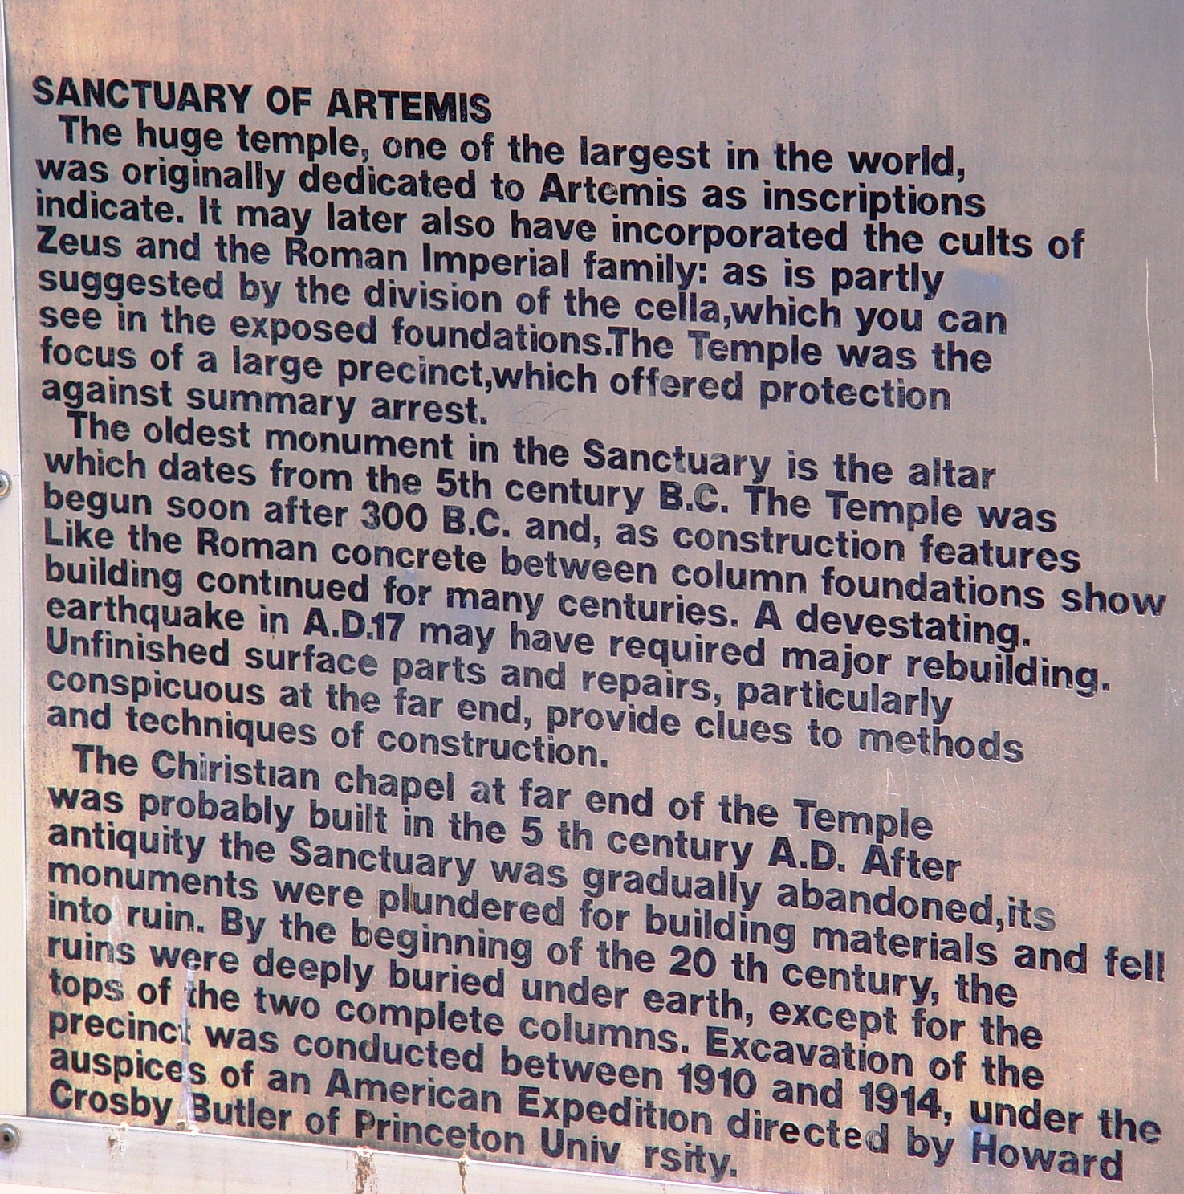

Slide 24
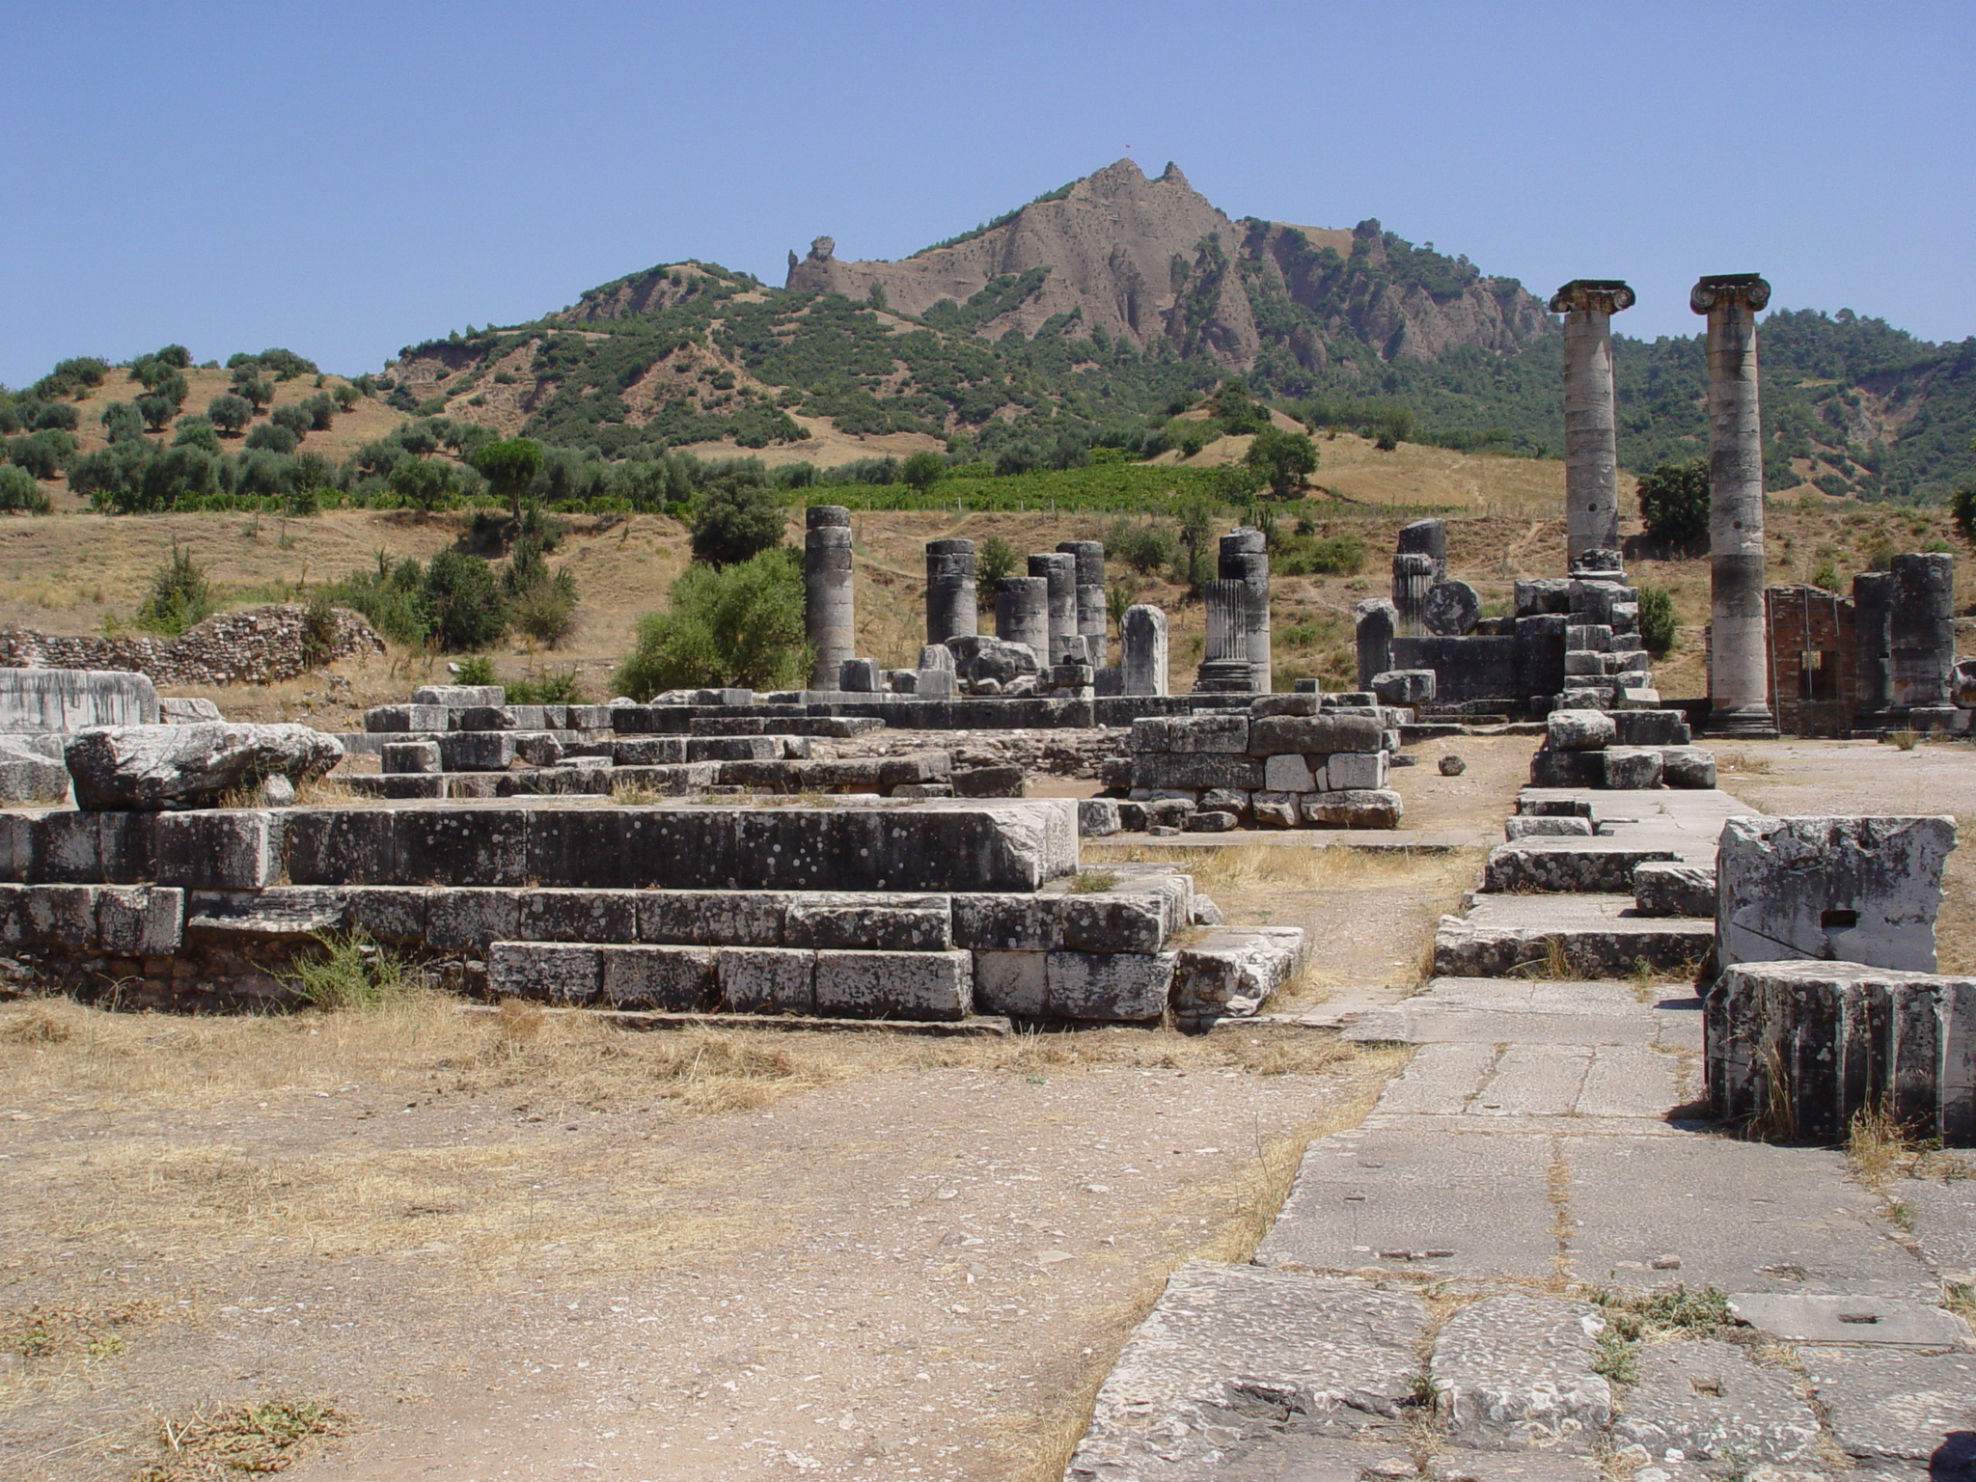
The Temple of Artemis was the fourth largest Ionic temple in the ancient world
Notes:
This temple to Artemis was built by Croesus in the 6th century B.C. but was then destroyed in the Ionian Revolt of 499 B.C. It was a magnificent structure, the fourth-largest Ionic-style temple existing in the ancient world. Alexander the Great began to rebuild this temple in 334 B.C. but never finished. Its remains were covered over by landslides from an earthquake in 17 A.D.

Slide 25
Lessons to be Learned from Sardis
Revelation
A church’s reputation may not be its true character (cf. Luke 18:9-14).
Two kinds of peace can exist.
  One resulting from effort and achievement.
  The other from lethargy, laziness and self-satisfaction (RIP).
Ultimate judgment will be of individuals, not congregations, but individuals must answer for the part they played or failed to play in the work and purity of the congregation.
Admonition and counsel for a dead church.
  Be watchful!
  Strengthen what remains!
  Remember how you received and heard.
  Hold fast and repent!

