Slide 2
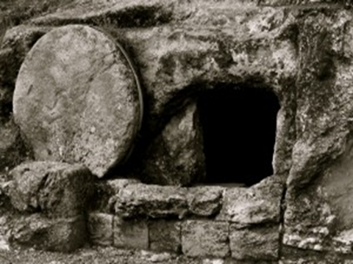

Slide 3
Was Jesus Raised From The Dead?
Is it within the realm of possibility?
  With God all things are possible.
Are there corroborating witnesses?
  Four Gospel writers; Peter and Paul; 500 brethren
Are the witnesses credible?
  No successful assaults on their character
Are there any changes that can best be explained by this event?
  Something must have happened that gave rise to the gospel, the church, and its rapid spread.
Are there reasonable alternative explanations?
  All other possibilities are weak

