Slide 1

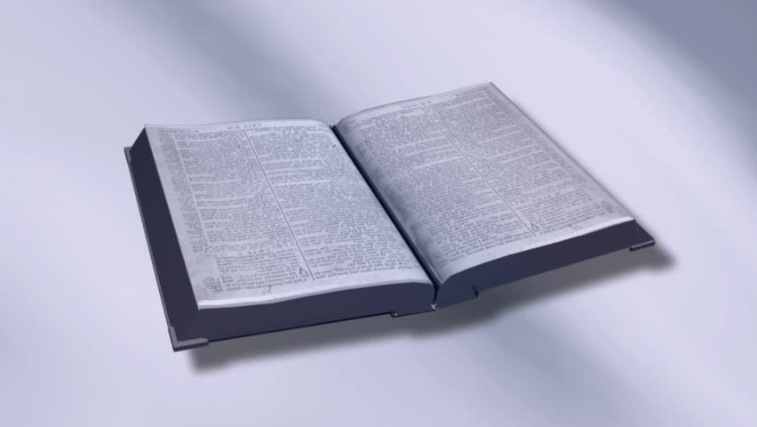
Building an Indestructible Life
Qualities That Bring Blessings
(Matthew 5:1-9)

Slide 2
Qualities That Bring Blessings
The Indestructible Life Matt 7:24-27
  To be on the solid rock…not the shifting sand
  Able to withstand life’s storms…avoid collapse
  To be prepared for life now…especially eternity
The Sermon “In A Quick Nutshell” Matt 5-7
  The Son of God taught upon a mountain/hill
  Audience was ordinary…not the “elite”
  His hearers knew what He said rang truer than anything they had ever heard before 7:28-29
  May we be as receptive today!!

Slide 3
Qualities That Bring Blessings
The Beatitudes Matt 5:1-12
  Describe the citizens IN heaven’s kingdom
  Not traits that are hereditary or the product of one’s environment
  They are characteristics that are entirely CHOSEN
  They do not describe 8 different citizens (the “meek” one vs. the “merciful” one)
  They are a composite of each kingdom citizen
  To possess one is to possess them all!!

Slide 4
Qualities That Bring Blessings
“Happy are the poor in spirit…” v. 3
  Not literal poverty, but “…in spirit”
  “Poor” means to crouch, cringe (pitiful position befitting abject beggars)
  A chosen characteristic signifying spiritual bankruptcy caused by sin Matt 18:23-27
  To be totally aware of one’s need for God…it makes one a beggar Lk 15:18-19
Why would spiritual poverty make one “happy?”
Because through Jesus’ poverty, the spiritually poor become rich 2 Cor 8:9

Slide 5
Qualities That Bring Blessings
“Happy are those who mourn…” v. 4
  Not the indiscriminate sorrow that comes to all men (death, funerals)
  A chosen sorrow because of how my sins have affected God Gen 6:5-6
  Mourning leads to change 2 Cor 7:8-9
  The spiritual mourner knows God is gracious, forgiving contrite penitent sinners in His mercy
Why would spiritual mourning make one “happy?”
Because it brings about repentance, which eventually leads to salvation 2 Cor 7:10

Slide 6
Qualities That Bring Blessings
“Happy are the gentle (meek)…” v. 5
  Meekness is not a natural inborn temperament
  Often incorrectly confused with weakness
  A better definition… “strength under control”
  A chosen resolve to refrain from using power one may possess to defend himself, right a wrong done to him Matt 26:53 Num 12:3
  Not passive indifference toward evil (apathy)
Why would spiritual meekness make one “happy?”
Because God eventually will exalt the one who humbles himself (shows meekness) 1 Pet 5:5-6

Slide 7
Qualities That Bring Blessings
“Happy are those who hunger & thirst…” v. 5
  “Hunger” & “thirst” describe deep human need
  It means to long for; crave; eagerly desire
  Physically hungry men will eat anything, even foods they hate (not normally choose), and even beg for seconds Lk 15:16-17
  A spiritual hunger & thirst that is chosen…a longing to be filled with what only God can supply

Slide 8
Qualities That Bring Blessings
“Happy are those who hunger & thirst…” v. 5
  Sadly, too many fill themselves with things that are not as eternal as they are Eccl 5:10 6:7
  This is doomed to failure because we are eternal beings…we need something eternal Eccl 3:9-11a
  We must choose the right food & drink Jn 6:26-27, 53-56, 60, 66-68
Why would spiritual hunger & thirst make one “happy?”
Because when consuming what Jesus offers, one will never hunger & thirst again Jn 4:14 6:14-15

Slide 9
Qualities That Bring Blessings
“Happy are the merciful…” v. 7
  Compassion, pity; refraining from dispensing punishment to those who deserve it
  Even forgiving those who have done wrong
  A chosen mindset because he wants the same
  He must extend mercy to receive mercy from God Mt 18:21-35 Titus 3:3-5
Why would showing spiritual mercy make one “happy?”
Because God will show us mercy, forgiveness Matt 6:14-15 (** side benefit – life will not be consumed by bitterness **)

Slide 10
Qualities That Bring Blessings
“Happy are the pure in heart…” v. 8
  Not discussing those already pure
  That which is genuine, sincere; free from corruption (i.e. purified metals)
  One who chooses to be completely honest with himself…more importantly, with God
  It is to be spiritually focused
    Having “single” (healthy) eye Mt 6:22-23
    Refusing to play games, use “gimmicks” to achieve desired outcomes Lk 16:1-8

Slide 11
Qualities That Bring Blessings
“Happy are the pure in heart…” v. 8
  Not discussing those already pure
  That which is genuine, sincere; free from corruption (i.e. purified metals)
  One who chooses to be completely honest with himself…more importantly, with God
  It is to be spiritually focused
    Not double-minded or a “straddler” Jas 1:5-8 4:8
Why would spiritual purity in heart make one “happy?”
Because it is the only way one can “ascend the hill of the Lord” and see God Psa 24:3-4

Slide 12
Qualities That Bring Blessings
“Happy are the peacemakers…” v. 9
  Yes…peace among men is desirable Rom 12:18
  We also know this peace was not the Lord’s focus when He came to earth Matt 10:34-36
  Not the arbiter (umpire) who uses keen skills to negotiate a compromise between parties at odds
  One who chooses to seek the most important peace there is…peace with God

Slide 13
Qualities That Bring Blessings
“Happy are the peacemakers…” v. 9
  When one has fellowship with God, he is in harmony (at peace) with the “God of peace” and is blessed to be one of His children Rom 15:33
Why would making spiritual peace make one “happy?”
Because through Christ’s sacrifice, we are no longer at odds with God Rom 5:1

