Slide 1

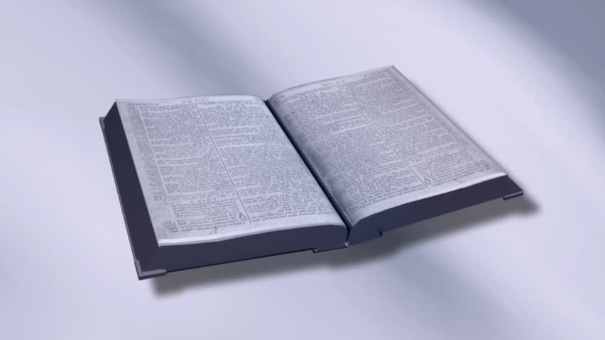
Building an Indestructible Life
Positive Personal Relationships
(Matthew 5:21-26, 43-48; 7:12)

Slide 2

Obituary Redwood Falls Gazette in Minnesota
Kathleen Dehmlow
  Kathleen Dehmlow (Schunk) was born on March 19, 1938 to Joseph and Gertrude Schunk of Wabasso.
  She married Dennis Dehmlow at St. Anne’s in Wabasso in 1957 and had two children Gina and Jay. In 1962 she became pregnant by her husband’s brother Lyle Dehmlow and moved to California.
  She abandoned her children, Gina and Jay who were then raised by her parents in Clements, Mr. and Mrs. Joseph Schunk.
  She passed away on May 31, 2018 in Springfield and will now face judgement. She will not be missed by Gina and Jay, and they understand that this world is a better place without her.

Slide 3

Relationships
Get Your Phones

Slide 4
What WE
do NOT
want
in relationships
is what God wants !
Joy
ARGUMENTS
STRIFE
Kindness
ENMITY
Peace
Love
Goodness
FACTIONS
Patience
ENVY
Respect
JEALOUSY
ANGER

Slide 5
Look at Self
Do we do this? Do we look at ourselves?
Why is focusing on self so important?
  I am rarely innocent.
  I am the only person I can change.

Slide 6
Start….with HEART
Motive
  The engine that drives our words and actions.
Questions that help identify my motive:
  What do I want out of this?
  What do I want for the other person?
  What do I want for the relationship?

Slide 7
Show….Biblical LOVE
neighbor
Love your _________ as yourself.
Love one another , as ___ have loved you.
Love _______ long and is _____.
Love does not ______ its own.
Love ______ all things, ________ all things, _______ all things, ________ all things.
I
suffers
kind
seek
bears
believes
hopes
endures

