Slide 1

Unmasking Illusions of our Culture
Affluence and Materialism

Slide 2
Affluence and Materialism
Affluence
the state of having a great deal of money; wealth.
Materialism
tendency to consider material possessions and physical comfort as more important than spiritual values
Notes:
How much money does it take to have a “great deal”?
Materialism is an attitude toward earthly things. A priority problem.
Do you think it’s a problem in today’s world? In the US?
Is it more of a problem now than in the past?

Slide 3
Wealth in Today’s World
Most of us are Wealthy and Enjoy the Material Things We Have
Having wealth is not a sin (Abraham, Job, etc.)
Danger is Our Attitude Toward Wealth
Society pushes us to desire wealth
Rich young ruler (wrong attitude toward riches)
Do you have a love of money?
Do we focus on riches too much?
How do we view money and things?
How do we view people with more than us?
Notes:
Being Wealthy is not a sin
Abraham – Gen. 13:2 – “Now Abraham was very rich in livestock, in silver, and in gold.”
Job - Job 1:3 – “Also, his possessions were seven thousand sheep…, so that this man was the greatest of all the people of the East.”
God didn’t condemn these men for having riches. He gave them the riches
Do you think they enjoyed having material things?
The Danger is our Attitude toward riches
Think about how much society encourages us to strive for wealth
You have to go to school to get the best job
You have to save xxx amount for retirement
These things aren’t bad or wrong, but where do they fall in a list of our daily priorities? How much time/effort is spent on these type of things?
Rich young ruler – Mark 10:17-27
He obviously loved his riches more than God.
The “Love of money is the root of all evil” (1 Tim. 6:10)
How much time do we spend thinking about money? Trying to decide on a career that will make the most money?
How excited to you get when you buy a new …? More than if you get to talk about the bible with someone?
Do you envy people that have nicer/more things than you?
How do people of the world view wealth and materialism?

Slide 4

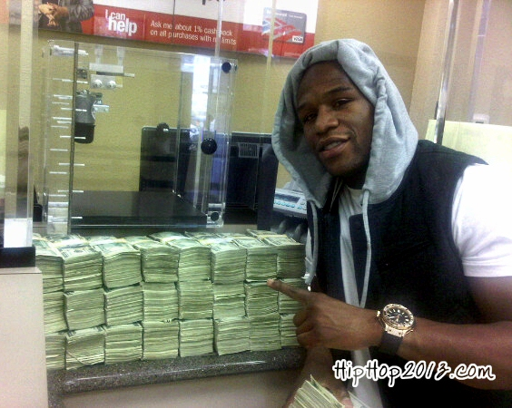
Notes:
We are bombarded with celebrities and athletes on TV and Social Media. A lot of them are showing off their riches and their lifestyle.
Seeing this so much can really cause us to be jealous and envious.
These small snapshots into their lives make it seem like they have things figured out. But if we look closer we will see that it is all an illusion that Satan want us to fall for.

Slide 5
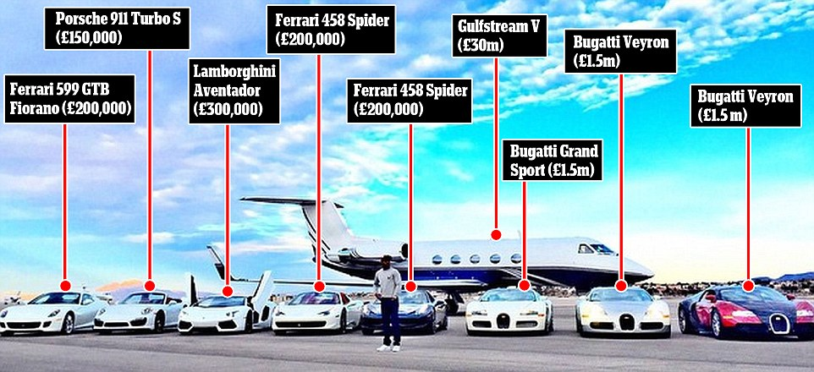

Slide 6
Illusions vs Reality
Wealth = Real Happiness
Idea that “money can buy happiness”
Look at the entertaining lives rich people live, how much fun they have
Reality: Earthly Wealth is Vain
Can be entertaining, but ultimately leaves you feeling empty
Eccl. 6:1-2
Prov. 3:13-18
Notes:
Here are some views that worldly people have. Views that Satan tries to use to influence and deceive us.
Wealth = Happiness
“Money can buy happiness”
Can afford any kind of entertainment, can fulfill any lust of the eye
Is there any worldly thing that money can’t get you?
Look at the celebrities and how they are portrayed. They are living the “good life.” Exotic vacations, extravagant toys, don’t have to work much, kick back and relax.
Reality: Earthly Wealth and Materials are all Vain
Wealth can entertain us, but it is only a shallow form of happiness. Eventually we get bored with entertainment and it takes something more to make us happy.
Eccl. 6:1-2 – Man is given riches and wealth and all he desires, but a foreigner consumes it. This is vanity and an evil affliction
Prov. 3:13-18 - “Happy is the man who finds wisdom and the man who gains understanding; For her proceeds are better than the profits of silver and her gain than fine gold….”

Slide 7
Illusions vs Reality
Wealth = Satisfaction
If I just had $1 Million I would be satisfied
I’ll have everything I want and more
Accomplished feeling
Reality: Wealth leaves you wanting more
Money leads to desire for more riches, and greed creeps in
Earthly wealth in not fulfilling
Eccl. 4:8, 5:10, 6:7
Notes:
Wealth = Satisfaction
If I just had $1 million I would never want anything again.
Rich people have contentment.
Wealth make you feel accomplished and means a fulfilling life
Reality: Only spiritual things satisfy
Reality is money leads to the desire for more money.
Greed
Eccl. 4:8 – “There is one alone with companion; He has neither son nor brother. Yet there is no end to his labors, nor is his eye satisfied with riches…”
Eccl. 5:10 – “He who loves silver will not be satisfied with silver; nor he who loves abundance, with increase. This is also vanity.”
Eccl. 6:7 – “All the labor of man is for his mouth, and yet the soul is not satisfied.”

Slide 8
Illusions vs Reality
Wealth = The Easy Life, No Needs
Kick back and enjoy life
Don’t need anyone or anything
Reality: More Money More Problems
More temptations and worries
Pride (Rev. 3:17)
Added responsibility
Notes:
Wealth = The Easy Life
Kick back and relax, eat drink and be merry
Independent, don’t need anyone or anything
Wealthy People Don’t need anything
Reality: More money can mean more problems
Added temptations and worries
Not relying on God
Consumes our time
Often consumes focus
Worry about losing it or people stealing it.
People come from everywhere asking for help
Worry about people taking advantage of you
Pride and thinking you’re self sufficient can be a huge problem.
Rev. 3:17 – “Because you say, I am rich, have become wealthy, and have need of nothing – and do not know that you are wretched, miserable, poor, blind, and naked”
Prov. 13:7 – “There is one who makes himself rich, yet has nothing; And one who makes himself poor, yet has great riches.”
In reality, having money generally means more worries.
Wealth leads to more responsibility

Slide 9
Illusions vs Reality
Wealth = Lasting Security
Money can get you out of problems
You can depend on it
Don’t have to worry about future needs
Reality: Earthly Wealth is Temporary
Can’t take anything with us (1 Tim. 6:7)
Prov. 23:5
Eccl. 2:18, 5:13-15
Notes:
Wealth = Security and peace of mind
Attitude of “I have money in the bank so I don’t have to worry”
People depend on it to get out of problems (hire the better lawyer)
People put their trust in it b/c it gets them out of problems
Reality: Earthly wealth is only temporary
Material wealth will not last. It may be taken from us in this life.
But definitely offers no eternal security.
1 Tim. 6:7 – “For we brought nothing into this world, and it is certain we can carry nothing out”
Prov. 23:5 – “Will you set your eyes on that which is not? For riches certainly make themselves wings; they fly away like an eagle toward heaven”
James 5:1-3 – “come now you rich, weep and howl for your miseries that are coming upon you. Your riches are corrupted, and your garments moth eaten…”
Eccl. 2:18 – Must leave everything you work for to the man who will come after you
Eccl. 5:13-15 – Riches perish through misfortune, naked he shall return and take nothing from his labor
Psalm 49:16-20 – “Do not be afraid when one becomes rich…For when he dies he shall carry nothing away…”

Slide 10
Responsibility of Wealthy
Earthly Wealth Means Responsibility
Good Stewards
Use Riches to Honor God
Help Those in Need
Give to the Church
Notes:
Even though we may not be pursuing riches and material things God may bless us with them.
If God blesses us with Riches/Wealth He expects us to use it in a certain way. In a way that will glorify Him!
Good stewards
Parable of Talents/Minas (Matt. 25:14-30, Luke 19:11-27)
God expect us to use what we have to do our Godly work!!! Talents, abilities, money, materials whatever it may be!
Honor God
Prov. 3:9-10 – “Honor the Lord with your possession, and with first fruits of all your increase; so your barns will be filled with plenty, and your vats will overflow with new wine”
How do you think we honor God with our possessions?
Help the Needy
Prov. 11:24 – “One gives freely, yet grows all the richer; another withholds what he should give, and only suffers want.”
Acts 2:45 – “…and sold their possessions and goods, and divided them among all, as anyone had need”
Give to the Church
1 Cor. 16: 1-2 – “…on the first day of the week let each of you lay something aside, storing up as he may prosper,…”

Slide 11
Conclusion
Focus on doing God’s work, not attaining riches
Matt. 6:33
Always have proper attitude toward our riches/wealth
Use our blessings to do God’s work
Must learn to be content with what we have
Heb. 13:5
Notes:
Focus on God’s work, the rest will take care of itself
Matt. 6:33 – “But seek ye first the kingdom of God and His righteousness, and all these things will be added to you.”
Proper attitude toward riches
Use our wealth/materials in doing God’s work
Eph. 4:28 – “Let the thief no longer steal, but rather let him labor, doing honest work with his own hands, so that he may have something to share with anyone in need”
Contentment
Life will be more enjoyable when you have contentment.
1 Tim. 6:6-10 – “Now there is great gain in godliness with contentment, for we brought nothing into the world, and we cannot take anything out of the world……..
Heb. 13:5 – “keep your life free from love of money, and be content with what you have, for he has said, “I will never leave you nor forsake you.
Don’t fall into the traps Satan has laid for us regarding physical things.
Put God First, Focus on Doing God’s work, learn to be content and everything will be taken care of!!!!

