Slide 1

Unmasking Illusions of our Culture
The Illusion that Drinking Alcohol is Harmless

Slide 2
The Illusion that Alcohol is Harmless
Alcohol leads to many physical, social, family and spiritual problems.
It deceives its user into thinking his problems go away, but it solves no problems and creates many (Prov. 20:1).
Serious character flaws typically develop with the use of alcohol (Isa. 5:11-12, 21-23).
Drinking is accepted in the world; it is one of the things that a Christian must leave behind (1 Peter 4:3-5).
Drinking and being spiritual are polar opposites (Ephesians 5:18).

Slide 3
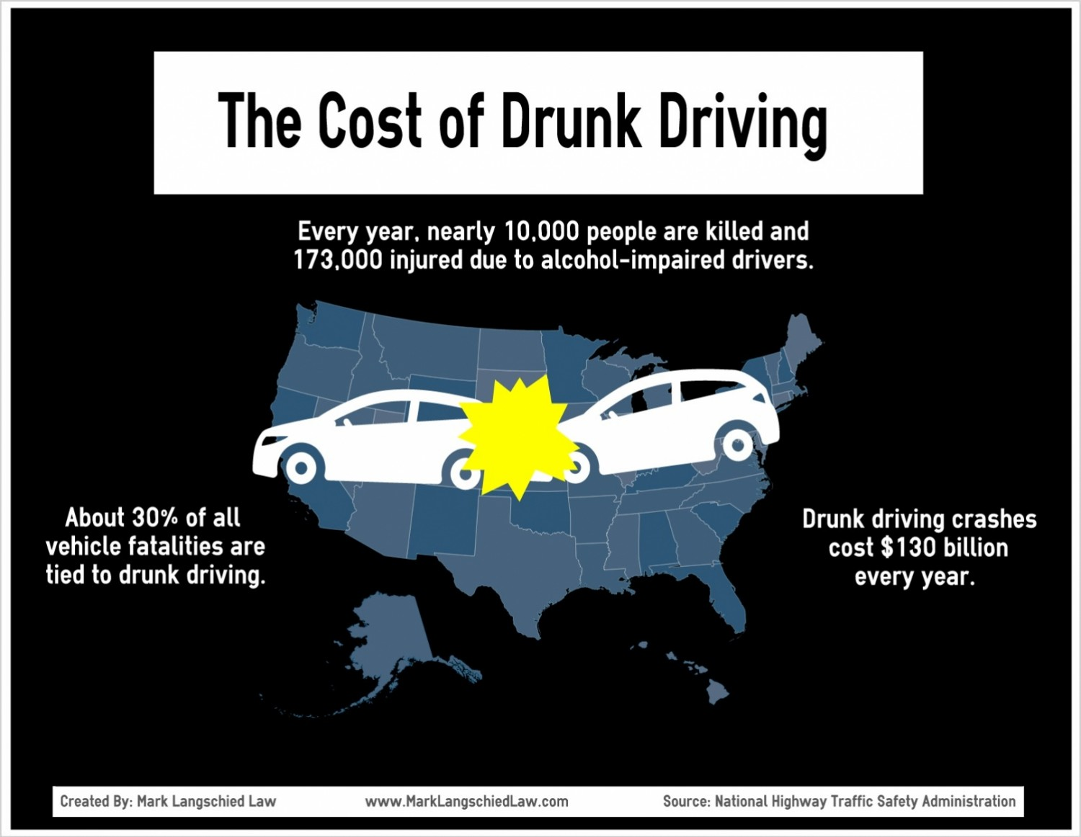
A Needed Reality Check!

Slide 4
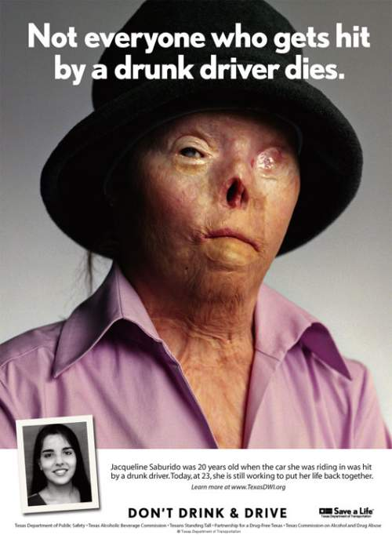

Slide 5
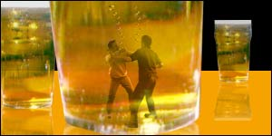
The Illusion that Alcohol is Harmless
A Needed Reality Check!
Drinking is associated with violent crime.

Slide 6
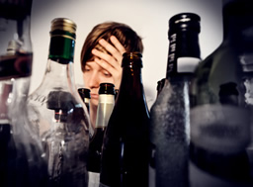
The Illusion that Alcohol is Harmless
A Needed Reality Check!
Drinking affects the home and personal life.
Correlation to domestic violence
Correlation to the break-up of families
Correlation to risky sexual behavior & unintended pregnancies
Lack of productivity or loss of job
A factor in many diseases and deaths

Slide 7
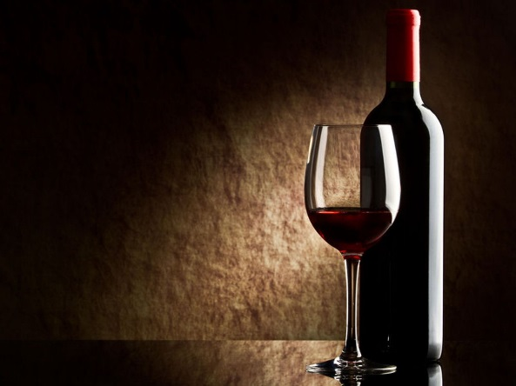
A Needed Reality Check!
The Illusion that Alcohol is Harmless
10,000 deaths per year in the U.S. are related to drinking and driving.
Alcohol is directly connected to violent crime.
Alcohol has a negative effect on the home and personal life.
Alcohol has a net negative effect on health.
Don’t let your reality check bounce!

Slide 8
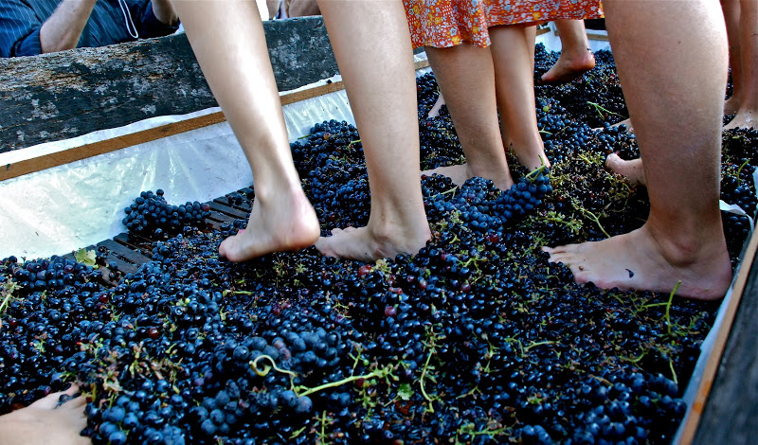
The Illusion that Alcohol is Harmless
Wine in the Bible
The word “wine” is used in the Bible to refer to both fermented and unfermented drink (Isaiah 16:10; 65:8; Mark 2:22)

Slide 9
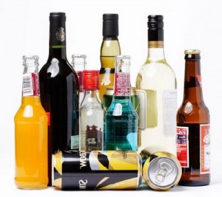
The Illusion that Alcohol is Harmless
Strong Drink in the Bible
“Strong drink” was always alcoholic; it could contain a max of 10% alcohol.
Nearly all modern alcoholic beverages would qualify as Biblical “strong drink” – Many are much stronger!

Slide 10
The Illusion that Alcohol is Harmless
Drinking Alcohol Socially is Prohibited
Three alcohol-related sins in 1 Peter 4:3
Drunkenness
Revelries (wild drinking parties)
Drinking parties
Literally “a drinking” without reference to amount
Greek scholar R. C. Trench says it is “not necessarily excessive” but that it gives “opportunity for excess.”
Christians must not “drink” alcohol on social or recreational occasions, even if they don’t drink “too much.”

Slide 11
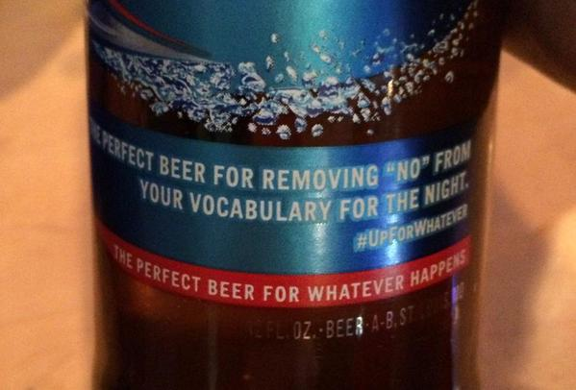
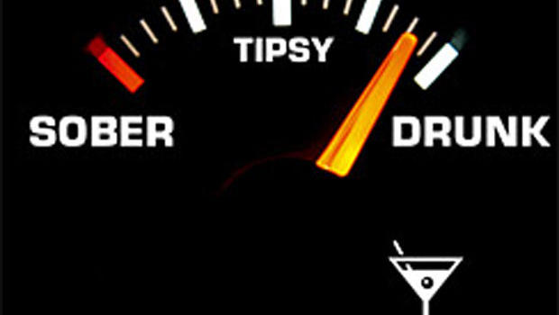
The Illusion that Alcohol is Harmless
Drinking Alcohol Leads to Other Sins
Committing the sin of drunkenness is a process. (Eph. 5:15-18. Galatians 5:21; 2 Peter 2:8; Genesis 19:30-36; 9:21).
Lack of self-control is sinful (2 Peter 1:6)

Slide 12
The Illusion that Alcohol is Harmless
Answering Arguments in Defense of Drinking
“Christ made wine at the wedding at Cana” (John 2:1-11). Was it fermented?
“Timothy was told to take wine” (1 Timothy 5:23). How much? For what purpose?
“It’s OK as long as you don’t drink too much.” (Titus 2:3; 1:7). Does forbidding a lot necessarily allow for a little? (James 1:21; 1 Peter 4:4)
“Romans 14:21 allows the use of wine as long as it does not cause others to stumble.” Was it fermented?
Wine is just a food (1 Timothy 4:1-5; Col. 2:16-23). Can we eat food without regard to God’s restrictions?

