Slide 1

Unmasking Illusions of our Culture
The Illusion of Independence & Self-sufficiency

Slide 2


Slide 3
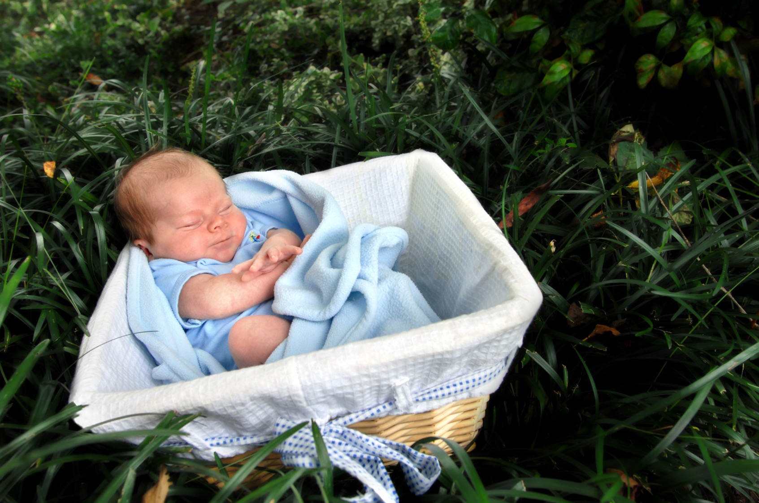

Slide 4


Slide 5

Reality:
We need God in every aspect of our lives.

Slide 6
“He upholds the universe by the word of his power.”
Hebrews 1:3 (ESV)

Slide 7
“The God in whose hand is your breath.”
Daniel 5:23 (ESV)

Slide 8

Illusions Satan
Wants Us
To Believe

Slide 9
We can go it alone without God
Satan’s first lie – Genesis 3:4-5
Satan minimizes the importance of God. – Romans 1
People who “suppress the truth” v. 18.
Who “did not honor him as God” v. 21.
Who were “claiming to be wise” v. 22.
Created to “seek God” – Acts 17:27

Slide 10
We don’t need God when things are going good.
We turn to God in desperation.
God warned Israel they would not serve the Lord when they became prosperous – Deuteronomy 28:47.
Church at Laodicea were rich even though they were spiritually poor – Revelation 3:14-22.

Slide 11
We don’t need people of “like precious faith” in our lives
They help when we are caught in transgression – Galatians 6:1-2.
They help us grow into Christ – Ephesians 4:16.
We all have something to contribute to the body of Christ – 1 Corinthians 12:12-30.

