Slide 1

Unmasking
Illusions of our Culture
The Illusion of Sexual Promiscuity

Slide 2

Sexual Promiscuity
Notes:
Graphic Material

Slide 3
The Sexual Relationship
God Created It for Good
Satan Exploits It to Destroy Your Soul!
Blessing or Curse – Your choice

Slide 4
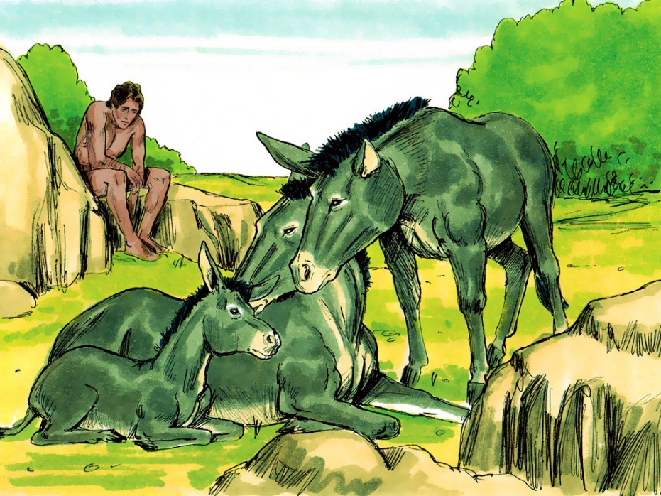
The Sexual Relationship
This is now bone of my bones and flesh of my flesh
God Created It For Good

Slide 5
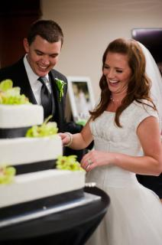

The Sexual Relationship
And the Two Became One Flesh

Slide 6

Sexual Promiscuity
Satan Exploits it to Destroy Your Soul!
I Peter 5:8
I John 2:16
Revelation 12:9
Notes:
I Peter 5:8 “Be sober, be vigilant; because your adversary the devil, as a roaring lion, walks about seeking whom he may devour.”
I John 2:16 “For all that is in the world, the lust of the flesh, and the lust of the eyes, and the pride of life, is not of the Father, but is of the world.”
Re 12:9 So the great dragon was cast out, that serpent of old, called the Devil and Satan, who deceives the whole world; he was cast to the earth, and his angels were cast out with him.

Slide 7


Sexual Promiscuity
If it makes you happy, it can’t be that bad
Notes:
This song highlights the words feeling toward almost everything.
Songs lyrics-
Cheryl Crow
“If it makes you happy, then it can’t be that bad”
“Hold me, touch me, and think of me when we're apart
Hold me, baby won't you touch me
And think of me here in the night
And you know it'll be alright”
Meatloaf
“You got to do what you can
And let Mother Nature do the rest
Ain't no doubt about it
We were doubly blessed
'Cause we were barely seventeen
And we were barely dressed”

Slide 8
Sexual Promiscuity
47%
{High School}
Notes:
47% of High School age students have had sexual intercourse
34% had had sexual intercourse during the previous 3 months
15% reported they had sex with four or more people.
According to the CDC

Slide 9
Sexual Promiscuity
75%
{College}
Notes:
75% (some research as high as 85-92%) have had sexual intercourse by their senior year of College.
Over half the Student speak of “Hooking Up” which most commonly means having sex within the first 24 hours of meeting someone, or sex with a friend with no strings attached.

Slide 10
Sexual Promiscuity
Ro 1:28-31 And even as they did not like to retain God in their knowledge, God gave them over to a debased mind, to do those things which are not fitting; being filled with all unrighteousness, sexual immorality, wickedness, covetousness, maliciousness; full of envy, murder, strife, deceit, evil-mindedness; they are whisperers, backbiters, haters of God, violent, proud, boasters, inventors of evil things, disobedient to parents, undiscerning, untrustworthy, unloving, unforgiving, unmerciful;
Notes:
First notice the company that “Sexual Immorality” keeps.
Those who practice these things are worthy of death
Those who approve (support) others who do them are worthy of death (include a comment about Homosexuality) here

Slide 11
Sexual Promiscuity
What are some illusions that Satan uses to inspire sexual immorality?
Notes:
Everyone is doing it and they tell me how much fun it is and make fun of me because I don’t (peer pressure)
It is nothing more than innocent fun. It isn’t that bad because it isn’t hurting anyone.
It does hurt and causes depression
Fear of pregnancy, regret, guilt, low self-respect and self-esteem, corrupts character, issues committing, depression/suicide, destroys relationships and can have a negative impact on current/future marriage.
Oral sex isn’t really sex so it is okay. Girls do it to avoid going further. However, they feel used and like an object instead of a person afterwards. Guys do try to talk a girl into this. You make them into an object to be used for your gratification instead of a person.
Girls though they may participate with the hookup scene, they still want more than a one night stand and they have the same feelings of being used and made into an object.

Slide 12
Sexual Promiscuity
What are some “tools” that Satan uses to inspire sexual immorality?
Notes:
Internet (Social media, snap chat, sexting, etc.) is not hurting anyone
Music (we have already looked the lyrics of one song but there are many where the music industry is glorifying this sin and lying about the consequences)
TV/Movies (I hear high school girls saying they want boys to act like boys instead of girls. I really fear TV stations like Disney, Nick, etc. have overt agenda to encourage feminine traits in boys. Many have pro-gay agendas which I fear correlates to the rise in teenage homosexual activity. They glorify homo-sexuality and I fear encourage some through power of suggestion)

Slide 13
Sexual Promiscuity
I lost my virginity when I was 15. My boyfriend and I thought we loved each other. But once we began having sex, it completely destroyed any love we had. I felt he was no longer interested in spending time with me—he was interested in spending time with my body.
—AMANDA, A COLLEGE STUDENT
https://www2.cortland.edu/dotAsset/199337.pdf

Slide 14


Sexual Promiscuity
Man’s laws vs. God’s laws
Age of consent vs. marriage
“Women frequently cheat in a marriage for emotional reasons”
“Men frequently cheat just for the sexual contact “
(www.divorcestatistics.info).
Notes:
Instructions for sexual activity
The State of Alabama says that a 16 year old is old enough to consent to being sexually active. God says sex is for marriage.
Song of Solomon 2:7b “Do not stir up nor awaken love until it pleases”
I Thess 4:3-4 “For this is the will of God, even your sanctification, that ye should abstain from fornication: That every one of you should know how to posses his vessel in sanctification and honor.”
Within the marriage relationship, the sexual relationship is a gift. It is given to be a special strength and bond between a husband and wife. I want to caution you to not think of your physical feelings as wrong or bad, they are not, but they are given for a set time in your life.
Heb 13:4 “Marriage is honorable in all, and the bed undefiled: but whoremongers and adulterers God will judge.”
Proverbs 5:15-18, 21 “Drink waters out of our own cistern, and running waters out of your own well. Let thy fountains be dispersed abroad, and rivers of waters in the streets. Let them be only your own, and not strangers’ with thee. Let thy fountain be blessed: and rejoice with the wife of your youth…For the ways of man are before the eyes of the Lord, and he ponders all his goings.”
I Cor 7:1-5 Now concerning the things of which you wrote to me: It is good for a man not to touch a woman. ² Nevertheless, because of sexual immorality, let each man have his own wife, and let each woman have her own husband. ³ Let the husband render to his wife the affection due her, and likewise also the wife to her husband. ⁴ The wife does not have authority over her own body, but the husband does. And likewise the husband does not have authority over his own body, but the wife does. ⁵ Do not deprive one another except with consent for a time, that you may give yourselves to fasting and prayer; and come together again so that Satan does not tempt you because of your lack of self-control.
God would not give us warnings if we weren’t in danger. Sexual promiscuity is not limited to young, single people. Age in years and marriage doesn’t protect your marriage from Satan. Women frequently cheat in a marriage for emotional reasons and men frequently cheat just for the sexual contact (www.divorcestatistics.info). This is why knowing God’s laws and you and your future partner obeying and respecting these laws is so important.
Warnings
Proverbs 5:1-23
Proverbs 6:23-29
Proverbs 7:1-27

Slide 15
Sexual Promiscuity
Bad Choices
Create
Bad Situation
Notes:
True stories- What sins do you recognize?
Two middle school age girls lied to each other’s family about where they were going to spend the night. They went out to the woods with two boys in their early twenties. They drank together. When they finished, one girl got in the back of the SUV with one guy and the other got in the back seat with the other guy. The pair in the back seat started kissing and “making out”. That led to them having sex. The pair in the back end did not, because she didn’t want to. The girl from the back seat, then switched places with her and had sex with the other guy. This was consensual, obviously spiritually and morally wrong, and also defined as rape in Alabama due to their ages. One guy was arrested and the other committed suicide.
The police saw a vehicle on the side of the road and they stopped to make sure everything was ok and see if they needed any help. Inside they found a teenager and older guy having sex. They were on their way home from her having an abortion.
Twenty-one year old, pregnant after being raped at 15, pregnant the second time at 20 with a guy she only knew one night, reported being raped a total of seven times in six years
Fourteen year old and 18 year old were having consensual sex, until she decided to change her mind. The guy didn’t listen.
18 year old, hasn’t thought much about sex, because she has been raised in the church and knows it is for marriage, she graduates and starts working with a 21 year old and 55 year old (divorced) who both openly state that they are having sexual relationships with their boyfriends and her boss is having a rumored affair with another co-worker. How do you think this influences her beliefs on a daily basis? Do you think it weakens her or strengthens her values?

Slide 16
Sexual Promiscuity
You Can Overcome
And Enjoy this Gift
Notes:
There is great news for us though, we can avoid all the bad and experience all the good that comes from this great gift from God. We can have that relationship with one person who we know on a level no one else does and they know us on the same level. So how do we do it?

Slide 17


Of You?
Who Will
You Let

Slide 18
Who Will
You Let
Of You?
Self-control
The virtue of one who masters his desires and passions.
Sober (Soundness of mind) (ROE)
Athletes who in preparing themselves for the game abstained from unwholesome food, wine, etc..

Slide 19
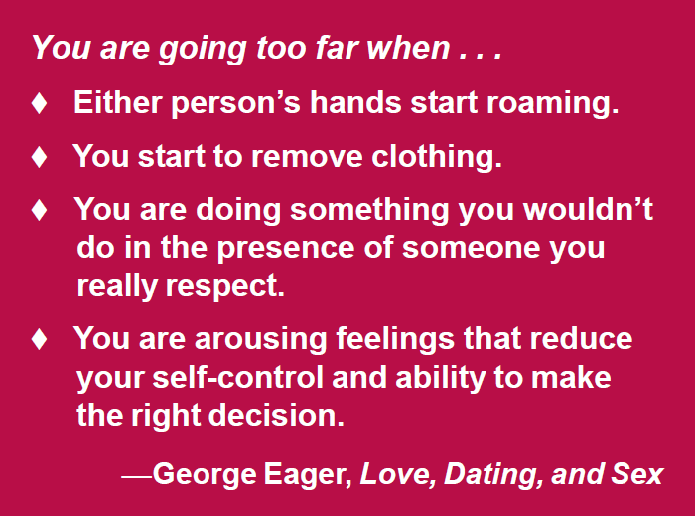
Sexual Promiscuity
Notes:
There is a desire or appetite within the human body for this sexual relationship. We must keep it under control and never feed it until marriage. Many speak of this relationship as a drug one gets addicted too. We must not stir up nor awaken love until it pleases – Song of Solomon 2:7b. We are commanded to control ourselves (1 Thess 4:3-4). I have heard people justify an adulterous marriage by saying “I just believe God wants me to be happy, so it is okay that I am in this marriage. God doesn’t want us to be unhappy does he?” Do you remember what Jesus said (Matthew 19:9-12) after his disciples stated this teaching was too hard and it would just be better not to marry? Jesus didn’t downplay their statement at all. Instead He answered, there are eunuchs for many reasons and one of those reasons was for the “kingdoms of heaven’s sake”.

Slide 20

Sexual Promiscuity
“It Isn’t Over if You Have Fallen”
Notes:
Based on this statistics earlier, it is very likely there are those listening right now who have already fallen to this temptation. Many people in this situation may not continue to be sexually active but feel they have failed, their worthless and there is no reason to change. This can’t be any further from the truth. If you are depressed, living with regret, feeling guilty because you fell to this temptation, Satan continues to destroy your soul. You can fix it by “Repenting – set your mind to never do it again”, ask forgiveness of God, and the third point is most important which is to forgive yourself. Otherwise, Satan has you under his control. David was a man after God's own heart and he fell to this temptation. Looking at his life you will see where he suffered consequences of his behavior but yet he did repent and turned back to the Lord.

Slide 21
Sexual Promiscuity
“Be in the right place, at the right time, doing the right thing in the right way.”

