Slide 1

Unmasking Illusions of our Culture
The Illusion of the Successful Career Woman: Career Path vs. Homemaker

Slide 2
Career Path vs. Homemaker
Genesis 2:18 “…I will make him a helper comparable to him.”
Proverbs 31:10-31 Working manager of household affairs
Titus 2:5 Wives to be “homemakers,” literally “workers at home”
I Timothy 5:14 God’s will is that wives “guide” or “manage the house” (KJV & NKJV).

Slide 3


Career Path vs. Homemaker
What are your plans for the future?

Slide 4
Career Path vs. Homemaker
Proverbs 31:10 “The Worthy Woman”
NKJV – Virtuous wife
NIV – Wife of noble character
ESV – Excellent Wife
ASV – Worthy woman
ERV – Perfect wife
AMP – Capable, intelligent, and virtuous woman
How can a woman be a helper for man?

Slide 5
Career Path vs. Homemaker
Notice the action verbs used of this virtuous wife:
Does good
Seeks wool and flax
Works willingly with her hands
Brings her food from afar
Rises while it is yet night

Slide 6
Career Path vs. Homemaker
Provides food for her household
Considers a field and buys it
Plants a vineyard
Girds herself with strength
Strengthens her arms
Perceives that her merchandise is good

Slide 7
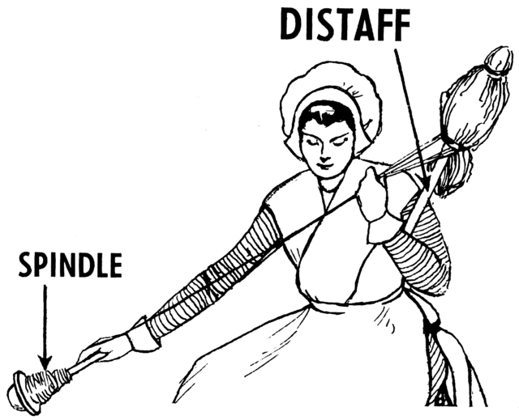
Career Path vs. Homemaker
Keeps lamp burning
Stretches out her hands to the distaff
Holds the spindle

Slide 8

Career Path vs. Homemaker
Extends her hand to the poor
Reaches out her hands to the needy
Cloths household with scarlet
Makes tapestry for herself

Slide 9
Career Path vs. Homemaker
Cloths herself with fine linen, purple
Makes linen garments
Supplies sashes for the merchants
Opens mouth with wisdom, kindness
Watches over the ways of household
Does not eat the bread of idleness
Fears the Lord

Slide 10
Career Path vs. Homemaker
Which verses from Proverbs 31 support the following qualities of the virtuous wife?
Works willingly
Takes care of family – food and clothing
Intelligent/educated
Exercises/healthy
13
14, 15, 21, 27
16, 18, 26
17

Slide 11
Career Path vs. Homemaker
18
Quality work
Hands on projects/sews, makes
Helps others
Plans ahead
Nice Appearance
Brings honor to family
Busy, not busybody
13, 19, 22, 24
20
16, 21
22
12, 23, 29, 31
27, 10-31

Slide 12

Career Path vs. Homemaker
26
Uses tongue wisely
Not idle
Fears the Lord
27
30

Slide 13
Career Path vs. Homemaker
Titus 2:5 “…homemakers…obedient to own husbands
GNT – good housewives who submit themselves to their husbands
CEB – working at home, submissive to their own husbands
NET – fulfilling their duties at home, being subject to their own husbands

Slide 14
Career Path vs. Homemaker
ASV – workers at home being in subjection to their own husbands
ESV – working at home and submissive to their own husbands
ERV – to take care of their homes and be willing to serve their husbands
CEV – a good homemaker who puts her own husband first
AMP – homemakers, adapting and subordinating themselves to their husbands

Slide 15
Career Path vs. Homemaker
I Timothy 5:14 “…manage the house”
AMP – guide the household
NET – manage a household
CEB – manage their homes
ASV – rule the household
CEV – look after their families
ERV – take care of their homes

Slide 16
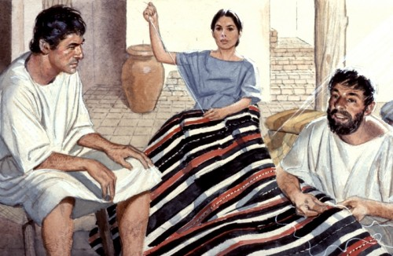
Career Path vs. Homemaker
Acts 18:3 – Priscilla and her husband, Aquila, were tentmakers.
Acts 16:14 – Lydia was a trader dealing in purple cloth. She was hospitable.

Slide 17
Career Path vs. Homemaker
Plan for the future.
Learn to work hard.
Be a helper to your husband and make a home for your husband and children.
Home-maker

