Slide 1
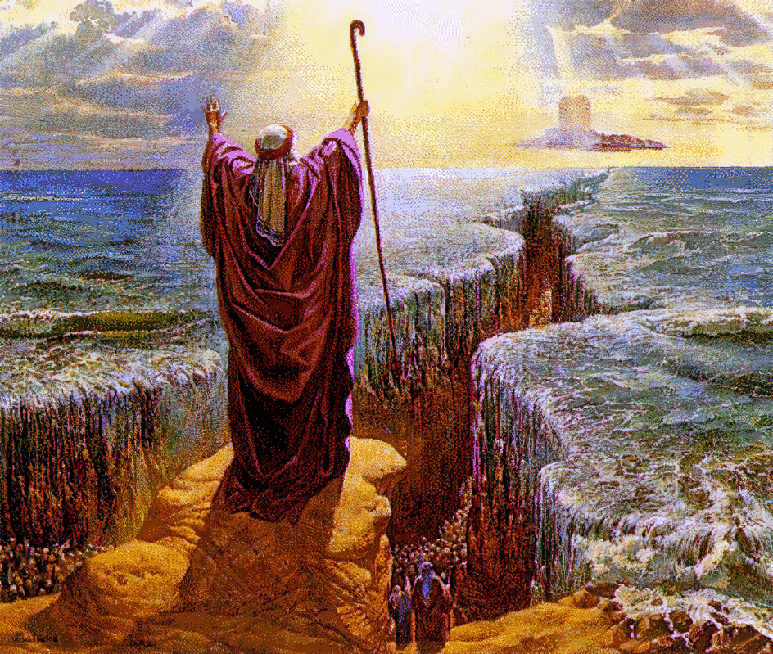

The Song of Moses and The Song of the Lamb

Slide 2
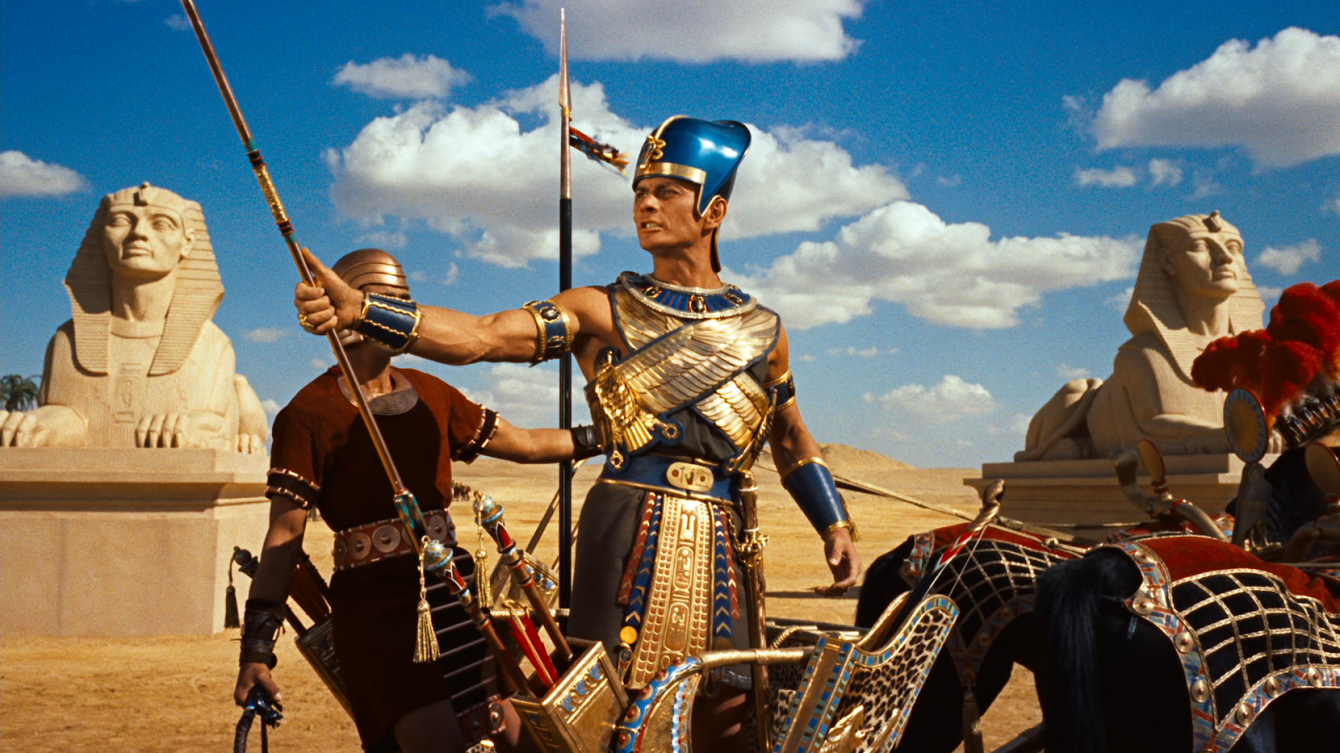
Prelude to the Song

Slide 3
Prelude to the Song
Echoes of Genesis 3
“Now the serpent was more shrewd…” (3:1)
Pharoah: “Come, let us deal shrewdly with them” (Exodus 1:10)
Like the serpent, he refuses to accept the supremacy of God
But Pharaoh said, “Who is the Lord, that I should obey his voice and let Israel go? I do not know the Lord, and moreover, I will not let Israel go.” – Exodus 5:2

Slide 4
Prelude to the Song
De-Creation in Egypt
Aquatic life destroyed when water turned to blood
Animal life destroyed through disease and hail
Plant life destroyed by locust
Light is turned to darkness
Life becomes death for the firstborn of the land

Slide 5
Prelude to the Song
Re-Creation for Israel
Guided by light in the darkness
Strong east wind separated water from land (see Genesis 1:2)
De-Creation complete for Egypt
Darkness separated them from Israel
Waters of Red Sea become chaotic waters of Genesis 1
Land and water rejoin resulting in death of Egyptians

Slide 6
The Song of Moses

Slide 7
The Song of Moses
The Glorious Lord (1-5)
“I will sing” to the Lord who has triumphed gloriously
No power can defeat Him
Your Right Hand, Glorious in Power (6-10)
Works are incomparable to human efforts (vs. 9)
Who is like You, Glorious in Deeds (11-12)
Majestic in holiness, glorious in deeds
Earth swallowed enemy like staff swallowed staffs
You Have Led in Steadfast Love (13-17)
You will plant them on your mountain abode (17)
You Will Reign Forever and Ever (18)

Slide 8
The Song of the Lamb

Slide 9
The Song of the Lamb
Picture of Pharaoh is a Miniature of Satan
Speak, and say, Thus says the Lord God: “Behold, I am against you, Pharaoh king of Egypt, the great dragon that lies in the midst of his streams, that says, ‘My Nile is my own; I made it for myself.’ – Ezekiel 29:3
“Son of man, raise a lamentation over Pharaoh king of Egypt and say to him: “You consider yourself a lion of the nations, but you are like a dragon in the seas; you burst forth in your rivers, trouble the waters with your feet, and foul their rivers. (32:2)

Slide 10
The Song of the Lamb
Numerous Similarities Between Exodus and Revelation
Devil works through an empire to persecute the faithful
God will de-create the enemy
Plagues will destroy
God will reign forever and ever (11:15)

Slide 11
The Song of the Lamb
God’s People Will be Brought Safely Through (Chapter 15)
They have overcome the chaotic waters – God’s new creation (21:1)
Now standing at their own Red sea (15:1)
They sing the song of Moses, but why?
Demonstrates God bringing down serpent aligned empire
They sing the song of the Lamb (3-4)
Christ will defeat all evil
All nations will bow their knee to Him
Ultimate Victory is not Through the Staff of Moses; it is Through the Blood of Christ

Slide 12
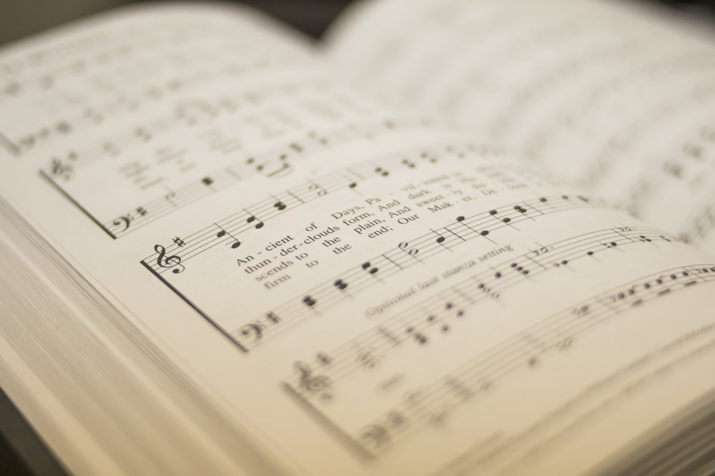
When We Sing…

Slide 13
When We Sing…
We Remember the Power of God
“I will sing to the Lord” repeated in Psalms 13 and 104
Singing should concentrate on God’s glorious power

Slide 14
When We Sing…
We Remember the Power of God
We Remember God Cares for His People
It is easy to feel that God has forgotten
Singing of His care for His people brings confidence
He has promised He will reign forever…and so will we
And night will be no more. They will need no light of lamp or sun, for the Lord God will be their light, and they will reign forever and ever – Revelation 22:5

Slide 15
When We Sing…
We Remember the Power of God
We Remember God Cares for His People
We Remember it is All About God
Hymnists, song leaders, and singers have great responsibility
God’s glory must always be the theme of our songs

Slide 16


