Slide 1

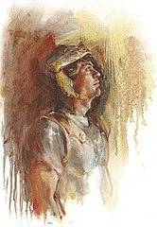
The Position of Christ Over His People
Matthew 28:18

Slide 2
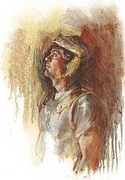

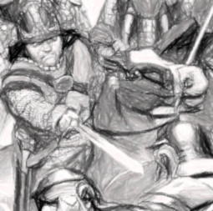
Truth
? ? ?
Belief
Righteousness
Purity

Slide 3
Blasphemer ??
Who
Lord ??
Liar
??

Slide 4

Crucified
Buried
Raised

Slide 5
Positions Of Christ Over His People
Lord over heaven and earth
King
Shepherd
Head

Slide 6
Approaching Scripture
Traditional
Ecclesiastical
Charismatic
Mystical
Rational
Material
Biased

Slide 7
Approaching Scripture
“What does your church believe about….?”
“Most denominations have changed their teachings about…”

Slide 8
Approaching Scripture
“If I accepted that, I’d be going against my mother and father…”
“Everyone has a right to his own interpretation…to decide what’s right…”

Slide 9
Approaching Scripture
“My preacher tells me that it’s wrong to do…”
“The Bible speaks in different ways to different people…”
“The Spirit led me to move to S. Africa to open a hospital…”

Slide 10
Approaching Scripture
“The teachings of the church are out of date with our culture…”
“I know the Bible says that, but in my heart I know…”
“I just don’t believe a loving God would send anyone to Hell…”

Slide 11
The Position of Christ Over His People
Matthew 28:18

