Slide 1


The Structure of Strong Churches
Scriptural Organization Of The New Testament Church

Slide 2

Scriptural Organization
Why Organization?
  Why do we have elders?
  Why do we have deacons?
  Why do we do things this way or that way?
These are great questions that we need to ask and we need to know the answers to.

Slide 3
Scriptural Organization
First, let's look at the church.
  Not designed by man.
  Designed by God.
  All part of the eternal plan.
OT Prophesies
  Daniel 2
  Isaiah 2
  Joel 2

Slide 4
Scriptural Organization
Daniel 2:31-45
  4 Kingdoms from Nebuchadnezzar's dream
    Babylonia
    Persia
    Greece
    Rome
  They all rise, and they all fall.
  Daniel 2:44
    “In the time of those kings, the God of heaven will set up a kingdom...”
  This “kingdom” will be the church.

Slide 5
Scriptural Organization
NT examples/prophesies
  Jesus prophesied
    Matthew 4:17, 23
    Mark 1:15
    Luke 4:43
    He mentions, “the time is at hand; the Kingdom is near.”

Slide 6
Scriptural Organization
So, when were these prophesies about the “kingdom”/church fulfilled?
  Acts 2 (Day of Pentecost)
  From this time on we hear about the church in the Present tense and not the Future tense.
    Hebrews 12:28
      “...we are receiving a kingdom that cannot be shaken...”
    Revelation 1:6
      “...(He) has made us to be a kingdom and priests...”
    Acts 20:28
      “...God's church which He bought with His own blood.”

Slide 7
Scriptural Organization
We have this church...now what?
  There needs to be organization in the church.
  Titus 1:5
    “...you should set in order the things that are lacking, and appoint elders in every city as I commanded you”
  AS I COMMANDED YOU!
    God gives us instruction in the Bible of what we must do.
    He tells us how the church should be organized.

Slide 8
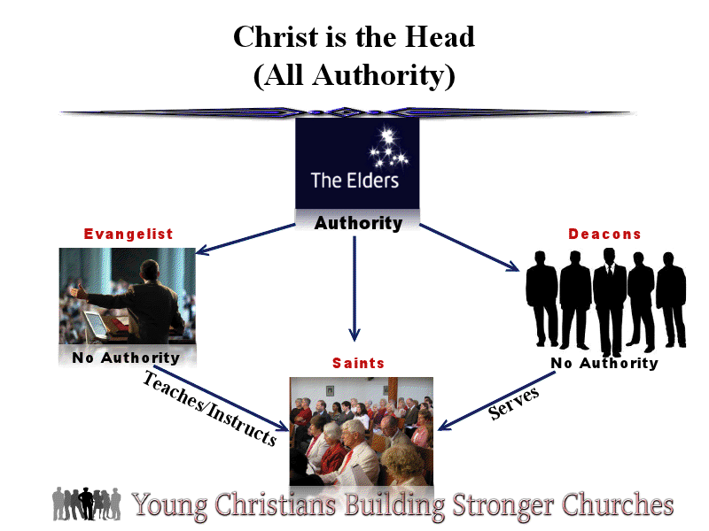

Slide 9
Scriptural Organization
First, Christ is the head...
  Ephesians 1:22-23
    “And God placed all things under his feet and appointed Him to be head over everything for the church, which is His body, the fullness of Him who fills everything in every way.”
  Ephesians 5:23
    “For the husband is head of the wife, even as Christ is head of the church...”
  The church is not an organization because it has no earthly head.

Slide 10
Scriptural Organization
It is a body, with Christ as it's Head...Ephesians 5:23
It is a kingdom, with Christ as it's King...1 Timothy 1:17
It is a bride, with Christ as it's Bridegroom...Matthew 9:15

Slide 12
Scriptural Organization
Next, are the elders.
  Elder, Pastor, Bishop
  Used at different times in the Bible.
  Elders are appointed:
    Acts 14:23
    Acts 15:4
    Titus 1:5
    Acts 20:17, 28
    Philippians 1:1
    1 Thessalonians 5:12-13
    1 Peter 5:1-2

Slide 13
Scriptural Organization
Terminology used with these words suggest:
  Age, experience, spiritual maturity, respectability, concern, an example of how one should live.
Qualifications
  1 Timothy 3:1-7
  Titus 1:6-9
  Responsibilities are mentioned in Acts 20:28

Slide 15
Scriptural Organization
Next, are Deacons.
  No authority.
  Definition means “Servant”
  Qualifications:
    1 Timothy 3:8-13
  The function of a deacon is to serve the church in whatever capacity they have been appointed.

Slide 17
Scriptural Organization
Next, are evangelists/teachers
  Evangelist is defined as messenger of good
  No authority
  “Qualifications”
    1 Timothy 4;13; 5:22; 2 Timothy 2:15; 1 Timothy 6:11; 2 Timothy 4:1-5
  Other name/designations
    Preacher: Romans 10:14
    Minister: 1 Timothy 4:7

Slide 18
Scriptural Organization
Function
  Spread the gospel...Acts 8:40; Acts 21:8
  Strengthen the faith of current Christians...1 Timothy 4:6; Titus 1:3; 2:1-5
  Refute error...1 Timothy 1:3
  Help in the understanding of organization...Titus 1:5
  And others...

Slide 19
Scriptural Organization
Teachers
  Should strive to learn so they can be able and ready to teach and be an example to others
  Mature Christian who studies and learns and is willing to teach others.
    2 Timothy 2:2

Slide 21
Scriptural Organization
In conclusion...
  1 Timothy 1:13
    “Hold fast the pattern of sound words which you have heard from me...”
  2 Timothy 2:2
    “And the things that you have heard from me among many witnesses, commit these to faithful men who will be able to teach others also.”
We should follow the pattern God has given us. Anything other than this pattern is going against what HE has taught us.

Slide 22

The structure of strong churches
The work of the New Testament Church

Slide 23
The Master’s perfect design
God is the Master designer
Can be seen through creation
- Genesis 1:31
- Psalm 19:1, 104:24
God’s perfect design:
The New Testament Church
- Ephesians 3:10
The phrase “ New Testament Church” is not found in scripture, but is simply a name given to Christians who form a spiritual body by following the exact pattern that God left for us through His holy word.

Slide 24
Understanding the master design
Understanding that God’s design of the Church is PERFECT and can not be adjusted/improved is key to following the perfect pattern and understanding the work of the Church.
- Just as we have no power to adjust creation or the rules of nature we have no power to adjust the perfect pattern of the Church.
- Ex. planting watermelon and growing pumpkin
The NT shows that all churches must follow the same pattern
- 1 Corinthians 4:17
God gives us his word so that we might clearly understand what He expects of the Church.
- 1 Corinthians14:33, 2 Timothy 3:16-17

Slide 25
The work of the Church
Evangelism: preaching of the gospel
As Christians we all have an individual responsibility to do our part in preaching and spreading God’s word (Mark 16:15)
Understanding that the gospel is for everyone and not just a select group of people is vital.
- All have sinned (Romans 3:23) (1 John 1:8, 10)
- God shows no partiality (10:34-35)
This is a great responsibility of the Church that we must not lose sight of!
The church at Thessalonica was praised for their work in evangelism (1 Thessalonians 1:8).

Slide 26
The work of the Church
EVANGELISM
According to God’s plan, local churches may spread the Word through several means.
1) Sending out evangelists from a local church:
- Acts 11:22-24
- Acts 13:1-3
- Acts 14:25-27 (they gave a report to the church)
2) Supporting evangelists financially:
- 1 Corinthians 9:14
- Philippians 4:15-16
3) Inviting unbelievers to hear the Word:
-1 Corinthians 14: 23-24

Slide 27
The work of the Church
Edification: building up and strengthening those who are Christians.
One of the primary reasons local churches assemble together for worship is for edification. (1 Corinthians 14:26)
Edification, is not doing whatever we want to do to make one another “feel good,” but rather it is doing what God has told us to do to make one another stronger and more faithful!
Edification comes through God’s word (Acts 20:32) not through external social events and activities!
Edification involves:
  Instruction, exhortation, correction and rebuke (1 Cor. 5, 2 Timothy 3:16)
  May even involve withdrawal (2 Thess. 3:6, 14-15)

Slide 28
The work of the Church
Edification in the church:
Praying (1 Cor. 14:15, Acts 2:42, 12:5)
Singing (1 Cor. 14:15, Eph. 5:19, Col. 3:16)
Partaking of the Lord’s supper ( 1 Cor. 11:18-34, Acts 2:42, 20:7)
Preaching/Teaching: (Acts 5:42, 2 Tim. 4:2)
Monetary collection for the saints (1 Cor. 16:1-2)
Reports of evangelical work (Acts 14:27)

Slide 29
The work of the Church
Helping needy saints
We must first understand that we have a responsibility to work (if we are able) to supply for our own physical needs.
  Genesis 3:19
  2 Thessalonians 3:10
However, because of famine, natural disaster, economic crises, death of provider or other similar problems can prevent individuals from being able to meet their physical needs.
In such cases, God expects his children individually to do what they can to help:
- Galatians 6:10
- Ephesians 4:28

Slide 30
The work of the Church
God also gives local churches the responsibility of relieving the physical needs of destitute saints:
  Acts 4:32-35
  Acts 11:25-30
  Romans 15:25-26 ; 2 Corinthians 8:1-4
  2 Corinthians 9:1-12
Through scripture we consistently see that local churches had the work of helping needy saints.
Churches MUST concern themselves with doing the work God has left for them to do and not straying from God’s perfect pattern!
We must accept that God’s design is not only the right way but also the best way!
John 17:4. Can we safely repeat these words as a local church?

Slide 31
The work of the Church
How young Christians can help the local
church accomplish its work:
Let no one despise your youth…(1 Timothy 4:12), be an example in:
  Word (Colossians 4:6, Ephesians 4:29, Matthew 5:37)
  Conduct ( Matt. 5:16, Eph.1:6)
  Love (1 Cor. 16:14, 1 John 3:18, 23)
  Faith (Hebrews 11:6, Revelation 2;10)
  Purity (Matt. 5:8, 2 Tim. 2:22, 1 Cor. 6:18)
Pray that the church will help spread God’s word
- (2 Thessalonians 3:1)
Be willing to serve for the church and visit people who need encouragement
  - (Galatians 5:13, James 1:27)
Teach others about the gospel (Mark 16:15, 2 Tim 4:1-5)

Slide 32
The work of the Church
LIVE A CHRIST-LIKE LIFE THAT GOD HAS COMMANDED TO ALL OF HIS CHILDREN AT ALL TIMES, ALWAYS AND FOREVER!
(Titus 2:6-8)

