Slide 1


Deviations in worship of the church
Gary Boyd

Slide 2

Deviations in worship of the church
Building the foundation….
  We are constantly bombarded with information…sometimes we must make decisions with this information.
  What is the basis of our decision making?
    Basis: a foundation upon which something rests

Slide 3
Deviations in worship of the church
Building the foundation….
Financial:
  Why is a piece of worthless paper worth something?
  Fiat money system
  Prior to 1973, our money was based on gold…the Gold Standard.
    Note: The term “gold standard” has come to mean “the supreme example of something against which others are judged or measured.”

Slide 4
Deviations in worship of the church
Building the foundation….
Sports:
  Why does a player get assessed a penalty when he drops the ball in the wrong location after a lost ball in the hazard?
  All organized sports have rules and regulations.
  “The Rules of Golf” is the “Gold Standard” of golf.

Slide 5
Deviations in worship of the church
Building the foundation….
Weight:
  How do we know how much an object weighs?
  There are laws, regulations, and standards to achieve equity between buyers and sellers in the marketplace.

Slide 6
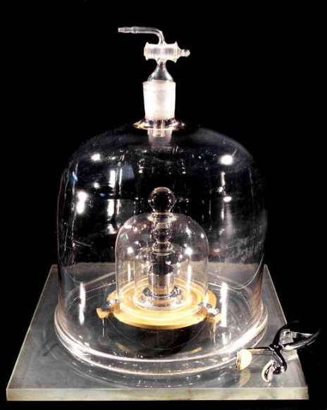
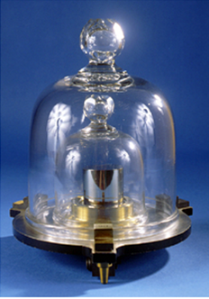
International Prototype of the kilogram (IPK)
The IPK is the “Gold Standard” of weight measurement.
IPK 20

Slide 7
Deviations in worship of the church
Building the foundation….
Law:
  How do we know when we break the law?
  In 1787, the Constitution was adopted by the Constitutional Convention.

Slide 8
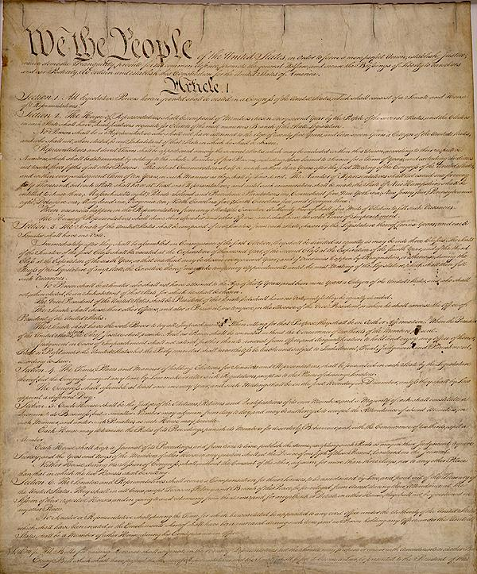
It established America’s national government and fundamental laws.
It is the basis for all laws within the United States.

Slide 9
The “Gold Standard” of the United States judicial system.

Slide 10
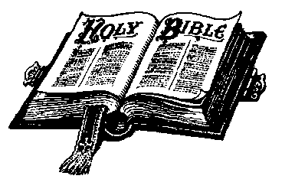
Deviations in worship of the church
Building the foundation….
Spiritual:
  How do we know how we should worship God?
  We MUST go to the “Standard”….God’s Word!

Slide 11
Deviations in worship of the church
God’s Word…the “Gold Standard”
God has directed the thoughts of mankind from the beginning.
  Genesis 2:16-17; the first commandment given
  Exodus 19-20; God gives the Law to Moses
  The prophets; (e.g. Ezekiel, Jeremiah, Zephaniah…)
  Hebrews 1:1-2; “God, who at various times and in various ways spoke in time past to the fathers by the prophets, has in these last days spoken to use by His Son, whom He has appointed heir of all things, through whom also He made the worlds”

Slide 12
Deviations in worship of the church
God’s Word…the “Gold Standard”
God’s thoughts and expectations have always been communicated in an effective manner.
God is our Creator, and hence, holds all authority over us.

Slide 13
Deviations in worship of the church
God’s Authority…the “Gold Standard”
God is the Ultimate Authority
  Gen. 1:1; John 7:16; John 19;11
God gave all authority to His Son
  Matthew 28:18; John 12: 44-50, 17:1-3
Jesus imparted power of God thru Holy Spirit
  John 15:26-27, 16:13-14
Holy Spirit inspired some of the disciples
  2 Timothy 3:16-17; I Thess. 2:13, 4:2-8

Slide 14
Deviations in worship of the church
God’s Authority…the “Gold Standard”
God is unchangeable! (Mal. 3:6)
His word endures forever! (1 Peter 1:22-25)
God’s word is the ultimate authority in all things spiritual.

Slide 15
Deviations in worship of the church
What is the “Gold Standard” of worship?
As Jesus spoke with the Samaritan woman at Jacobs well…
“…the hour is coming, and now is, when the true worshipers will worship the Father in spirit and truth; for the Father is seeking such to worship Him. God is Spirit, and those who worship Him must worship in spirit and truth.” (John 4:23-24)

Slide 16
Deviations in worship of the church
What is the “Gold Standard” of worship?
Worshipping in spirit…
  Giving your all to God in your worship.
  Matthew 22:37-38 “You shall love the LORD your God with all your heart, with all your soul, and with all your mind. This is the first and great commandment.”

Slide 17
Deviations in worship of the church
What is the “Gold Standard” of worship?
Worshipping in spirit…words from the psalmist
  Psalms 5:7 – “But as for me, I will come into Your house in the multitude of Your mercy; In fear of You I will worship toward Your holy temple.”
  Psalms 89:7 - "God is greatly to be feared in the assembly of the saints, and to be held in reverence by all those around Him.“
  Ps. 96:9 – “Oh, worship the Lord in the beauty of holiness! Tremble before Him, all the earth.”

Slide 18
Deviations in worship of the church
What is the “Gold Standard” of worship?
Worshipping in truth…
  Ps. 25:5 – “Lead me in Your truth and teach me, For You are the God of my salvation; On You I wait all the day.”
  Ps. 138:2 – “I will worship toward Your holy temple, And praise Your name For Your loving-kindness and Your truth; For You have magnified Your word above all Your name.”
words from the psalmist

Slide 19
Deviations in worship of the church
What is the “Gold Standard” of worship?
Worshipping in truth…words from the NT writers
  Mt. 4:10 – “Thou shalt worship the Lord thy God, and him only shalt thou serve.”
  Rom. 1:1 – “I beseech you therefore, brethren, by the mercies of God, that you present your bodies a living sacrifice, holy, acceptable to God, which is your reasonable service.
  Hebrews 12:28-29 ....”let us have grace, whereby we may serve God acceptably with reverence and godly fear: For our God is a consuming fire.”

Slide 20
Deviations in worship of the church
What is the “Gold Standard” of worship?
  God blessed us with His love
    John 3:16
  God bestows upon us His unbelievable mercy
    Eph. 2:4, Rom. 11:32
  God showered us with His grace
    Eph. 2:8, Rom. 5:15

Slide 21
Deviations in worship of the church
What is the “Gold Standard” of worship?
  How can we NOT stand in awe of Him and want to worship Him as He wants to be worshipped?

Slide 22
Deviations in worship of the church
What is the “Gold Standard” of worship?
“They that know Thee not may call upon Thee as other than Thou art, and so worship not Thee but a creature of their own fancy; therefore enlighten our minds that we may know Thee as thou art, so that we may perfectly love Thee and worthily praise Thee.” (A. W. Tozer)

Slide 23
Deviations in worship of the church
Deviating from the “Gold Standard” of worship
Examples of God’s people deviating in worship
    The Israelites – Exodus 32:1-28. The people were determined to worship God in their own manner.
    Nadab & Abihu – Lev. 10:1-3. Decided their own way was better than God’s way.
    King Uzziah – 2 Chron. 26:16-23. Did not honor God’s ways.
    Pharisees – Matthew 15:3-9. Worshipped God in vain.

Slide 24
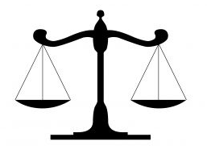
Deviations in worship of the church
Deviating from the “Gold Standard” of worship
TEKEL
“You have been weighed in the balances, and found wanting”

Slide 25
Deviations in worship of the church
Deviating from the “Gold Standard” of worship
    Mankind has a propensity to try and change God, and the worship to God, into what we want rather than what God wants.
    The focus of biblical worship should be God and Him alone
    Worship is to draw each of us closer to God, giving Him the fruit of our lips and the devotion of our heart because of what He has done for us.

Slide 26
Deviations in worship of the church
Deviating from the “Gold Standard” of worship
    Worship is about what we can give to God!

Slide 27
Deviations in worship of the church
Deviating from the “Gold Standard” of worship
Modern types of deviations in worship
    Entertainment
      The contemporary worship service: the use of modern (contemporary) music in an informal setting.
      A “worship leader” ensures that the audience is entertained in the worship service.

Slide 28
Deviations in worship of the church
Deviating from the “Gold Standard” of worship
Modern types of deviations in worship
    Entertainment
    “No longer can we afford the luxury of thinking that the people who are sitting in our pews are going to be there every Sunday. We have to arrest their attention. We have to use every device possible to reach them and to teach them and we need not be so apologetic about entertaining them. I mean, they've been entertained all week long, every time they turn around. I have no apology for putting a good singer in front of them to entertain them if they're not Christians; you've got to do something to reach them. . . .” Max Lucado, Preaching Magazine, 1993

Slide 29
Deviations in worship of the church
Deviating from the “Gold Standard” of worship
Modern types of deviations in worship
    Entertainment
      These actions are not taught nor demonstrated in the NT standard!

Slide 30
Deviations in worship of the church
Deviating from the “Gold Standard” of worship
Modern types of deviations in worship
    Entertainment
      Christians should not be obsessed with pleasure and entertainment. (Eccl. 2:1; 1 Tim. 5:6)
      The truth should be sufficient to draw us closer to God. (John 8:31-32)

Slide 31
Deviations in worship of the church
Deviating from the “Gold Standard” of worship
Modern types of deviations in worship
    Outward demonstrations of emotions
      Activities that were allowed or required in worship under the old law are not authorized under the new law that we are under.

Slide 32
Deviations in worship of the church
Deviating from the “Gold Standard” of worship
Modern types of deviations in worship
    Outward demonstrations of emotions
      Instrumental music & Dancing
      (Psalm 149:3; 150:3-5)
      Hand-clapping
      (Psalm 47:1)
      These actions are not taught nor demonstrated in the NT standard!

Slide 33
Deviations in worship of the church
Deviating from the “Gold Standard” of worship
Modern types of deviations in worship
    Changes to the structure and orderliness of the Lord’s Supper
      The symbols used: unleavened bread and fruit of the vine.
      How often to observe the Lord’s Supper.
      Structure of the Lord’s Supper.

Slide 34
Deviations in worship of the church
Deviating from the “Gold Standard” of worship
Modern types of deviations in worship
    Changes to the structure and orderliness of the Lord’s Supper
      Allow the actions that are taught and/or demonstrated in the NT standard to guide our decisions!

Slide 35
Deviations in worship of the church
Allowing the “Gold Standard” of God’s word to be our guide
Are we seeking our own righteousness or are we submitting to God’s righteousness?
  Romans 10:1-3

Slide 36
Deviations in worship of the church
Allowing the “Gold Standard” of God’s word to be our guide
As we worship God, our focus should be to “perfect holiness in the fear of God.” (2 Cor. 7:1)
How do we glorify God?
By doing what He tells us, in the manner that He tells us, doing it when He tells us, and the way He tells us, and where He tells us, and finally for the reason He tells us.

Slide 37
Deviations in worship of the church
Allowing the “Gold Standard” of God’s word to be our guide
Our worship should be done in the following manner:
  In reverence and fear (Hebrews 12:28; Ps. 89:7)
  In the beauty of His holiness (Ps. 96:9)
  In obedience to His will (Ps. 119:33-35)

Slide 38
Deviations in worship of the church
Allow God’s Word to be our guide…
  “The essence of true holiness is conformity to the nature and will of God.”
  (Samuel Lucas)

Slide 39

Deviations in worship of the church

