Slide 1


Teaching
Wayne Holt

Slide 2


Teaching
A privilege
A duty
A great responsibility
A time for learning
Without learning there is no teaching
Notes:
to help to learn; tell or show (how)
to give instruction or lessons in (a subject)
to cause to learn or understand

Slide 3

What To Teach
BIBLE is our textbook
Use of workbooks
Memory work
  Scripture
  Books of Bible
  Days of creation
  Generations
  Sons of Israel
  Plagues
  Judges
  Kings
  Apostles

Slide 4

Most Important Point
What is your assigned text/topic?
Know assigned material
Know the lesson

Slide 5

Most Important Point
What is the text teaching?

Slide 6

Who Are You Teaching?
Know your audience
Prior knowledge of text/topic
Background leading up to text/topic
Biblical examples
  Eunuch Acts 8
  Baptism of John Acts 19
  Acts 2 vs Acts 10

Slide 7

How To Teach
Make a statement of fact
  John 4
Discourse/Lecture
  Matthew 5-6-7
Ask a question
  Matthew 16
Tell a story/parable
  Matthew 13

Slide 8
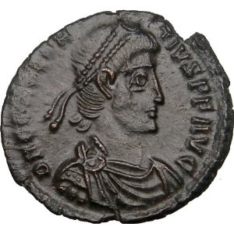
How To Teach
Use an object
  Matthew 22
Contrast
  Luke 16
Correct a wrong understanding
  John 4
If there was no failure, how would we know what success is?
... happy and sad
... up and down

Slide 9

P - I - E
Tell me I’ll forget
Show me I may remember
Involve me and I’ll understand
How to use an iPad
Present
Involve
Evaluate

Slide 10
Present
Lecture
Handout
Bulletin board
Marker board
PowerPoint
Illustration or Case Study

Slide 11
Involve
Debate
Field Trip
Panel Discussion
Quote memory verse
Read scripture
Answer questions (verbally)
Write on handout

Slide 12
Evaluate
Test
Homework
Listen to student
  quote verse
  answer question
What question did student ask?
Observation

Slide 13
Visual Aids
Handouts
Information sheets
Questions to do in preparation
Questions to do at beginning of class
During lesson presentation
  as a review/quiz

Slide 14
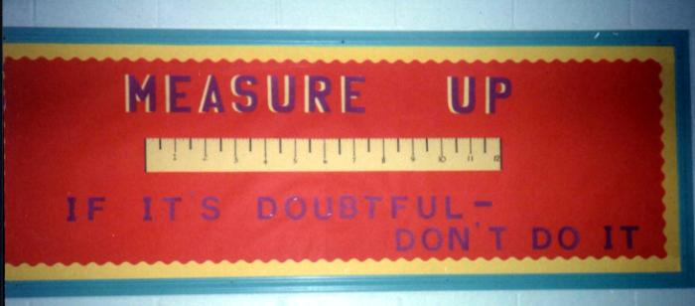
Visual Aids
Bulletin boards
Can be silent
Can be referenced during class

Slide 15
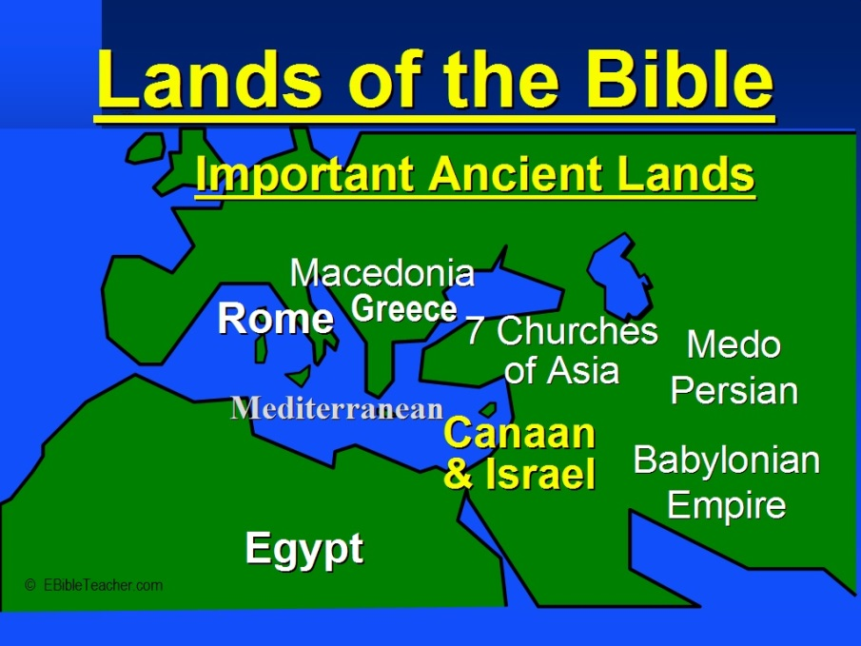
Visual Aids
Interactive
  have student do matching
  put a pin on a map, etc
Pictures
Drawings
Maps

Slide 16
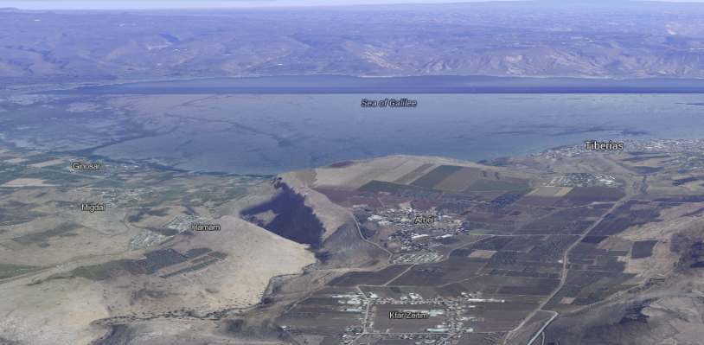
Visual Aids

Slide 17

Visual Aids

Slide 18

Visual Aids
PowerPoint
tool designed to augment your
presentation not be your presentation
Talk to the audience; not the screen
DO NOT read your slide
  (unless a direct quote)

Slide 19
Visual Aids
PowerPoint
Use pictures
Use font size that can be read
  “If people can’t read my slides from the back of the room, my type is too small.”
Not ‘busy’ – leave whitespace
4-6 lines of text

Slide 20
Visual Aids
PowerPoint
Avoid paragraphs or long blocks of text
  (unless direct quote)

Slide 21
Assyrian Empire
From their origins in a few major cities on the Tigris river in Northern Iraq—Nineveh, Ashur, and Kalakh—the Assyrians grew by the 9th century BC to control most of the Middle East, from Egypt to the Persian Gulf. Almost uniformly illiterate (not that unusual for the time) the Assyrians regarded warfare as their most important activity, and considered it a divinely-inspired goal to impose their gods upon conquered territories. They were the first major power to equip soldiers with iron weapons and to master the tactics of the light horse-drawn chariot, and this, combined with their superb military organization, turned them into the most successful fighting power the ancient world had yet seen. At its height the Assyrian army numbered in the hundreds of thousands, and the thunder of its chariotry inspired fear in all who heard it.

Slide 22
Don’t

Slide 24
Overuse
Overuse

Slide 25
animation

Slide 26
Visual Aids
PowerPoint
Use, but don’t overuse animation
  Remember, often less is more
  Fancy slide transitions and fly-ins get old quickly
Limit the number of slides
Keep it simple
  Your slides must not distract from your presentation

Slide 27
Summary
What to teach – Bible; assignment
Know your material (scripture)
Who are you teaching?
Biblical examples of how to teach
Present, Involve, Evaluate
Use of visual aids

