Slide 1
…

Slide 2
Life of Christ, part 2 Close of Jesus’ Ministry
Lesson 1
John 7:1—8:20

Slide 3
Intro
Years of preparation – 30 yrs
Beginning of ministry – 6 mos
Great Galilean ministry – 18 mos
Period of retirements – 6 mos
Close of ministry – 6 mos
Last week
Resurrection and exaltation

Slide 4
Period of Retirements
review

Slide 5
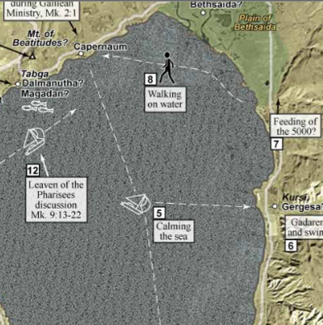

Looking for Quiet
Jesus went to Bethsaida
He crosses the sea via boat
Crowds run around the sides of the sea

Slide 6
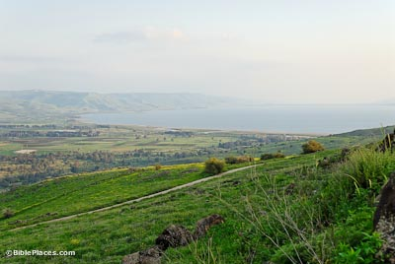
…

Slide 7
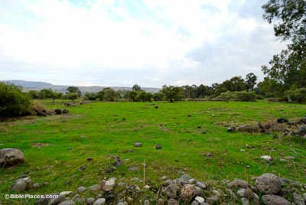
…

Slide 8
Notes
John 6:4 Now the Passover, a feast of the Jews, was near.
April of our year
Feeding of five thousand only miracle recorded in all four gospels
one year until crucifixion

Slide 9
Feeding of Five Thousand Matt 14:13-21; Mark 6:30-44; Luke 9:10-17; John 6:1-14
Jesus continues to heal the sick and teach the people—compassion
Evening comes and it is time to eat
In a deserted place
‘send the crowd away’
“You give them something to eat”
Only five barley loaves and two small fishes
Barley loaves eaten by the poorer
‘sardine’ size fishes

Slide 10
The Second Retirement

Slide 11
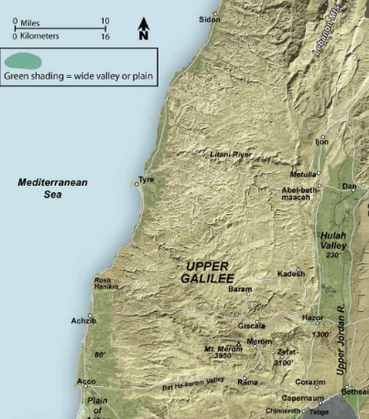
Looking for Quiet Matthew 15:21-28; Mark 7:24-30
Jesus went to the region of Tyre and Sidon
Sidon
Tyre
Sea of Galilee

Slide 12
The Third Retirement

Slide 13
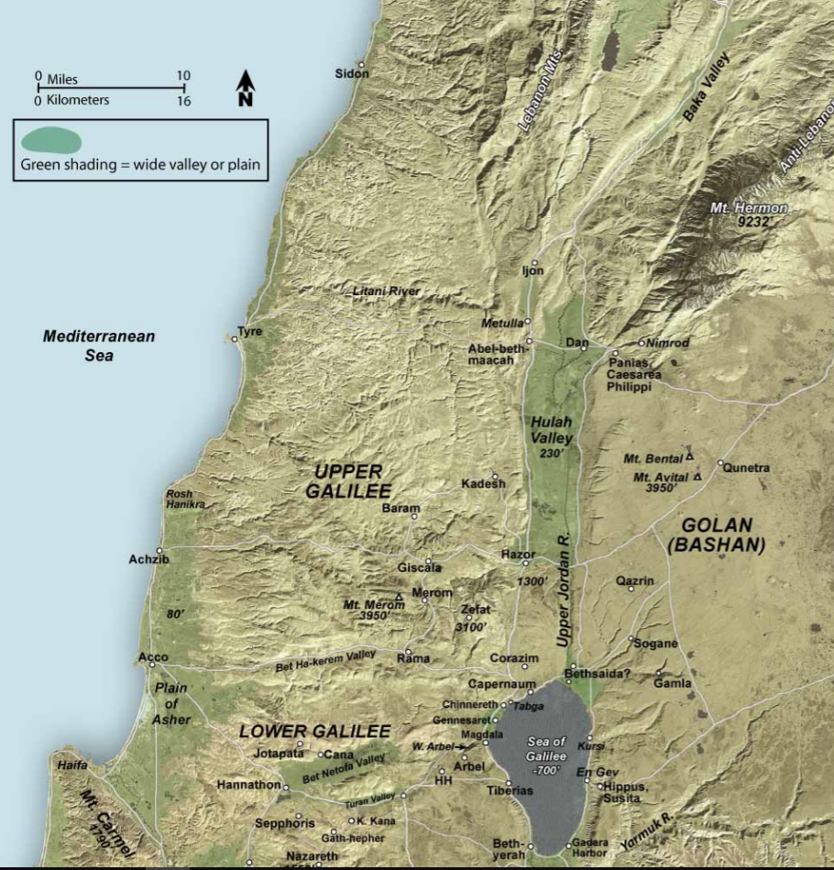
…

Slide 14
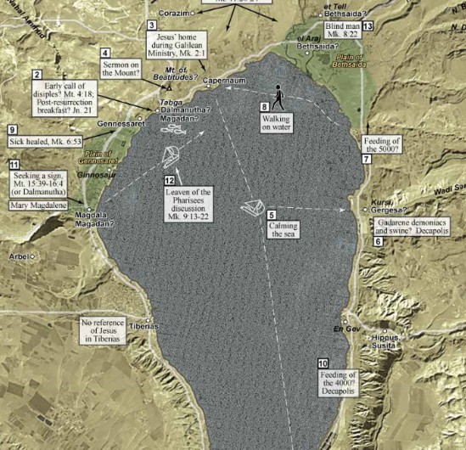
…

Slide 15
Feeding of 4,000
The multitude hearing Jesus had grown large
They had been with Jesus three days and have nothing to eat
Some had come from a far distance
Jesus asked how much food was available
Seven loaves and a few fishes

Slide 16
…

Slide 17
The Fourth Retirement

Slide 18
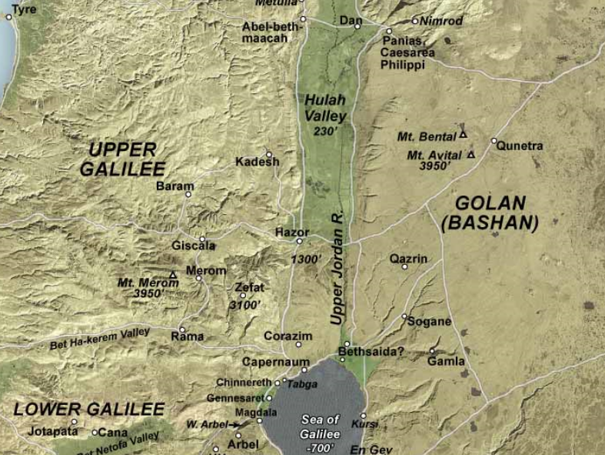
…

Slide 19
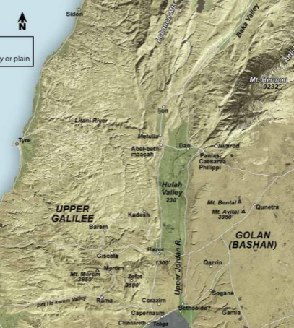
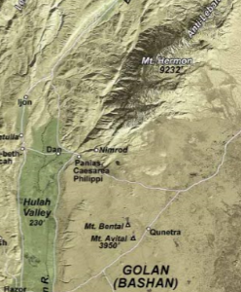
Peter’s Confession
Jesus asked the apostles who men thought He was
Then, who do you say that I am?
Notes:
One way to teach—have students draw a conclusion then correct as necessary (P-I-E)

Slide 20
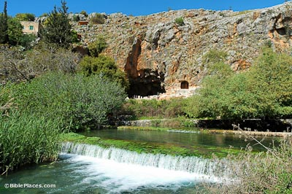
…

Slide 21
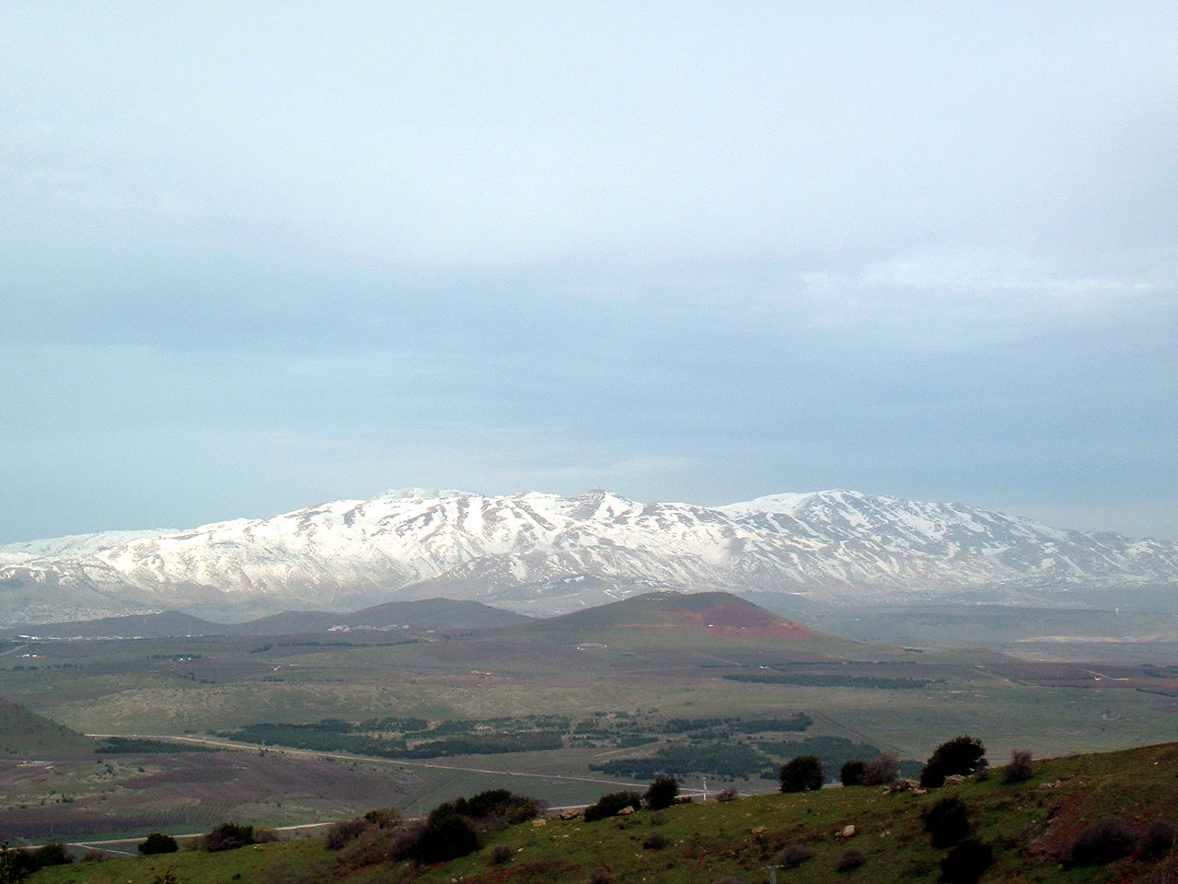
The Transfiguration Matthew 17:1-13; Mark 8:1-13; Luke 9:28-36
Jesus took Peter, James, and John up to a high mountain

Slide 22
Intro
Years of preparation – 30 yrs
Beginning of ministry – 6 mos
Great Galilean ministry – 18 mos
Period of retirements – 6 mos
Close of ministry – 6 mos
Last week
Resurrection and exaltation
Notes:
Question: "What is the Feast of Tabernacles?" Answer:The Feast of Tabernacles, also known as the Feast of Booths and Sukkot, is the seventh and last feast that the Lord commanded Israel to observe and one of the three feasts that Jews were to observe each year by going to “appear before the Lord your God in the place which He shall choose” (Deuteronomy 16:16). The importance of the Feast of Tabernacles can be seen in how many places it is mentioned in Scripture. In the Bible we see many important events that took place at the time of the Feast of Tabernacles. For one thing, it was at this time thatSolomon’s Templewas dedicated to the Lord (1 Kings 8:2). It was also at the Feast of Tabernacles that the Israelites, who had returned to rebuild the Temple, gathered together to hear Ezra proclaim the word of God to them (Nehemiah 8). Ezra’s preaching resulted in a great revival as the Israelites confessed their sins and repented of them. It was also during this Feast that Jesus said, “If anyone thirsts, let him come to me and drink. He who believes in Me, as the Scripture has said, out of his heart will flow rivers of living water” (John 7:37-39). The Feast of Tabernacles takes place on the 15th of the Hebrew month Tishri. This was the seventh month on the Hebrew calendar and usually occurs in late September to mid-October. The feast begins five days after the Day of Atonement and at the time the fall harvest had just been completed. It was a time of joyous celebration as the Israelites celebrated God’s continued provision for them from the current harvest and also to remember and celebrate His provision and protection during the 40 years in the wilderness. As one of the three feasts that all “native born” male Jews were commanded to participate in, the Feast of Tabernacles is mentioned multiple times in Scripture, sometimes called the Feast of the Ingathering, the Feast to the Lord, or the Feast of Booths (Exodus 23:16;Deuteronomy 16:13). As one of the pilgrim feasts (when Jewish males were commanded to go to Jerusalem), it was also the time when they brought their tithes and offerings to the Temple (Deuteronomy 16:16). With all the influx of people coming to Jerusalem at that time, we can only imagine what the scene must have been like. Thousands upon thousands of people coming together to remember and celebrate God’s deliverance and His provision, all living in temporary shelters or booths as part of the requirements of the feast. During the eight-day period, so many sacrifices were made that it required all twenty-four divisions of priests to be present to assist in the sacrificial duties. We find God’s instructions for celebrating the Feast of Tabernacles in Leviticus 23, given at a point in history right after God had delivered Israel from bondage in Egypt. The feast was to be celebrated each year on “the fifteenth day of this seventh month” and was to run for seven days (Leviticus 23:34). Like all feasts, it begins with a “holy convocation” or Sabbath day where the Israelites were to stop working to set aside the day for worshiping God. On each day of the feast they were to offer an “offering made by fire to the Lord” and then after seven days of feasting, again the eighth day was to be “a holy convocation” when they were to cease from work and offer another sacrifice to God (Leviticus 23). Lasting eight days, the Feast of Tabernacles begins and ends with a Sabbath day of rest. During the eight days of the feast, the Israelites would dwell in booths or tabernacles that were made from the branches of trees (Leviticus 23:40-42). The Feast of Tabernacles, like all the feasts, was instituted by God as a way of reminding Israelites in every generation of their deliverance by God from Egypt. Of course the feasts are also significant in that they foreshadow the work and actions of the coming Messiah. Much of Jesus’ public ministry took place in conjunction with the Holy Feasts set forth by God. Like other parts of the Old Testament ceremonial and sacrificial system, the feasts are a foreshadowing of what the coming Messiah, Jesus Christ, would and did accomplish. The three pilgrim feasts where all Jewish males were commanded to “appear before the Lord in the place he chooses” are each very important in regards to the life of Christ and His work of redemption. We know with certainty that the Passover and the Feast of Unleavened Bread are symbolic of Christ’s atoning sacrifice on the cross. Likewise we know that Pentecost, which marked the beginning of the Feast of Weeks, was the time of Jesus’ bodily ascension. And most scholars would agree that the Feast of Tabernacles is symbolic of Christ’s Second Coming when He will establish His earthly kingdom. The Feast of Tabernacles begins and ends with a special Sabbath day of rest. During the days of the feast all native Israelites were “to dwell in booths” to remind them that God delivered them out of the “land of Egypt” and to look forward to the coming Messiah, Jesus Christ, who would deliver His people from the bondage of sin. This feast, like all of the feasts of Israel, consistently reminded the Jews and should remind Christians as well that God has promised to deliver His people from the bondage of sin and deliver them from their enemies. Part of God’s deliverance for the Israelites was His provision and protection of them for the 40 years they wandered in the wilderness, cut off from the Promised Land. The same holds true for Christians today. God protects us and provides for us as we go through life in the wilderness of this world. While our hearts long for the Promised Land (heaven) and to be in the presence of God, He preserves us in this world as we await the world to come and the redemption that will come when Jesus Christ returns again to “tabernacle” or dwell among us in bodily form. Recommended Resources:Our Father Abraham: Jewish Roots of the Christian Faith by Marvin WilsonandLogos Bible Software.
While he is not the author of every article on GotQuestions.org, for citation purposes, you may reference our CEO, S. Michael Houdmann.
Read more:http://www.gotquestions.org/Feast-of-Tabernacles.html#ixzz2m34tVVJ0

Slide 23
Intro
Feast of Tabernacles
Leviticus 23:23-43; Nehemiah 8:16-18
Late September, early October
Every male Jew was to attend
Day of Atonement
Special sacrifices
Six months before Jesus’ death
Would die in spring
During Feast of Passover
Notes:
Question: "What is the Day of Atonement (Yom Kippur)?" Answer:The Day of Atonement (Leviticus 23:27-28), also known as Yom Kippur, was the most solemn holy day of all the Israelite feasts and festivals, occurring once a year on the tenth day of Tishri, the seventh month of the Hebrew calendar. On that day, the high priest was to perform elaborate rituals to atone for the sins of the people. Described inLeviticus 16:1-34, the atonement ritual began with Aaron, or subsequent high priests of Israel, coming into the holy of holies. The solemnity of the day was underscored by God telling Moses to warn Aaron not to come into the Most Holy Place whenever he felt like it, only on this special day once a year, lest he die (v. 2). This was not a ceremony to be taken lightly, and the people were to understand that atonement for sin was to be done God’s way. Before entering the tabernacle, Aaron was to bathe and put on special garments (v. 4), then sacrifice a bull for a sin offering for himself and his family (v. 6, 11). The blood of the bull was to be sprinkled on the ark of the covenant. Then Aaron was to bring two goats, one to be sacrificed “because of the uncleanness and rebellion of the Israelites, whatever their sins have been” (v. 16), and its blood was sprinkled on the ark of the covenant. The other goat was used as a scapegoat. Aaron placed his hands on its head, confessed over it the rebellion and wickedness of the Israelites, and sent the goat out with an appointed man who released it into the wilderness (v. 21). The goat carried on itself all the sins of the people, which were forgiven for another year (v. 30). Read more:http://www.gotquestions.org/Day-Atonement-Yom-Kippur.html#ixzz2m36URIbp
The Day of Atonement in The Old Testament
(This Study Covers Leviticus 16:1-28; 23:26-32, Numbers 29:7-11)
While the work in the courtyard and the holy place was performed every day, the work of the most holy place was performed only once a year. Day by day the repentant sinner brought his offering to the door of the sanctuary and placing his hand upon the victim’s head, confessed his sins, thus in symbol transferred them from himself to the innocent sacrifice. Such was the work that went on each day, throughout the year. The sins of Israel were thus transferred to the sanctuary, and a special work became necessary for their removal. Once a year, on the Day of Atonement, the high priest entered the most holy place for the cleansing of the sanctuary. The work of the Day of Atonement in the most holy place symbolizes the third and final phase of the ministry of Jesus. Let us examine the events of this, the most solemn day in the life of ancient Israel.
1. What was contained in the second apartment, or the most holy place? Exodus 40:20, 21 He took the Testimony and put it into the ark, inserted the poles through the rings of the ark, and put the mercy seat on top of the ark. And he brought the ark into the tabernacle, hung up the veil of the covering, and partitioned off the ark of the Testimony, as the LORD had commanded Moses.
Note: The Second Apartment, or Most Holy Place (Exodus 26:33) contained the Ark of the Covenant (Exodus 26:17-22). Between two Cherubim was the glory of the Shekinah the Presence of God (Exodus 26: 22; 40:34). Beneath it was the Mercy Seat, a solid gold slab that covered the top of the Ark, wherein lay the foundation of God's government: the Moral law of Ten Commandments (Exodus 20:3-17) which was written by the finger of God on stone (Exodus 24:12) and then placed in the Ark (Exodus 40:20). All of mankind is to be governed by those holy precepts, even down to the end of time (Revelation 12:17; 14:12) and beyond (Revelation 22:14; Isaiah 66:22).
2. Where was God, by the symbol of His presence, to meet with Israel's high priest? Exodus 25:22 "And there I will meet with you, and I will speak with you from above the mercy seat, from between the two cherubim which are on the ark of the Testimony, about everything which I will give you in commandment to the children of Israel.”
3. Who only was allowed in the second apartment? How often? And for what purpose? Hebrews 9:7 “But into the second part the high priest went alone once a year, not without blood, which he offered for himself and for the people's sins committed in ignorance.”

Slide 24
Jews wanted to kill Jesus
Jews
People, nation
Leaders
Pharisees
Sanhedrin
Pharisees in Galilee
Matthew 12:14
Jews of Jerusalem
John 5:18
Notes:
Definition: The Sanhedrin was the supreme council, or court, in ancient Israel.
The Sanhedrin was comprised of 70 men, plus the high priest, who served as its president. The members came from the chief priests, scribes and elders, but there is no record on how they were chosen.
During the time of the Roman governors, such as Pontius Pilate, the Sanhedrin had jurisdiction only over the province of Judea. The Sanhedrin had its own police force which could arrest people, as they did Jesus Christ. While the Sanhedrin heard both civil and criminal cases and could impose the death penalty, in New Testament times it did not have the authority to execute convicted criminals. That power was reserved to the Romans, which explains why Jesus was crucified—a Roman punishment—rather than stoned, according to Mosaic law.
The Sanhedrin was abolished with the fall of Jerusalem and the destruction of the Temple in 70 A.D.
Mt 12:14 ¶ Then the Pharisees went out and plotted against Him, how they might destroy Him.
Joh 5:18 Therefore the Jews sought all the more to kill Him, because He not only broke the Sabbath, but also said that God was His Father, making Himself equal with God.

Slide 25
To the Feast of Tabernacles
Jesus delayed going
My time is not yet come
Went during the middle of the feast
Jews (leaders) watching for Him
Mixed sentiments
Taught formally in the temple
“Where did He get His learning?”
Notes:
John 7
1 – in Galilee; Jews in Judea want to kill Him
2 – time is Feast of Tabernacles (all males required to go)
[5 – brothers did not believe in him]
3 – brothers say it is time to go to Jerusalem….
Brothers went to Jerusalem, Jesus remained in Galilee
10 – Jesus goes later, secretly
11 – Jews (leaders) ar looking for Him
12 – some say good, some that He is a deceiver
14 – teaching in the temple
15 – never studied under a Jewish rabbi (like Paul at the feet of Gamaliel)

Slide 26
Jesus’ teaching
My doctrine (teaching) is from God
Want to do God’s will?
Know the doctrine is not from Me
I don’t seek My own glory
But glory of One who sent Me

Slide 27
Why kill me?
Why do you seek to kill me?
People thought he was ‘crazy’
Didn’t know of leaders’ plots
Healed on Sabbath
Possibly John 5:5-13
Circumcise on Sabbath
Use righteous judgment
Notes:
Joh 5:5 Now a certain man was there who had an infirmity thirty-eight years.
6 When Jesus saw him lying there, and knew that he already had been in that condition a long time, He said to him, "Do you want to be made well?"
7 The sick man answered Him, "Sir, I have no man to put me into the pool when the water is stirred up; but while I am coming, another steps down before me."
8 Jesus said to him, "Rise, take up your bed and walk."
9 And immediately the man was made well, took up his bed, and walked. And that day was the Sabbath.
10 The Jews therefore said to him who was cured, "It is the Sabbath; it is not lawful for you to carry your bed."
11 He answered them, "He who made me well said to me, 'Take up your bed and walk.'"
12 Then they asked him, "Who is the Man who said to you, 'Take up your bed and walk'?"
13 But the one who was healed did not know who it was, for Jesus had withdrawn, a multitude being in that place.
Albert Barnes' NT Commentary:
Verse 24. Judge not according to the appearance. Not as a thing first offers itself to you, without reflection or candour. In appearance, to circumcise a child on the Sabbath might be a violation of the law; yet you do it, and it is right. So, to appearance, it might be a violation of the Sabbath to heal a man, yet it is right to do works of necessity and mercy.
Judge righteous judgment. Candidly; looking at the law, and inquiring what its spirit really requires.

Slide 28
Where was Jesus from?
Seems some did not know
Should they know?
Can anyone do more signs than He?
I’m going where you cannot find Me
Where could He be going?
To the Greeks?

Slide 29
Jesus preaching
On the last day of the feast
"If anyone thirsts, let him come to Me and drink
Those who believed would receive the Spirit
Not yet come (Acts 2:4)
Jesus not yet glorified (John 17:1ff)

Slide 30
Where was Jesus from?
Some said, “This is the Christ”
Must come from Bethlehem
Jesus is from Galilee??
Seed of David
From Bethlehem
People were divided

Slide 31
Go get Him
Soldiers had been sent to get Jesus
Returned without Him
No man ever spoke as He
Nicodemus spoke up
We must judge him fairly
Seems some of his associates turn on him

Slide 32
Go get Him
No prophet comes from Galilee
Jonah
2 Kings 14:25
Christ would come from Galilee
Isaiah 9:1-2
Matthew 4:13-16
Prophecy tied directly to Christ
Notes:
2 Ki 14:25 He restored the territory of Israel from the entrance of Hamath to the Sea of the Arabah, according to the word of the LORD God of Israel, which He had spoken through His servant Jonah the son of Amittai, the prophet who was from Gath Hepher.
Isa 9:1 Nevertheless the gloom will not be upon her who is distressed, As when at first He lightly esteemed The land of Zebulun and the land of Naphtali, And afterward more heavily oppressed her, By the way of the sea, beyond the Jordan, In Galilee of the Gentiles.
2 The people who walked in darkness Have seen a great light; Those who dwelt in the land of the shadow of death, Upon them a light has shined.
Mt 4:13 And leaving Nazareth, He came and dwelt in Capernaum, which is by the sea, in the regions of Zebulun and Naphtali,
14 that it might be fulfilled which was spoken by Isaiah the prophet, saying:
15 "The land of Zebulun and the land of Naphtali, By the way of the sea, beyond the Jordan, Galilee of the Gentiles:
16 The people who sat in darkness have seen a great light, And upon those who sat in the region and shadow of death Light has dawned."

Slide 33
Tempting Jesus
Woman caught in adultery
Same punishment for man and woman
Leviticus 20:10
Deuteronomy 22:22
Pharisees bring her to Jesus
[The Jews are under Roman rule and could not execute anyone]
Notes:
Le 20:10 'The man who commits adultery with another man's wife, he who commits adultery with his neighbor's wife, the adulterer and the adulteress, shall surely be put to death.
Adam Clarke's Commentary:
Verse 5. That such should be stoned] It is not strictly true that Moses ordered adultery in general to be punished by stoning. The law simply says that the adulterer and the adulteress shall be put to death. Le 20:10; De 22:22. The rabbins say they were strangled. This they affirm was the ordinary mode of punishment, where the species of death was not marked in the law, If the person guilty of an act of this kind had been betrothed, but not married, she was to be stoned: De 22:23. But if she was the daughter of a priest, she was to be burned alive: Le 16:9. It appears, from Eze 16:38,40, that adulteresses in the time of that prophet were stoned, and pierced with a sword.
Selden and Fagius suppose that this woman's case was the same with that mentioned, De 22:23. If a damsel that is a virgin be betrothed unto a husband, and a man find her in the city, and lie with her; then ye shall stone them with stones that they die, the damsel because she cried not, and the man because he hath humbled his neighbours wife. As the Pharisees spoke of stoning the woman, it is possible this was her case; and some suppose that the apparent indulgence with which our Lord treated her insinuates that she had suffered some sort of violence, though not entirely innocent. Therefore he said, I do not condemn thee, i.e. to death, because violence had been used. Sin no more. Nevertheless thou art in certain respects guilty; thou mightest have made more resistance.

Slide 34
Tempting Jesus
What is happening?
Woman was in sin
Law demanded death
Pharisees were hypocrites
Jesus wanted compassion and mercy

Slide 35
Tempting Jesus
At first, Jesus knowing their purpose ignored them (wrote in dirt)
Let him who is without sin cast the first stone
Witness must cast first stone
Deuteronomy 17:7
This would be lawful justice
Notes:
De 17:5 "then you shall bring out to your gates that man or woman who has committed that wicked thing, and shall stone to death that man or woman with stones.
6 "Whoever is deserving of death shall be put to death on the testimony of two or three witnesses; he shall not be put to death on the testimony of one witness.
7 "The hands of the witnesses shall be the first against him to put him to death, and afterward the hands of all the people. So you shall put away the evil from among you.

Slide 36
Tempting Jesus
Called their bluff
All left
From oldest to youngest
Convicted by their own conscience

Slide 37
Jesus to the woman
Neither do I condemn you
Would He condemn adultery?
He was not a witness to adultery
Go your way and sin no more
Nothing said about forgivness
Not about justice for sin committed
Rather hypocrisy of Jews
And Jesus’ mercy

Slide 38
“I am the light of the world”
Follow Me and not walk in darkness
Jesus accused of bearing witness for Himself
Two witnesses (as law required)
“I bear witness of Myself”
The Father bears witness of Me
No one arrested Him for His hour had not yet come

Slide 39
Lessons
They did not know Jesus
Did not know where He was from
And why that was important?
How do we avoid similar charges?

Slide 40
Lessons
Jews were using the Law
Jesus was showing mercy and compassion
Did Jesus violate the Law by not stoning this adulteress?
How do we mix these today?

Slide 41
Lessons
How does this example affect our dealing with sin in the church today?
Consider
Romans 16:16
1 Corinthians 5
2 Thessalonians 3:6,14
Must we be sinless to condemn?
Consider Matthew 7:1-5
Notes:
Ro 16:16 Greet one another with a holy kiss. The churches of Christ greet you.
1Co 5: 1 It is actually reported that there is sexual immorality among you, and such sexual immorality as is not even named among the Gentiles--that a man has his father's wife!
2 And you are puffed up, and have not rather mourned, that he who has done this deed might be taken away from among you.
3 For I indeed, as absent in body but present in spirit, have already judged (as though I were present) him who has so done this deed.
4 In the name of our Lord Jesus Christ, when you are gathered together, along with my spirit, with the power of our Lord Jesus Christ,
5 deliver such a one to Satan for the destruction of the flesh, that his spirit may be saved in the day of the Lord Jesus.
6 Your glorying is not good. Do you not know that a little leaven leavens the whole lump?
7 Therefore purge out the old leaven, that you may be a new lump, since you truly are unleavened. For indeed Christ, our Passover, was sacrificed for us.
8 Therefore let us keep the feast, not with old leaven, nor with the leaven of malice and wickedness, but with the unleavened bread of sincerity and truth.
9 I wrote to you in my epistle not to keep company with sexually immoral people.
10 Yet I certainly did not mean with the sexually immoral people of this world, or with the covetous, or extortioners, or idolaters, since then you would need to go out of the world.
11 But now I have written to you not to keep company with anyone named a brother, who is sexually immoral, or covetous, or an idolater, or a reviler, or a drunkard, or an extortioner--not even to eat with such a person.
12 For what have I to do with judging those also who are outside? Do you not judge those who are inside?
13 But those who are outside God judges. Therefore "put away from yourselves the evil person."
(NKJV)
2Th 3:6 But we command you, brethren, in the name of our Lord Jesus Christ, that you withdraw from every brother who walks disorderly and not according to the tradition which he received from us.
2Th 3:14 And if anyone does not obey our word in this epistle, note that person and do not keep company with him, that he may be ashamed.
Mt 7:1 "Judge not, that you be not judged.
2 "For with what judgment you judge, you will be judged; and with the measure you use, it will be measured back to you.
3 "And why do you look at the speck in your brother's eye, but do not consider the plank in your own eye?
4 "Or how can you say to your brother, 'Let me remove the speck from your eye'; and look, a plank is in your own eye?
5 "Hypocrite! First remove the plank from your own eye, and then you will see clearly to remove the speck from your brother's eye.
Mt 7:15 "Beware of false prophets, who come to you in sheep's clothing, but inwardly they are ravenous wolves.
Joh 7:24 "Do not judge according to appearance, but judge with righteous judgment.“
1Co 10:15 I speak as to wise men; judge for yourselves what I say.
1Jo 4:1 Beloved, do not believe every spirit, but test the spirits, whether they are of God; because many false prophets have gone out into the world.

Slide 42
…

