Slide 1
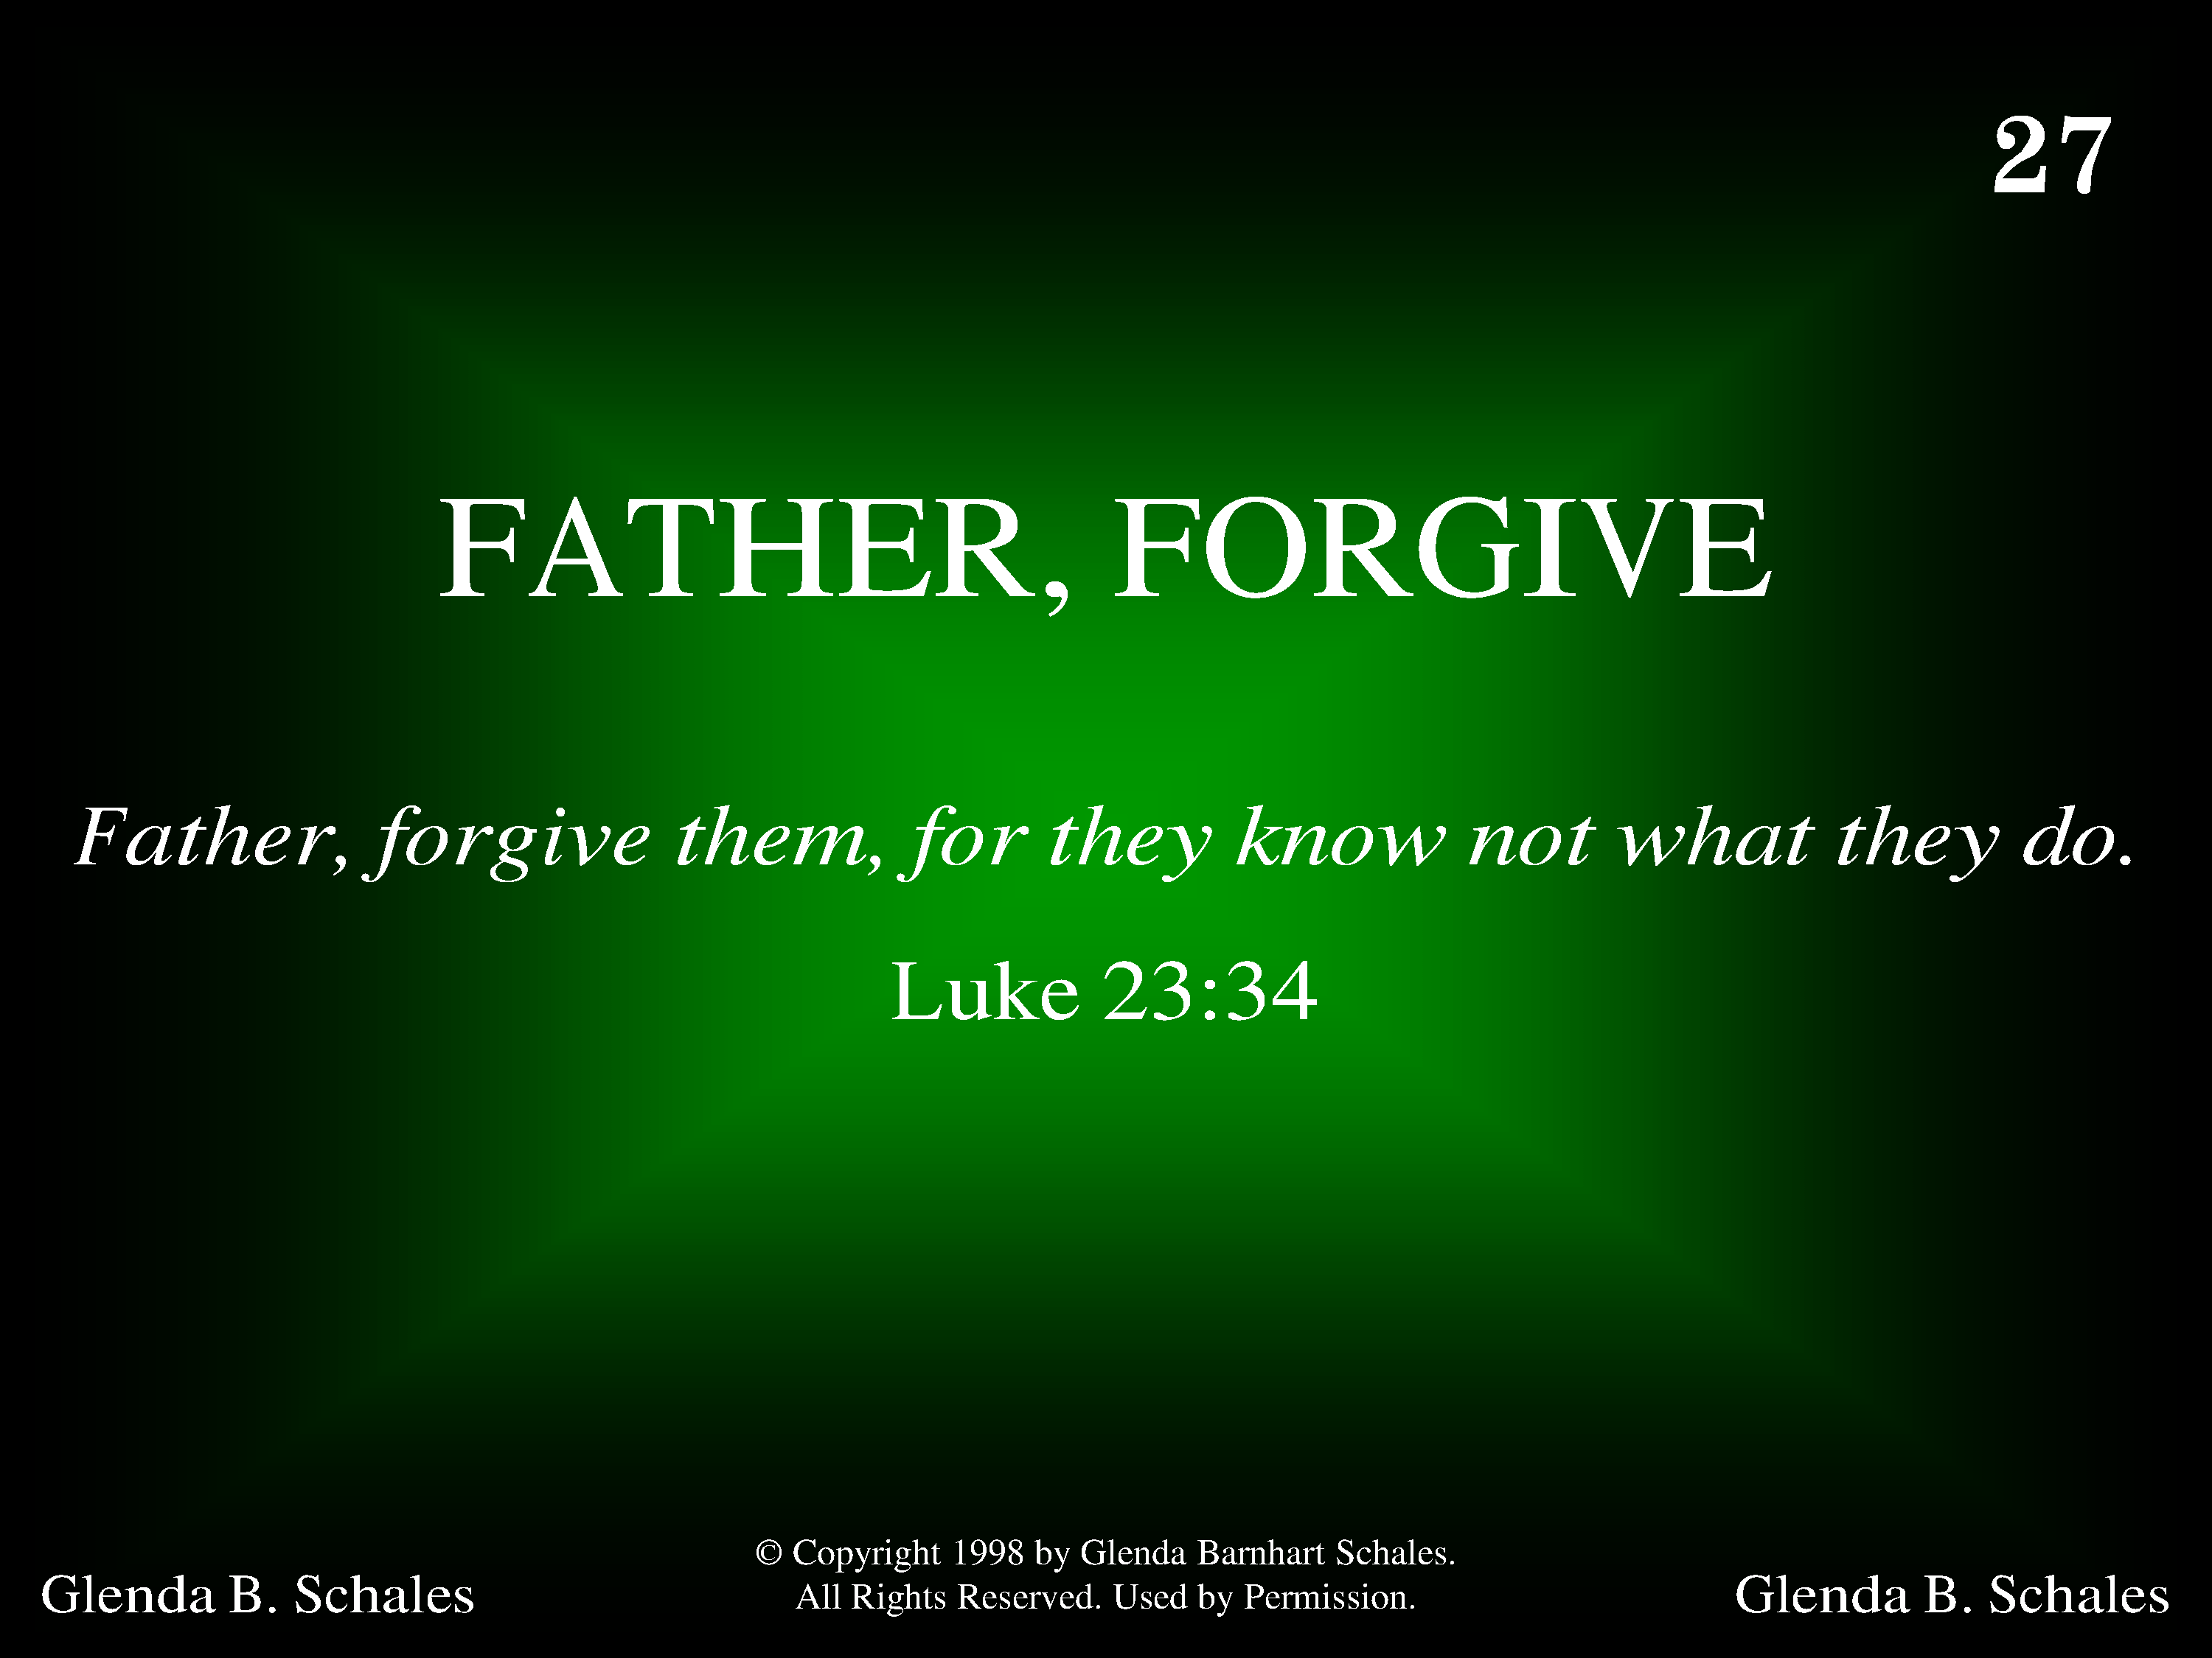
1027 - Father, Forgive - Title

Slide 2
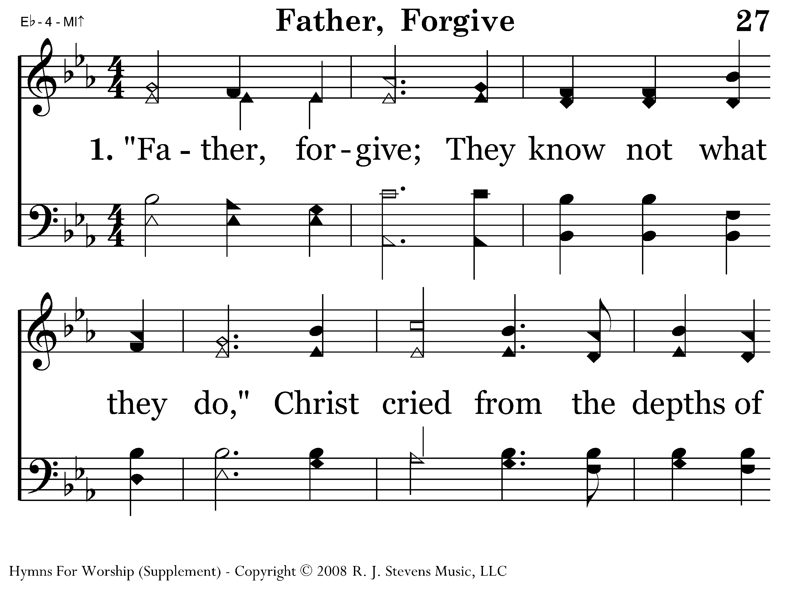
1027 - Father, Forgive - 1.1

Slide 3
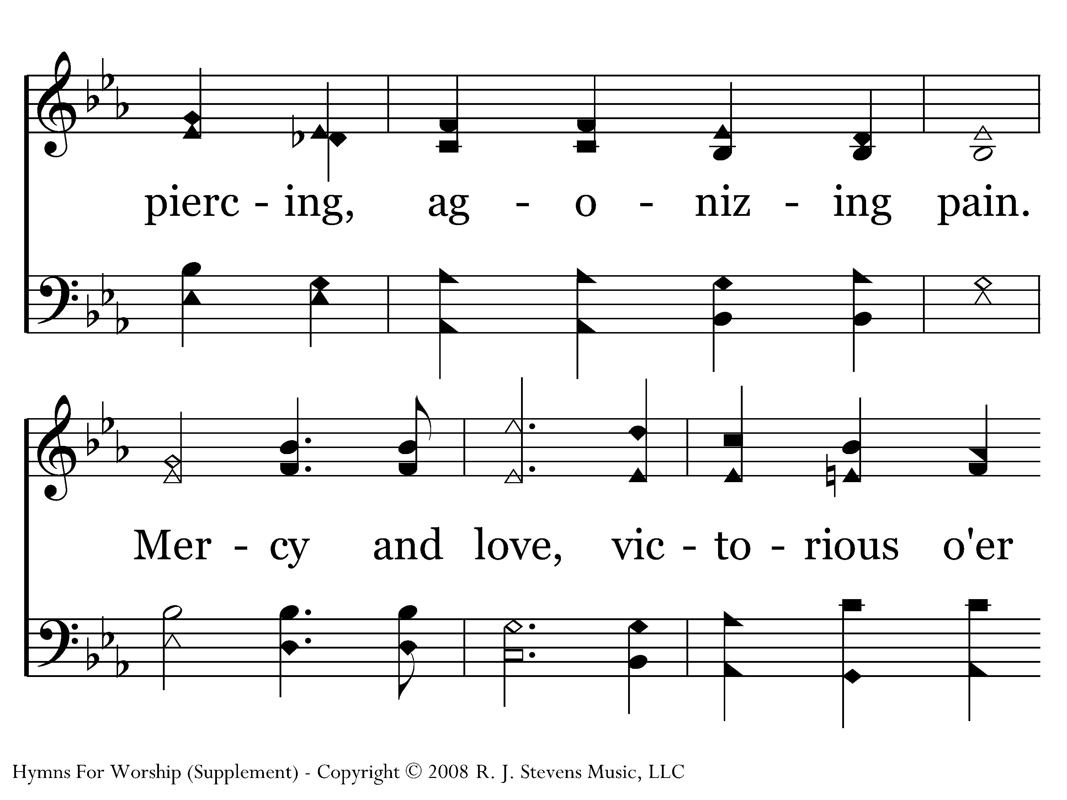
1027 - Father, Forgive - 1.2

Slide 4
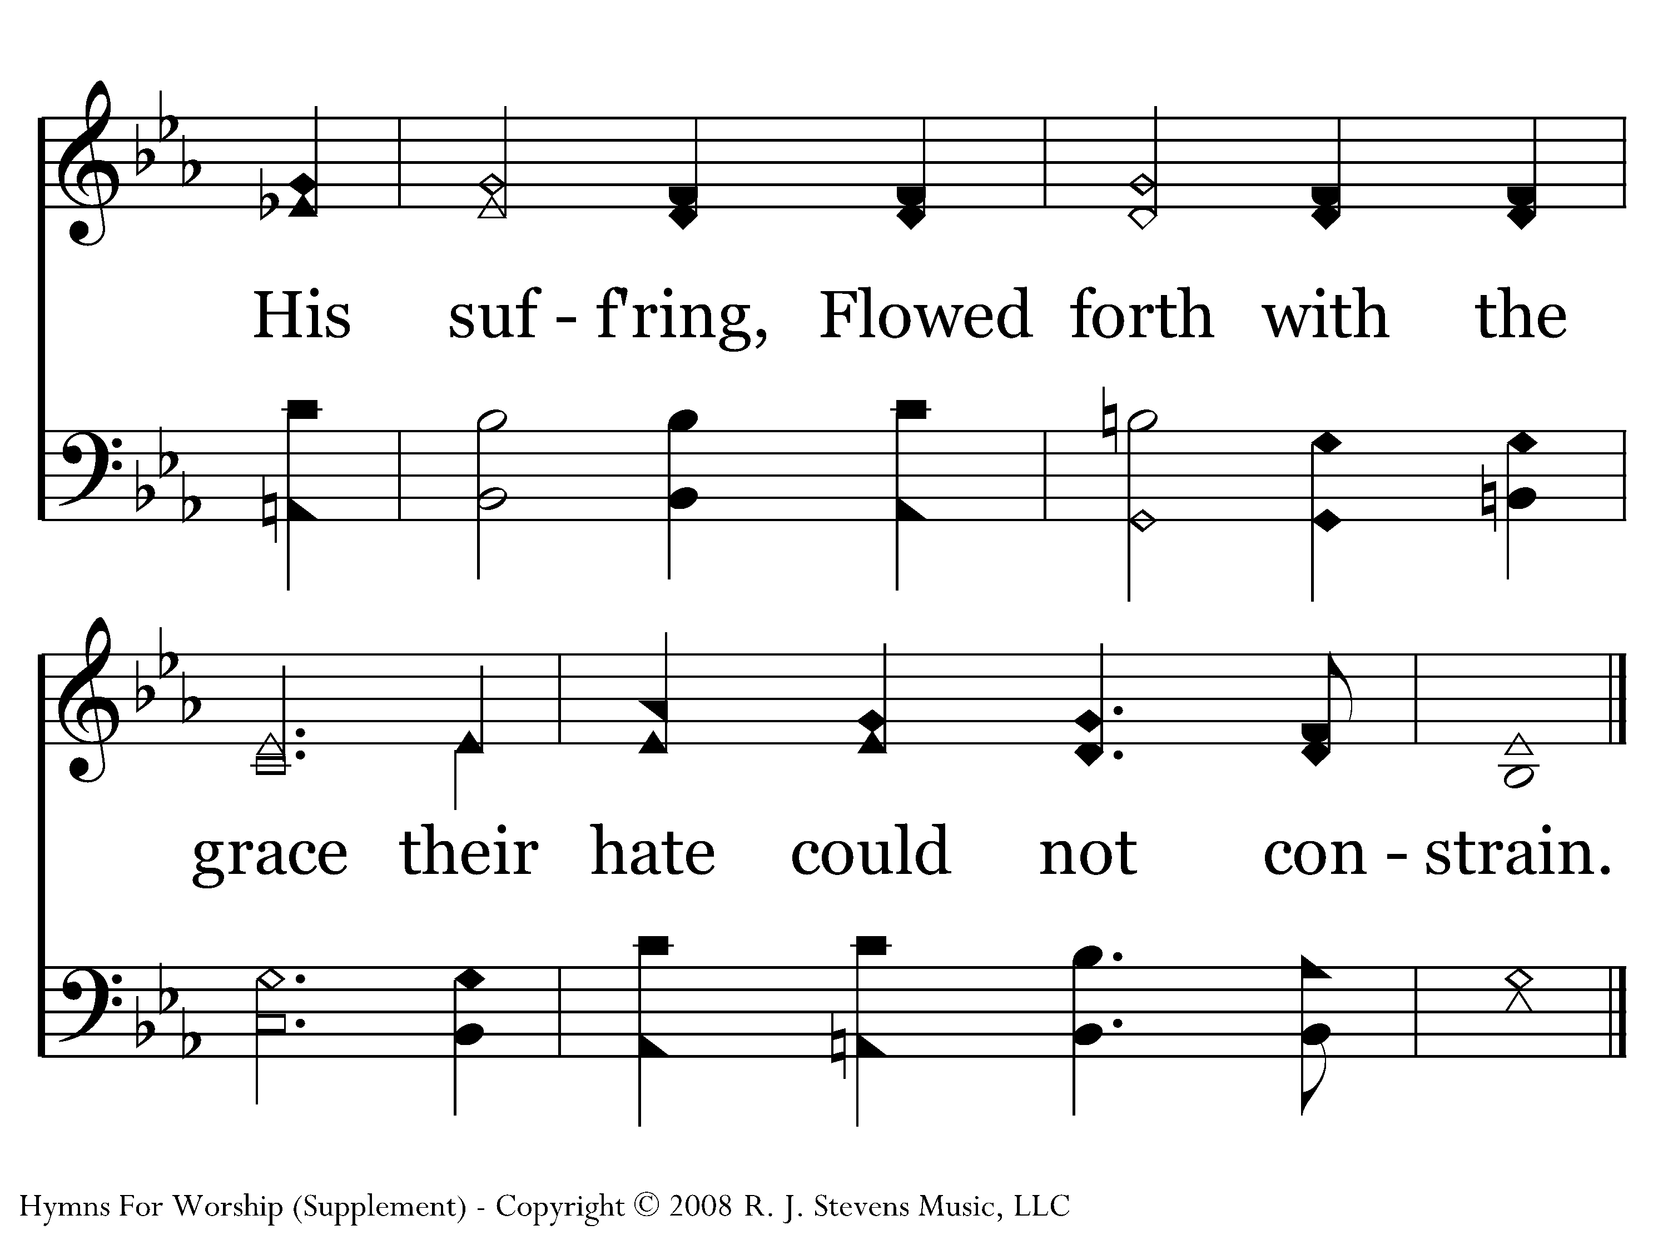
1027 - Father, Forgive - 1.3
End of Verse 1

Slide 5
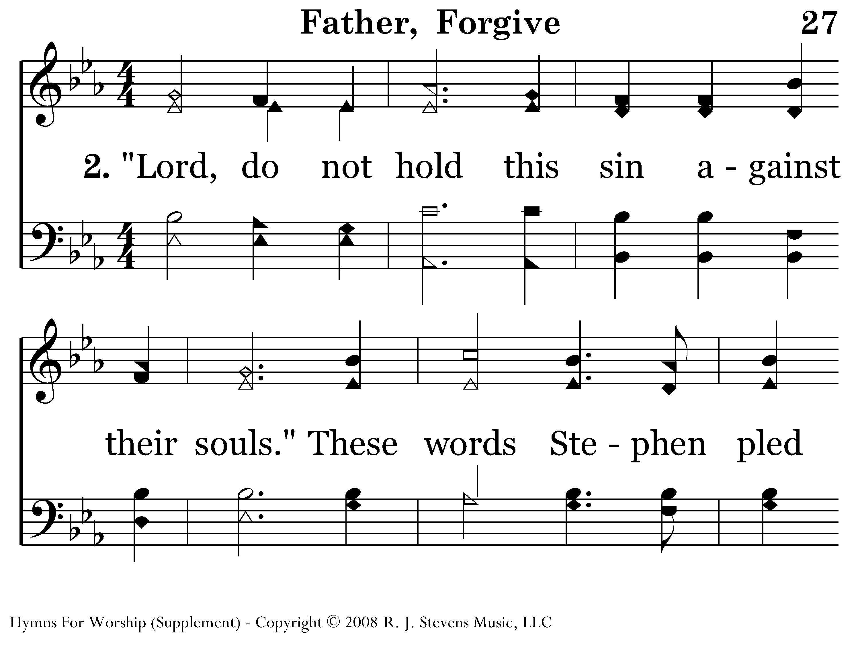
1027 - Father, Forgive - 2.1

Slide 6
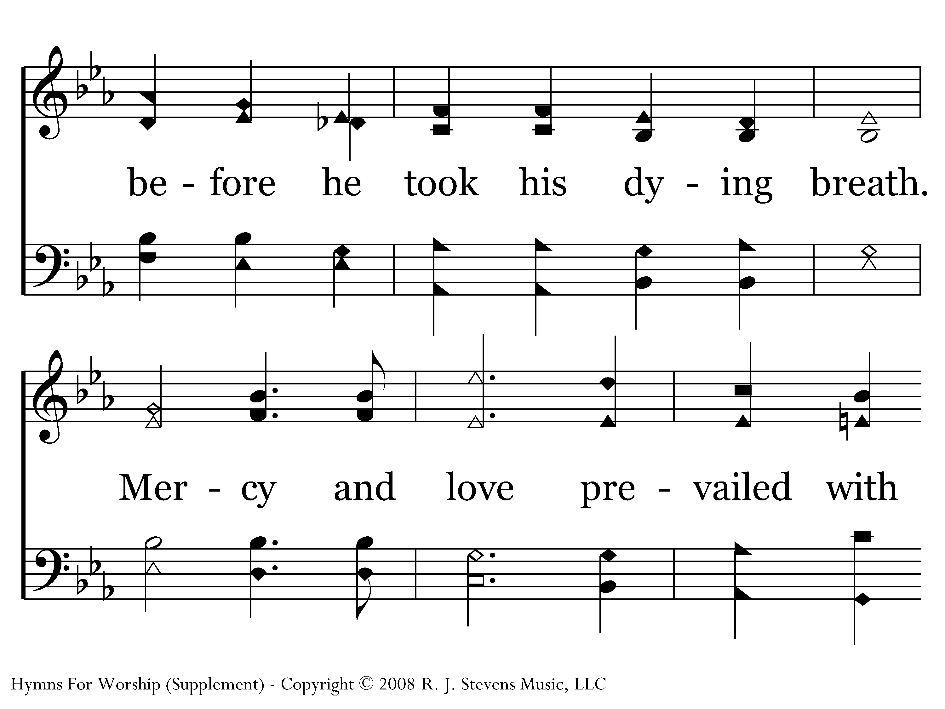
1027 - Father, Forgive - 2.2

Slide 7
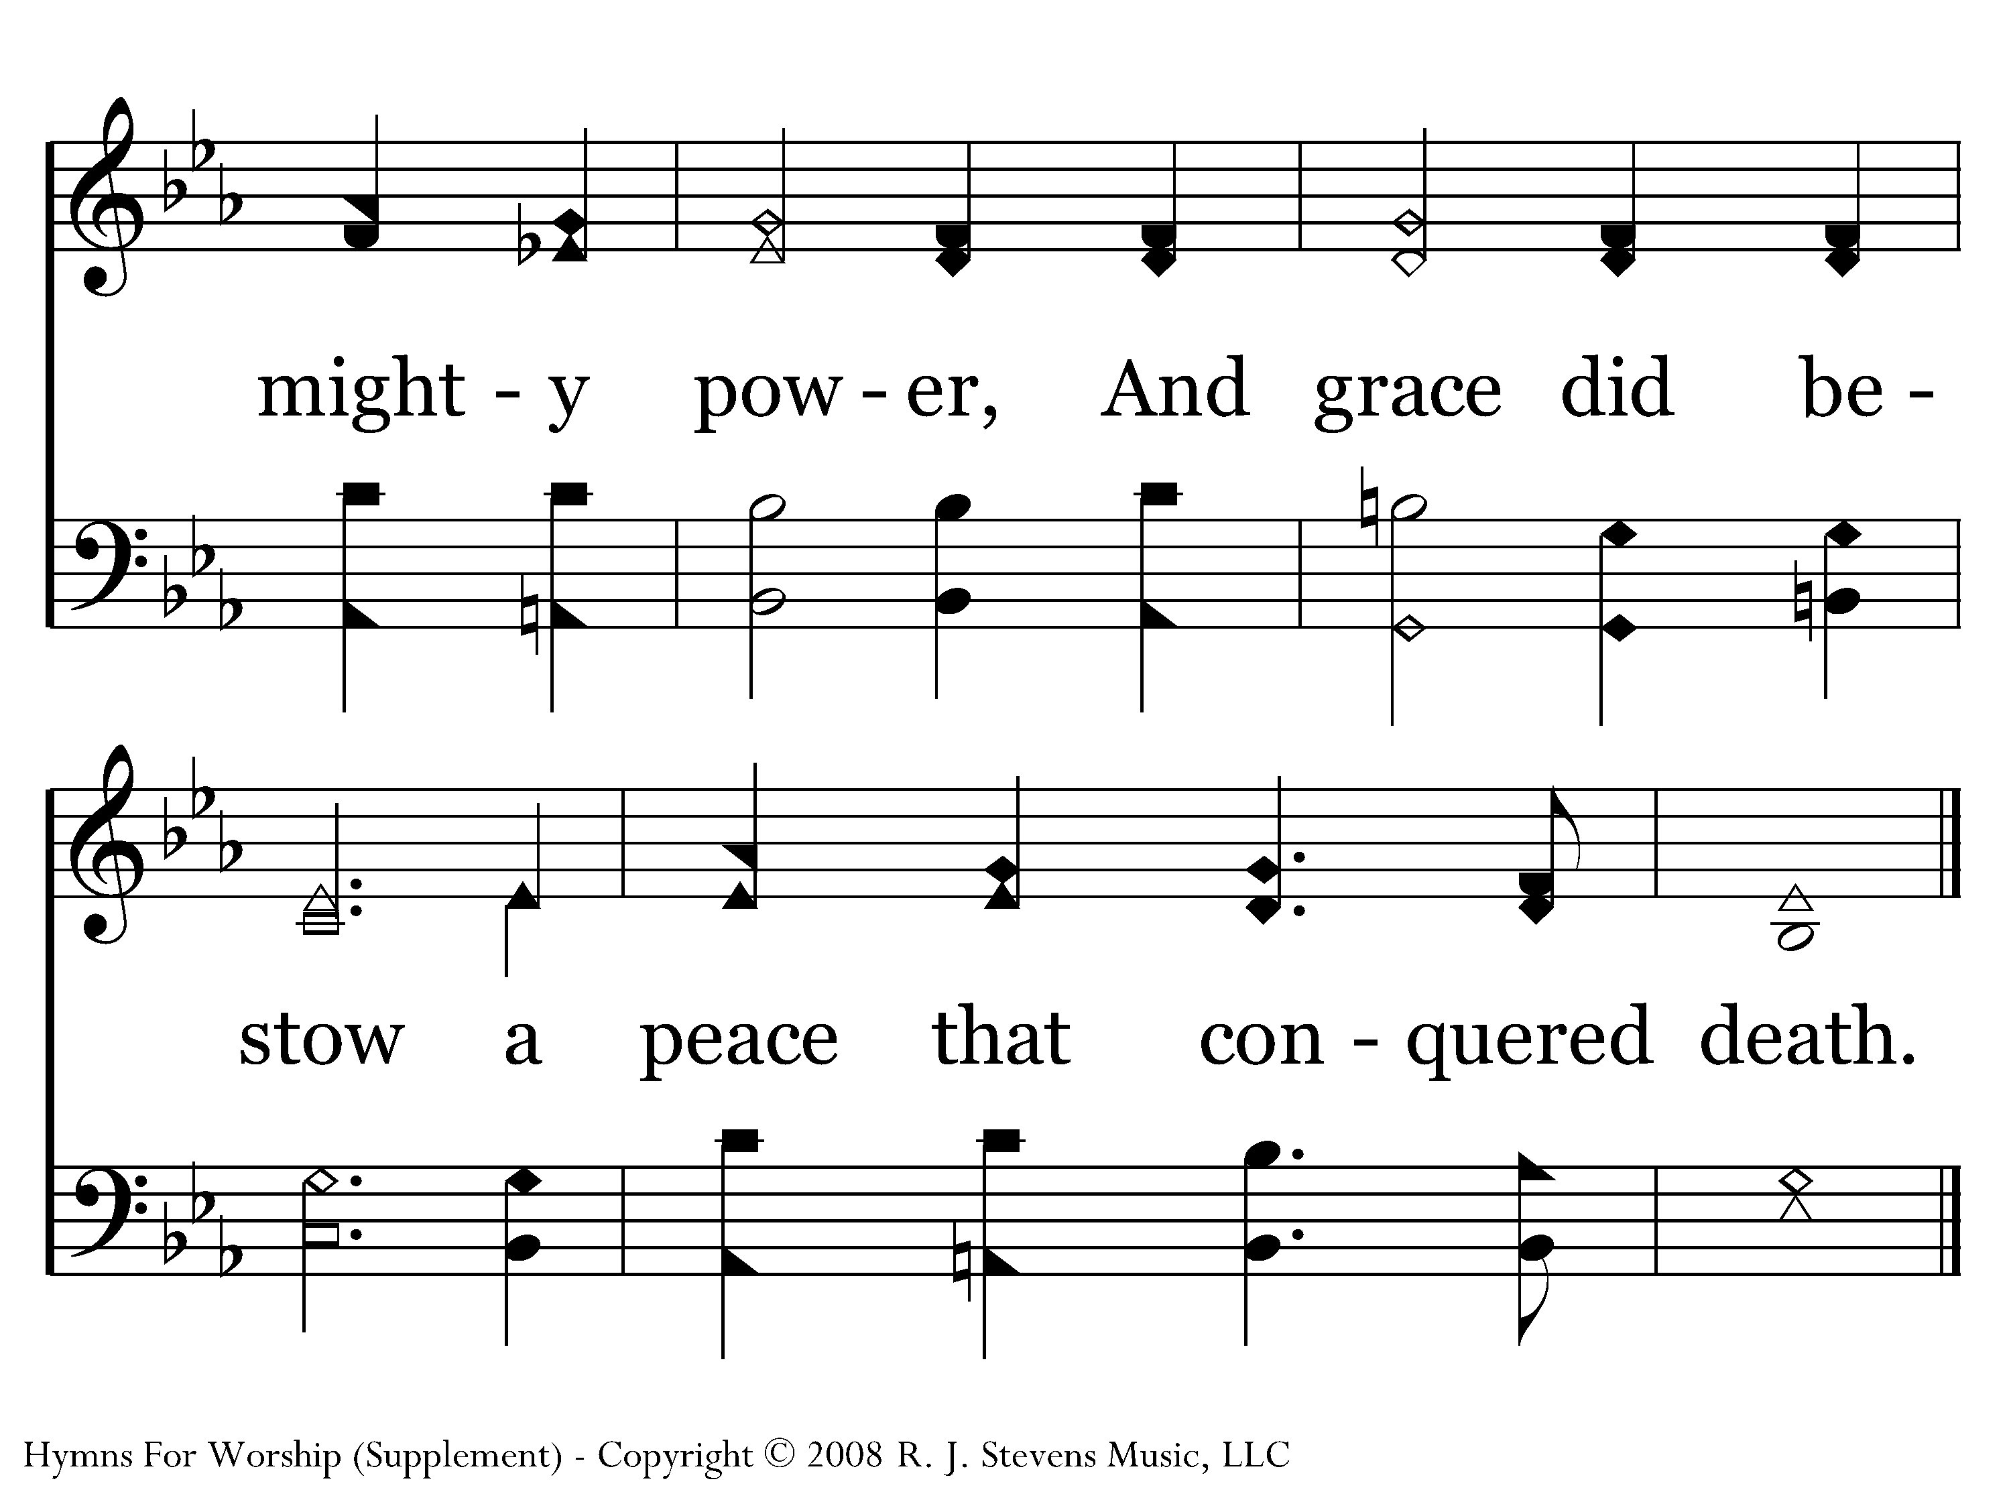
1027 - Father, Forgive - 2.3
End of Verse 2

Slide 8
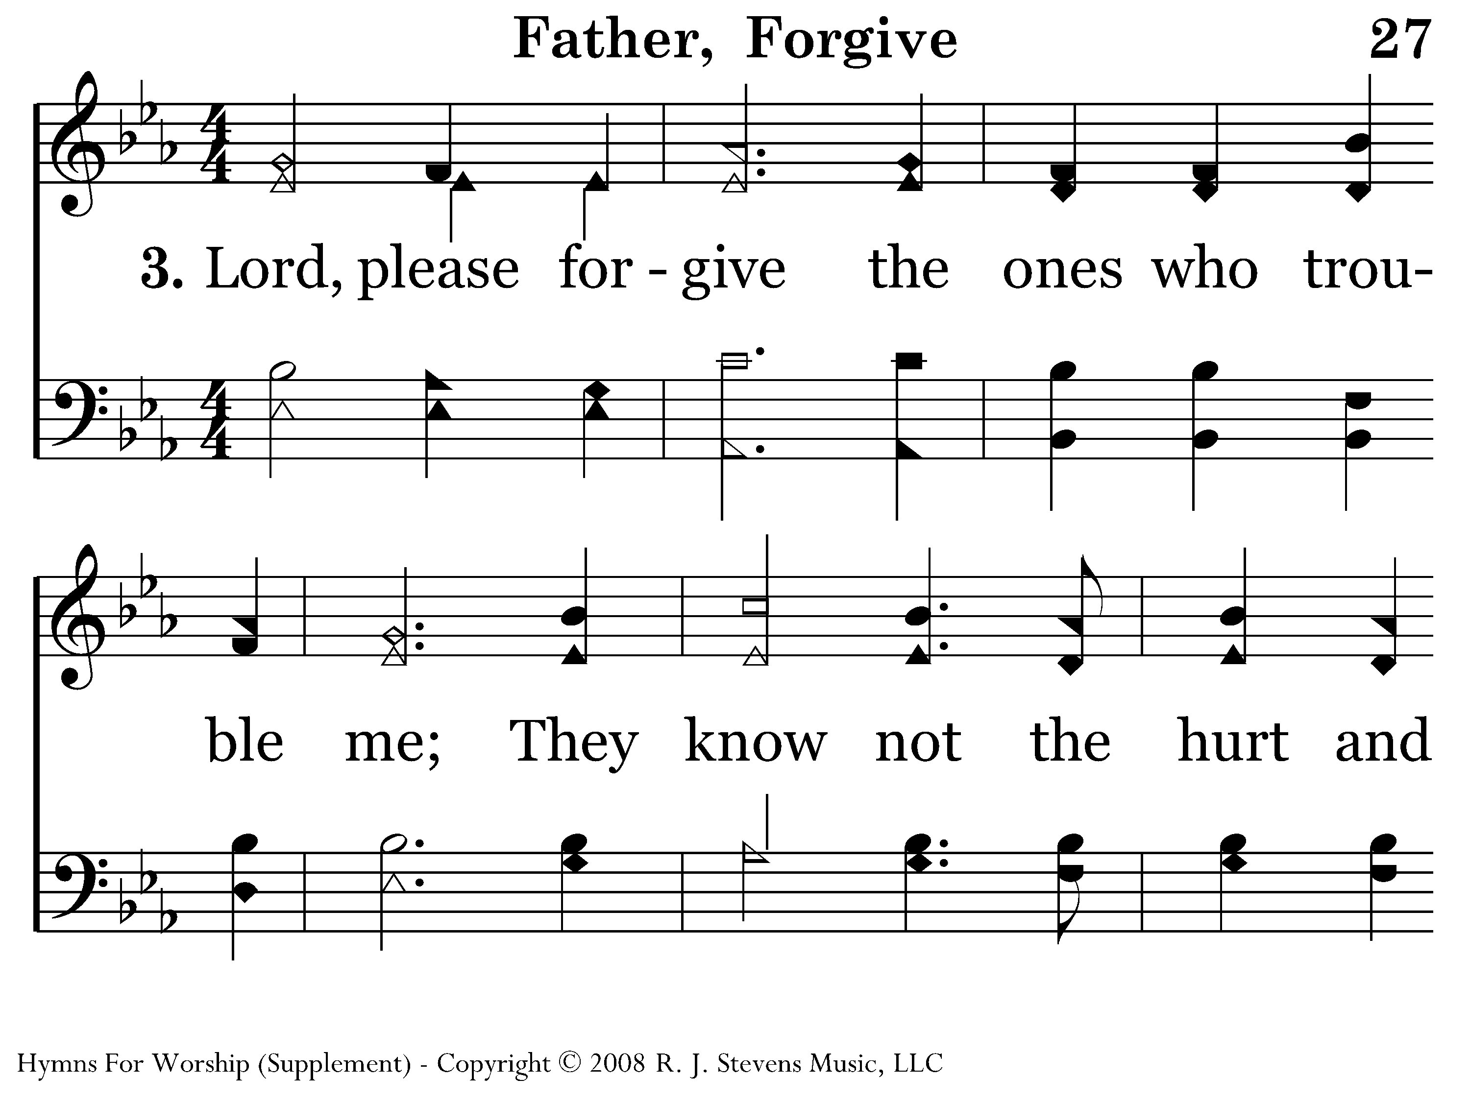
1027 - Father, Forgive - 3.1

Slide 9
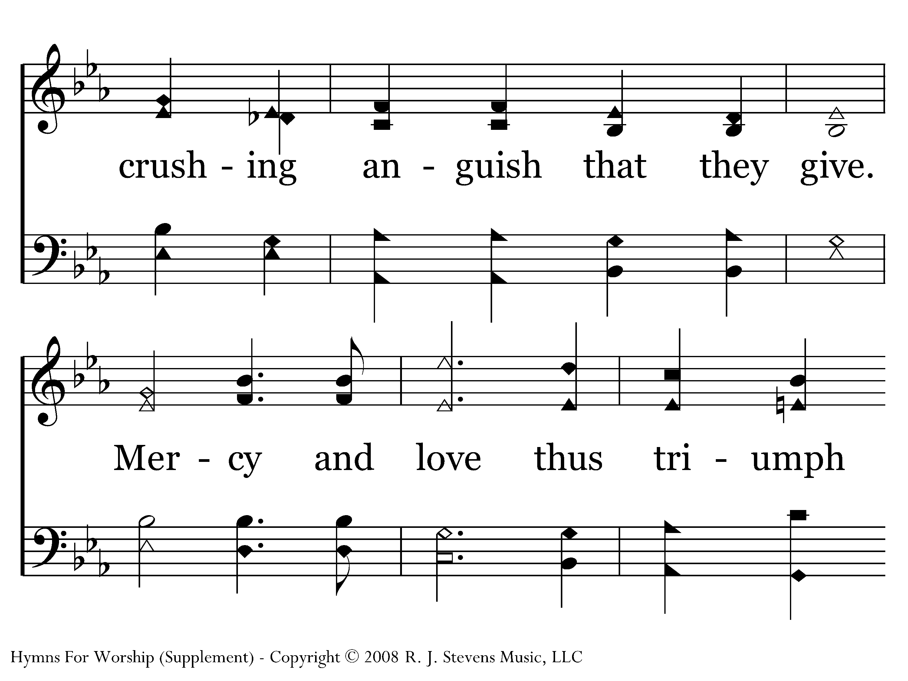
1027 - Father, Forgive - 3.2

Slide 10
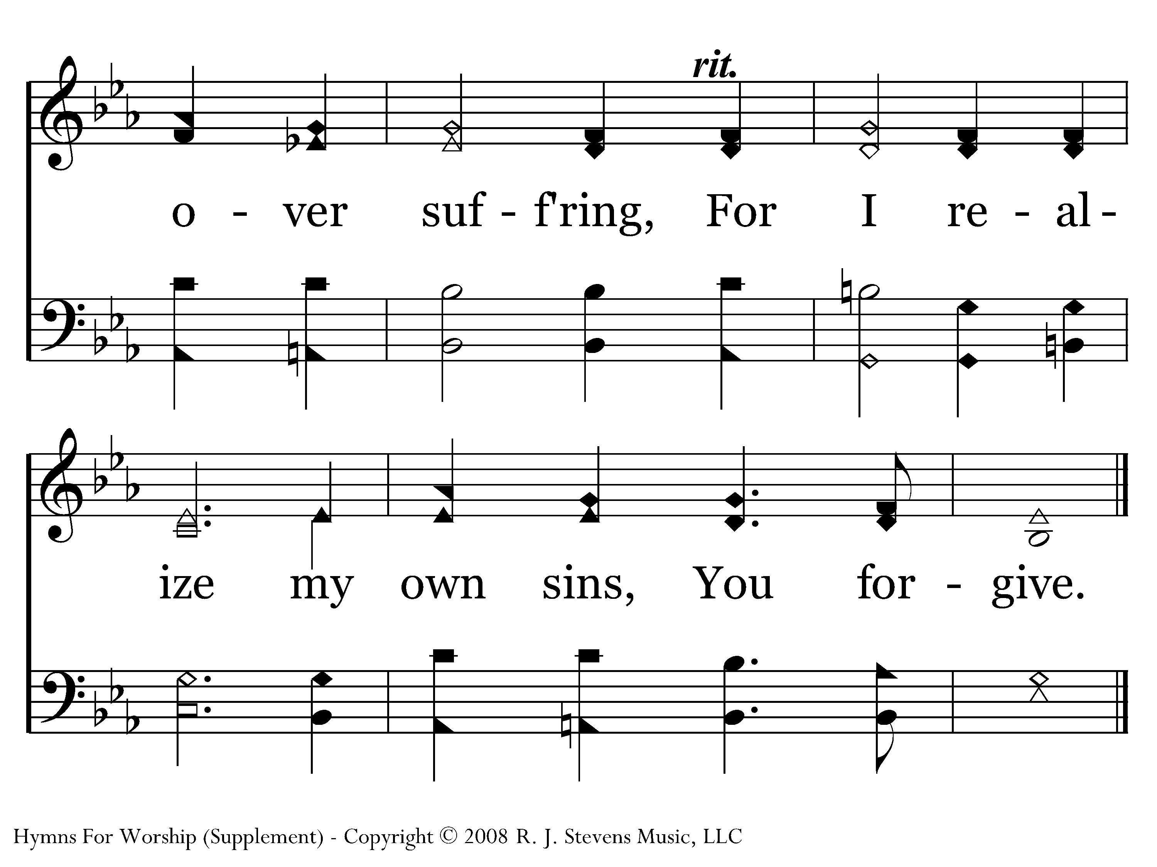
1027 - Father, Forgive - 3.3
End of Song

Slide 11
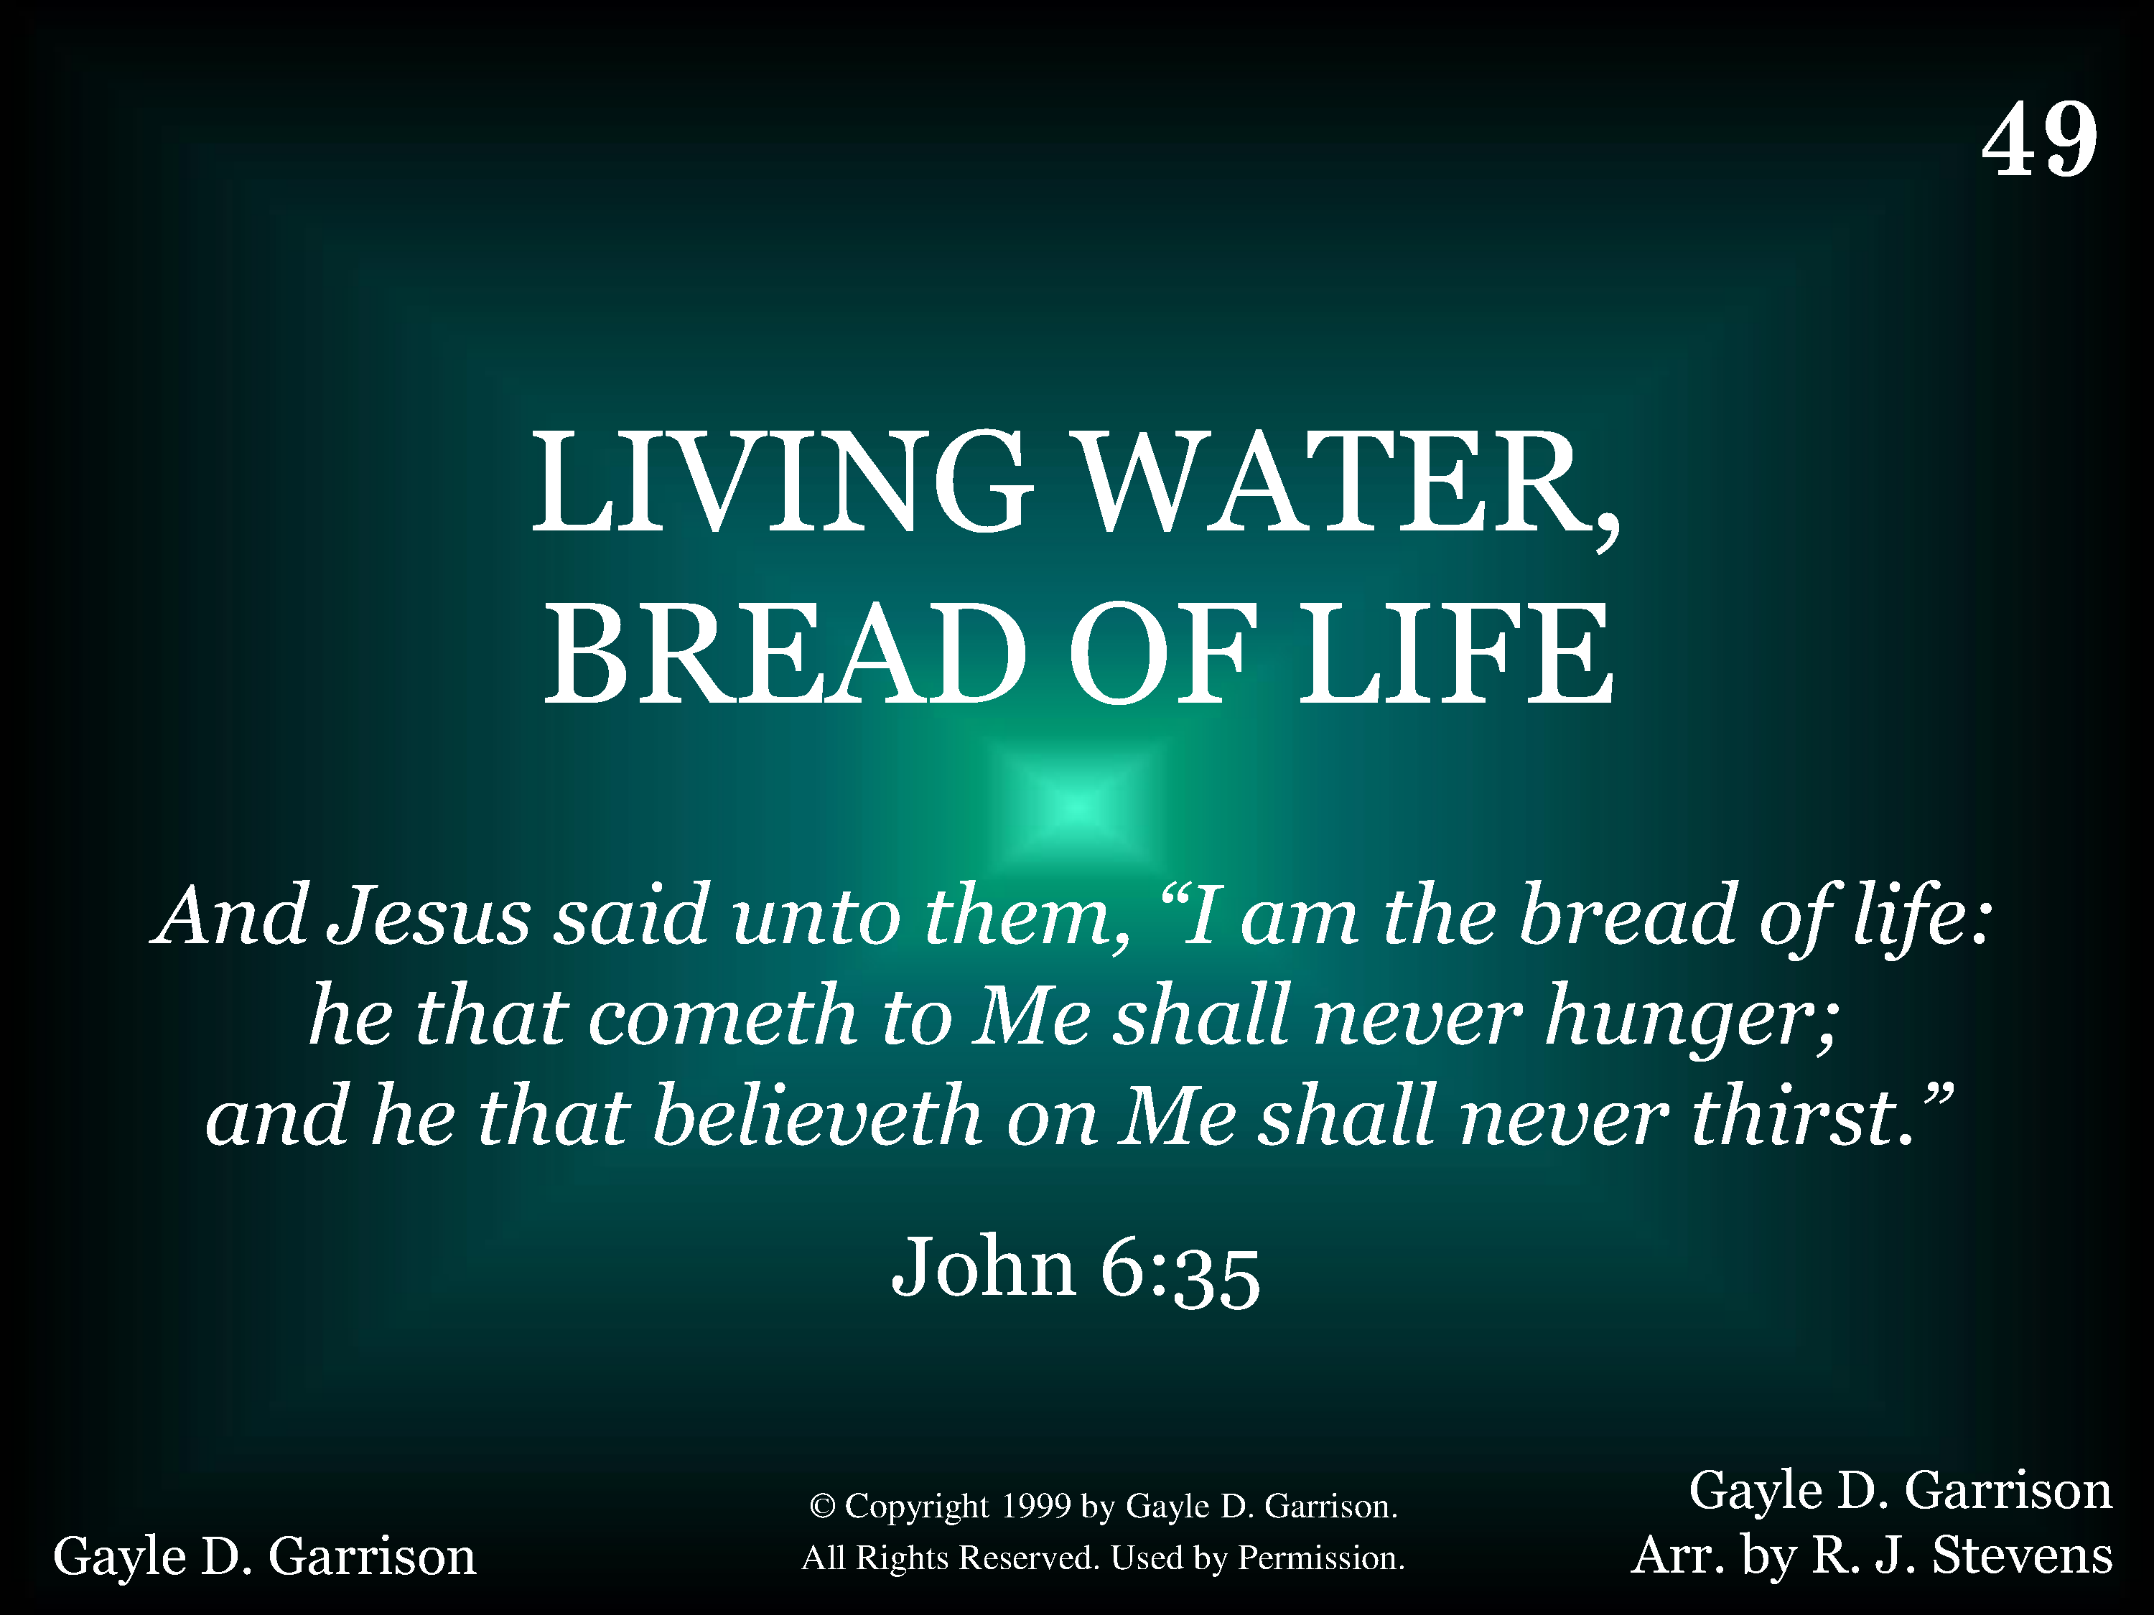
1049 - Living Water, Bread Of Life - Title

Slide 12
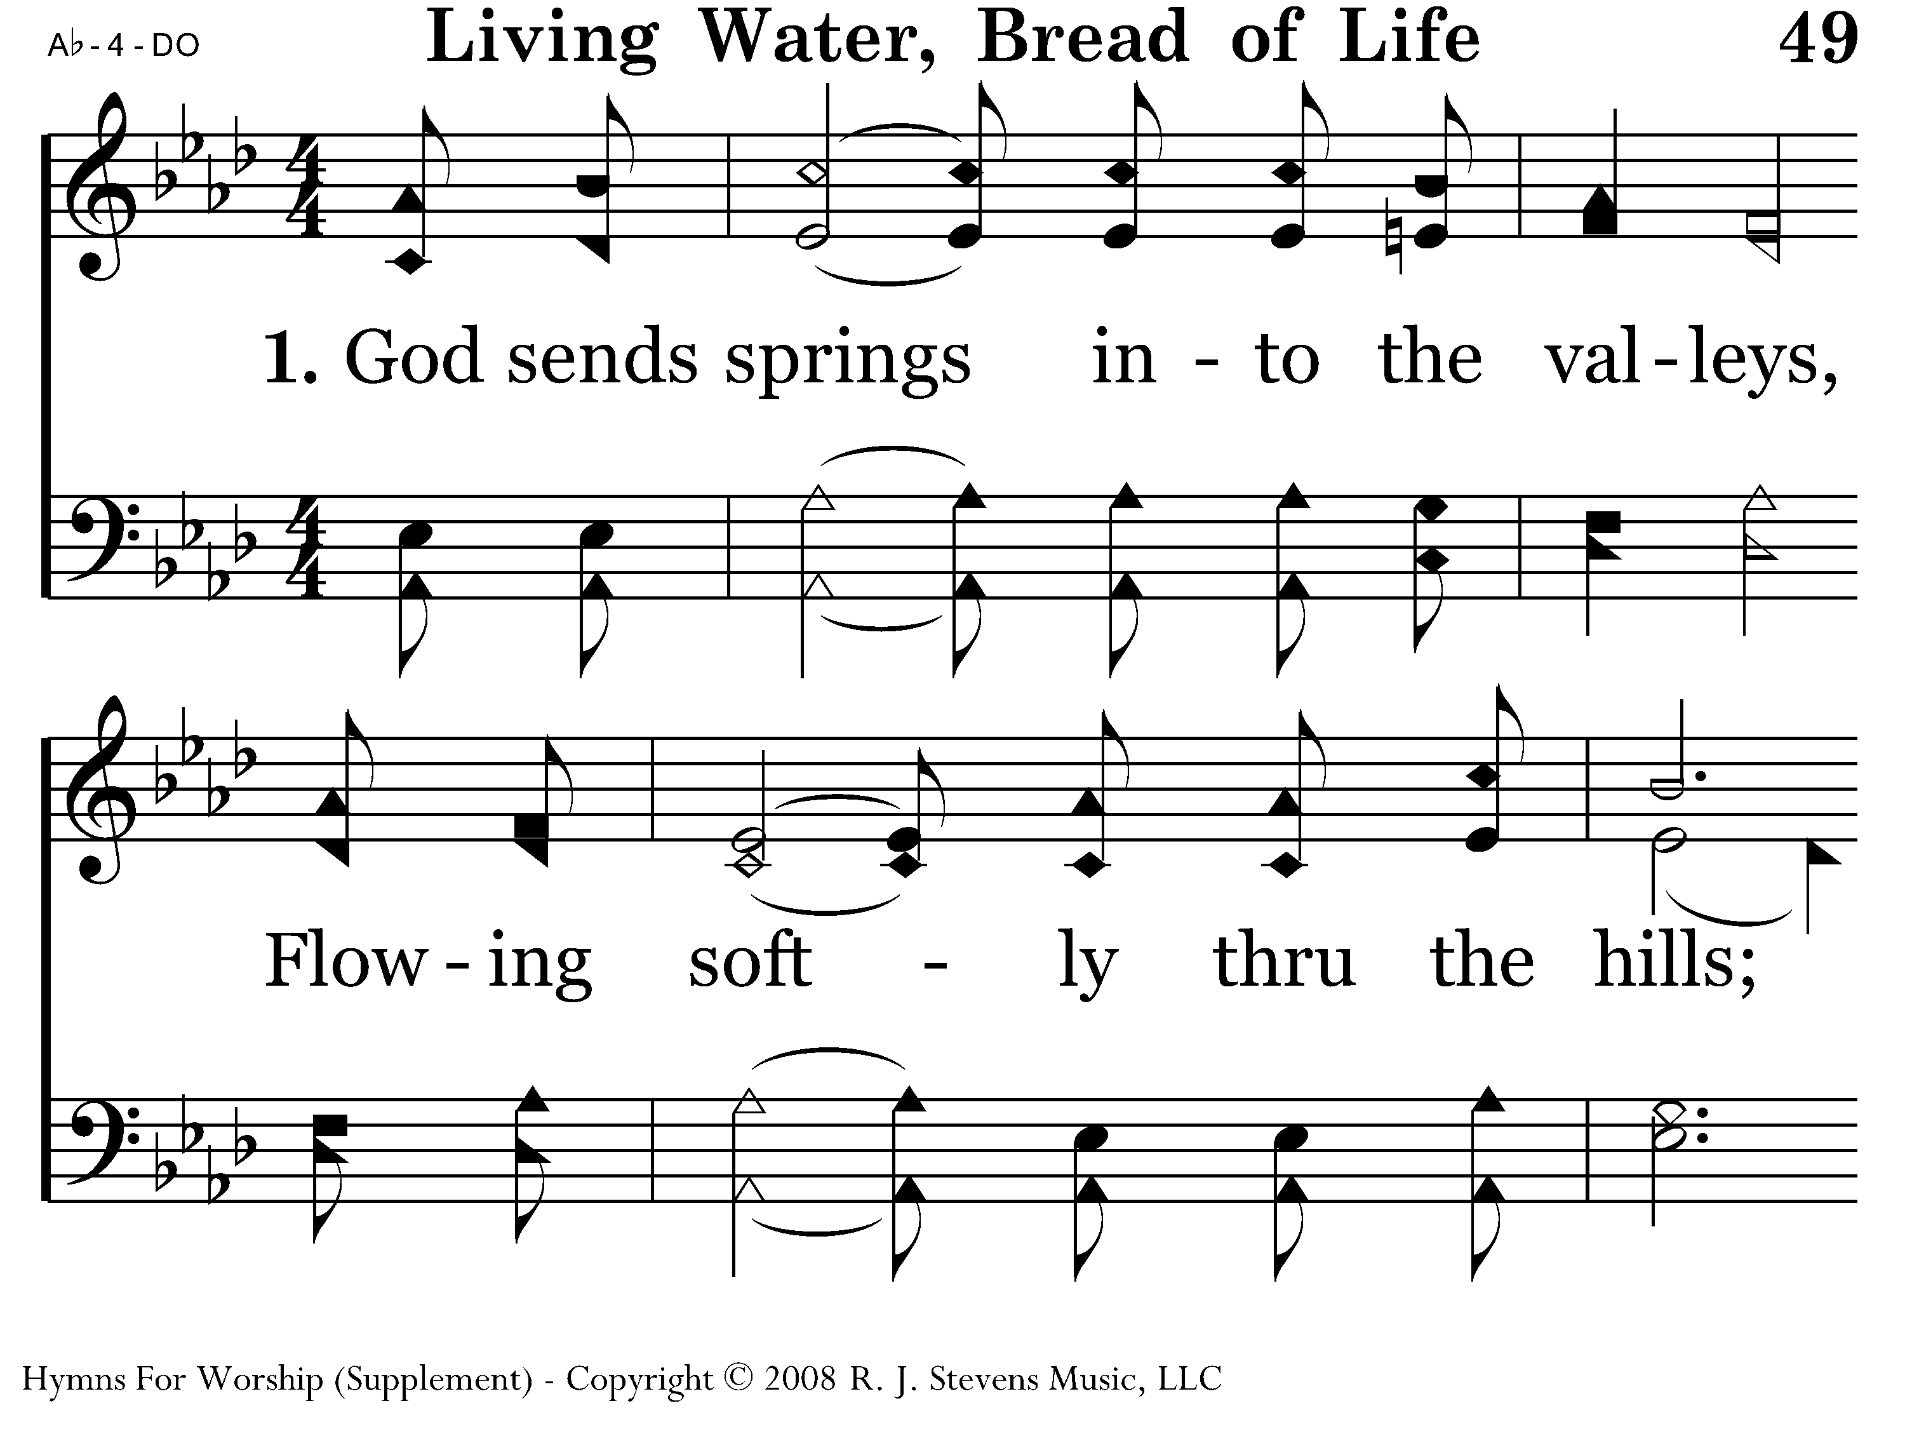
1049 - Living Water, Bread Of Life - 1.1

Slide 13
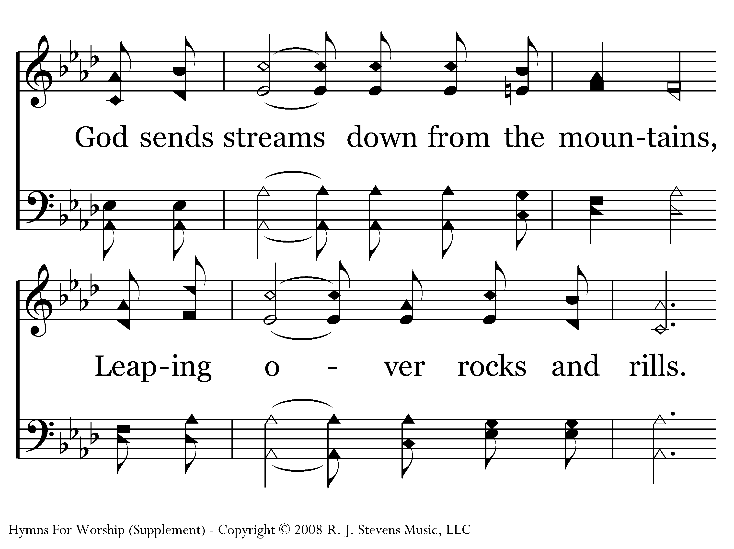
1049 - Living Water, Bread Of Life - 1.2

Slide 14
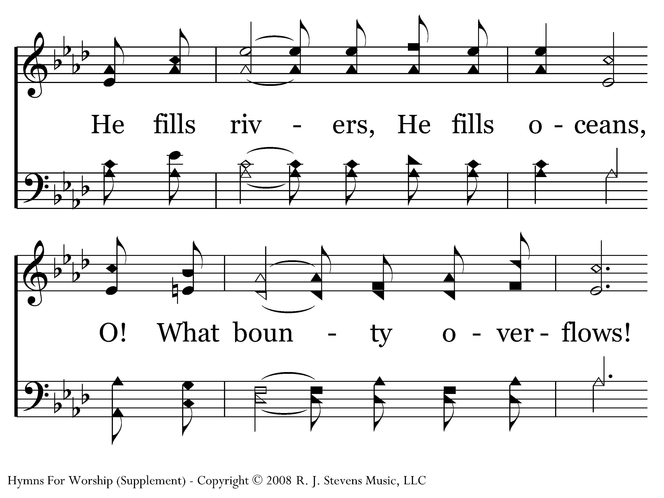
1049 - Living Water, Bread Of Life - 1.3

Slide 15
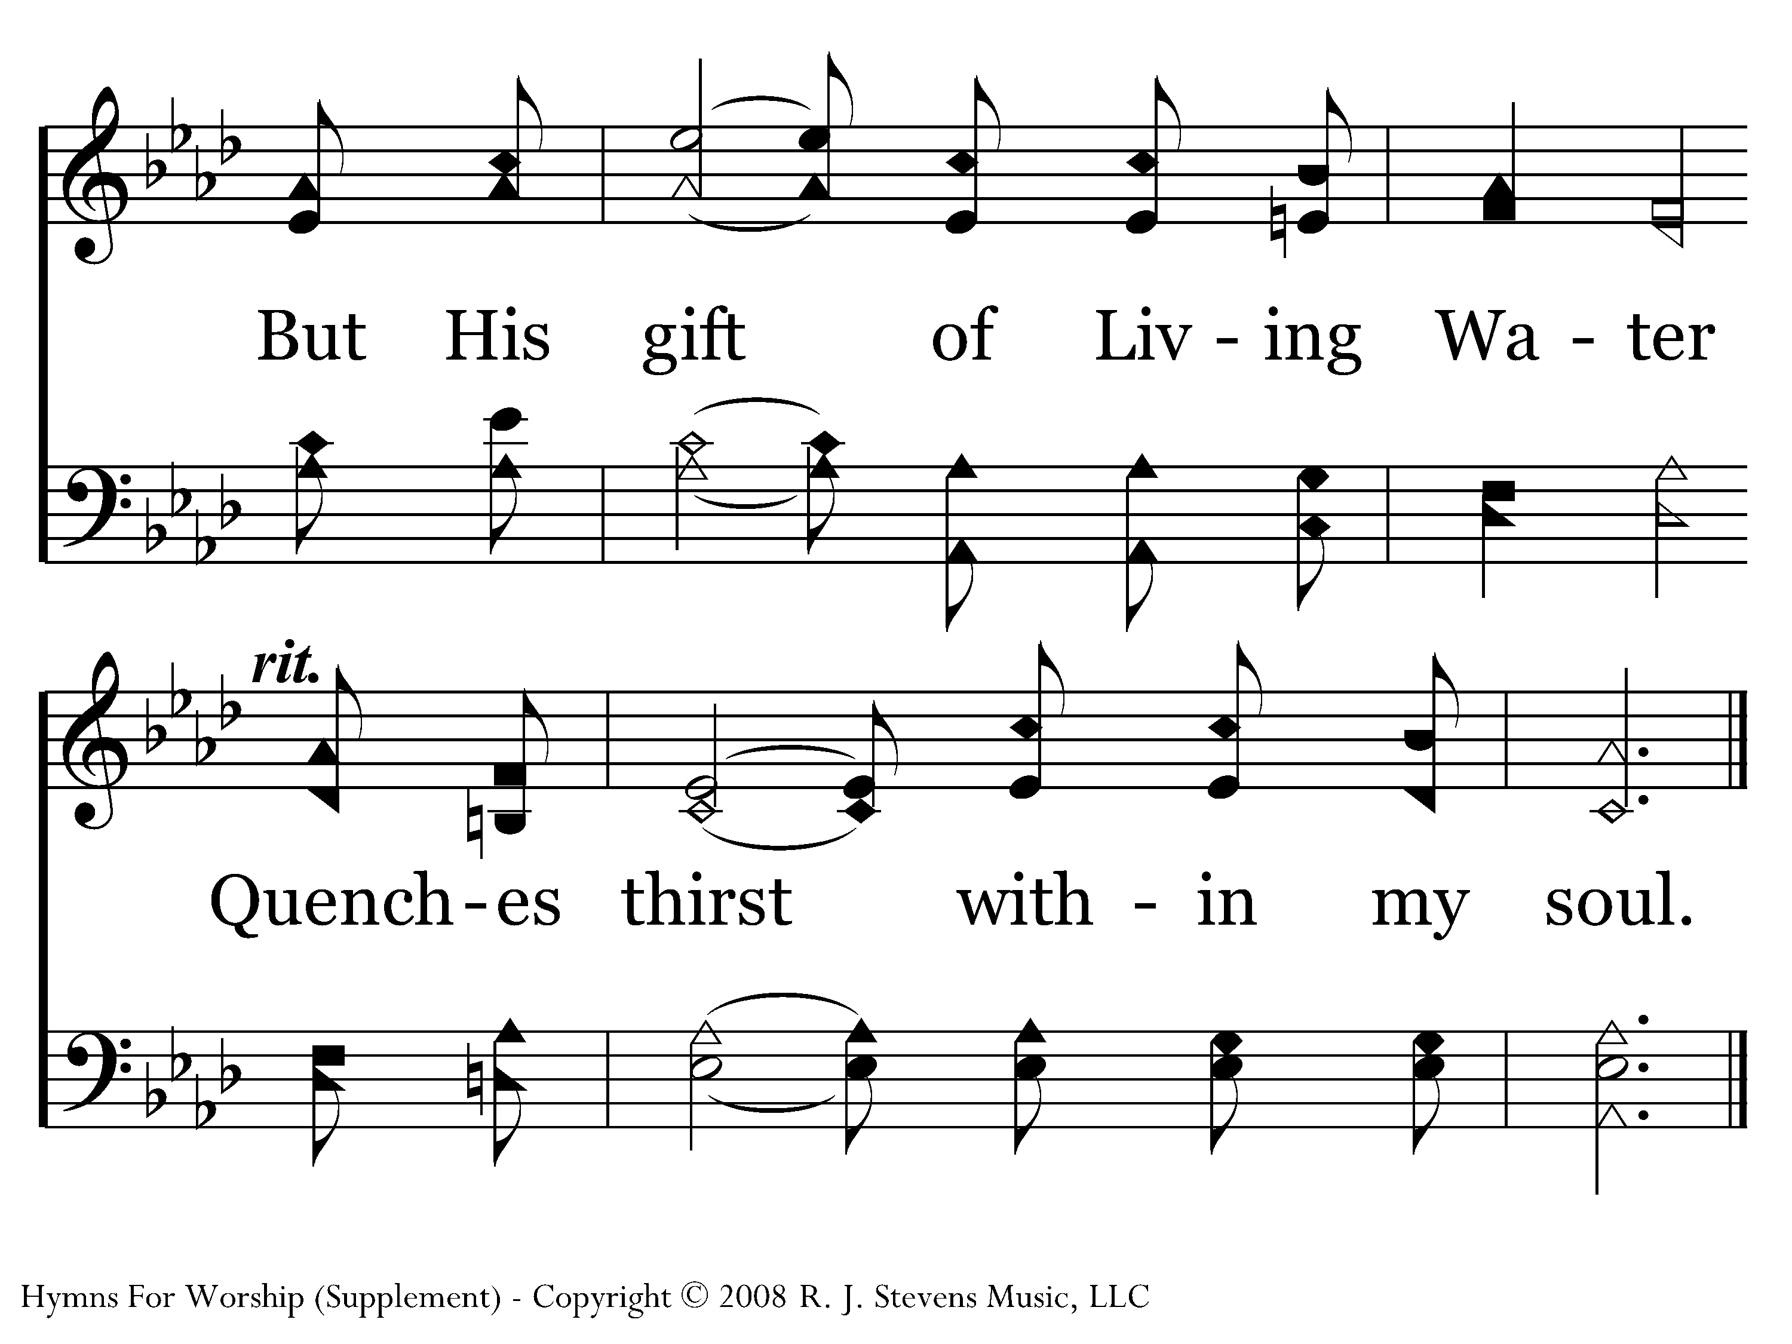
1049 - Living Water, Bread Of Life - 1.4
End of Verse 1

Slide 16
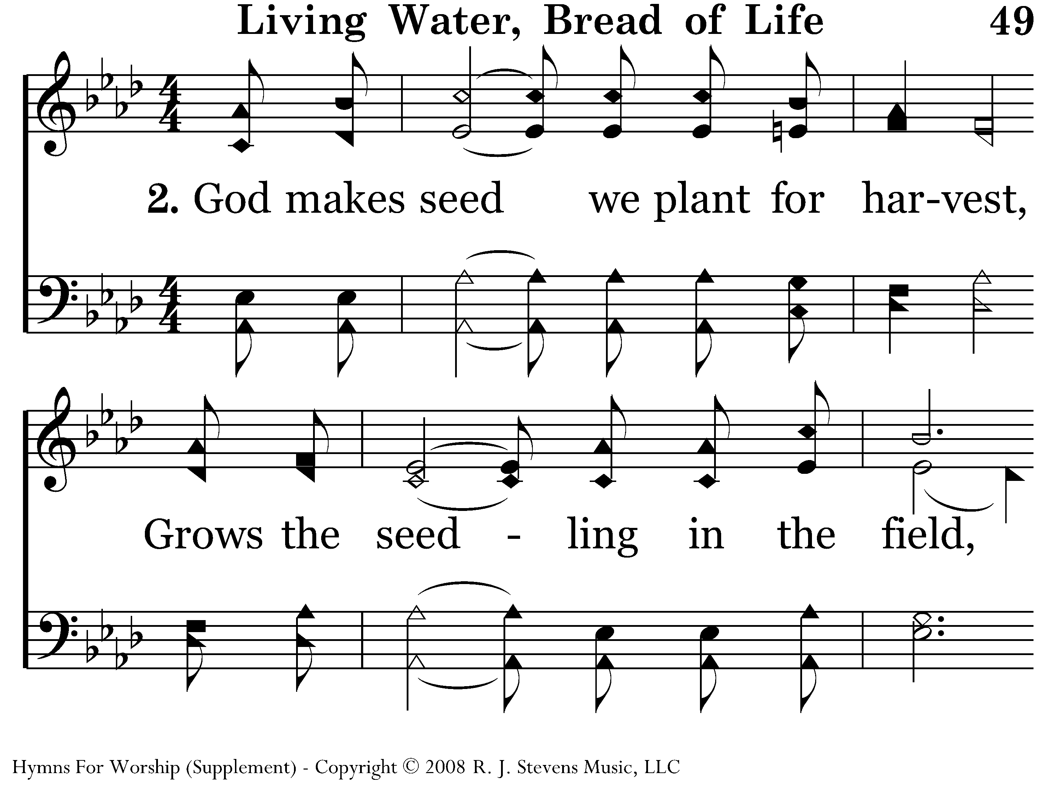
1049 - Living Water, Bread Of Life - 2.1

Slide 17
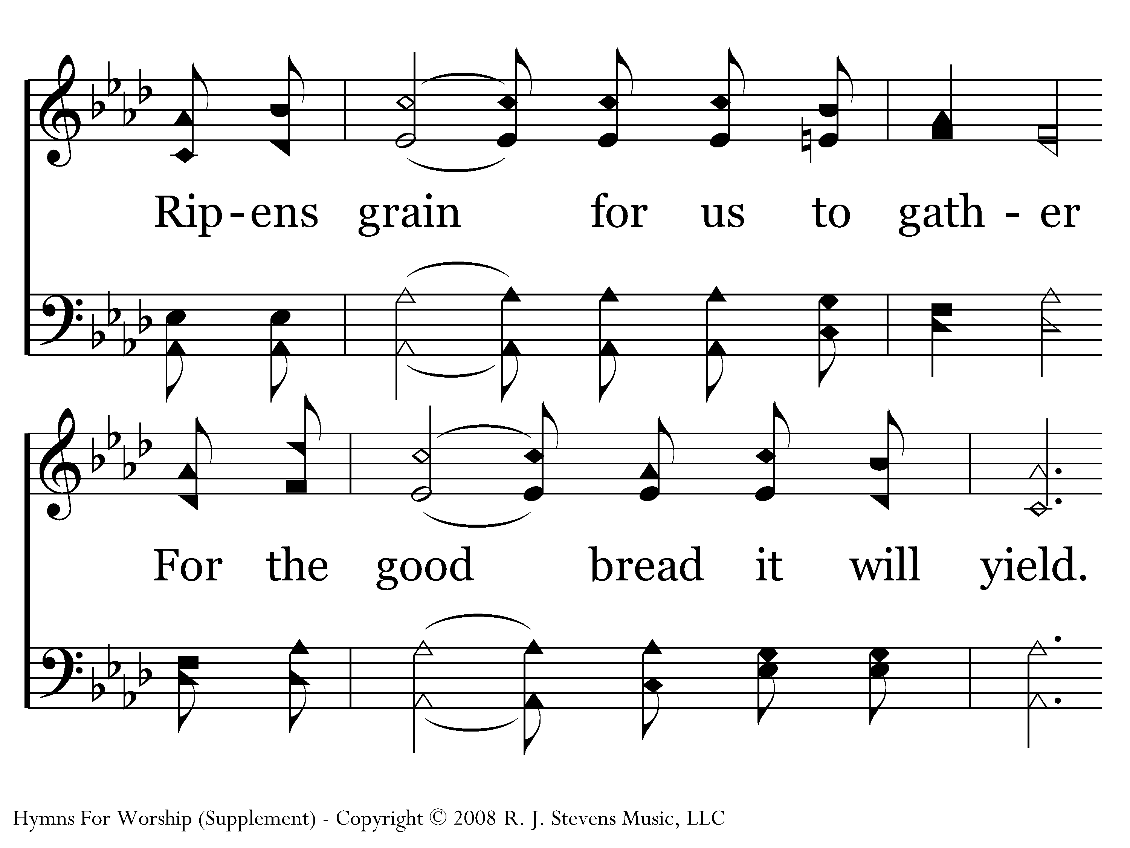
1049 - Living Water, Bread Of Life - 2.2

Slide 18
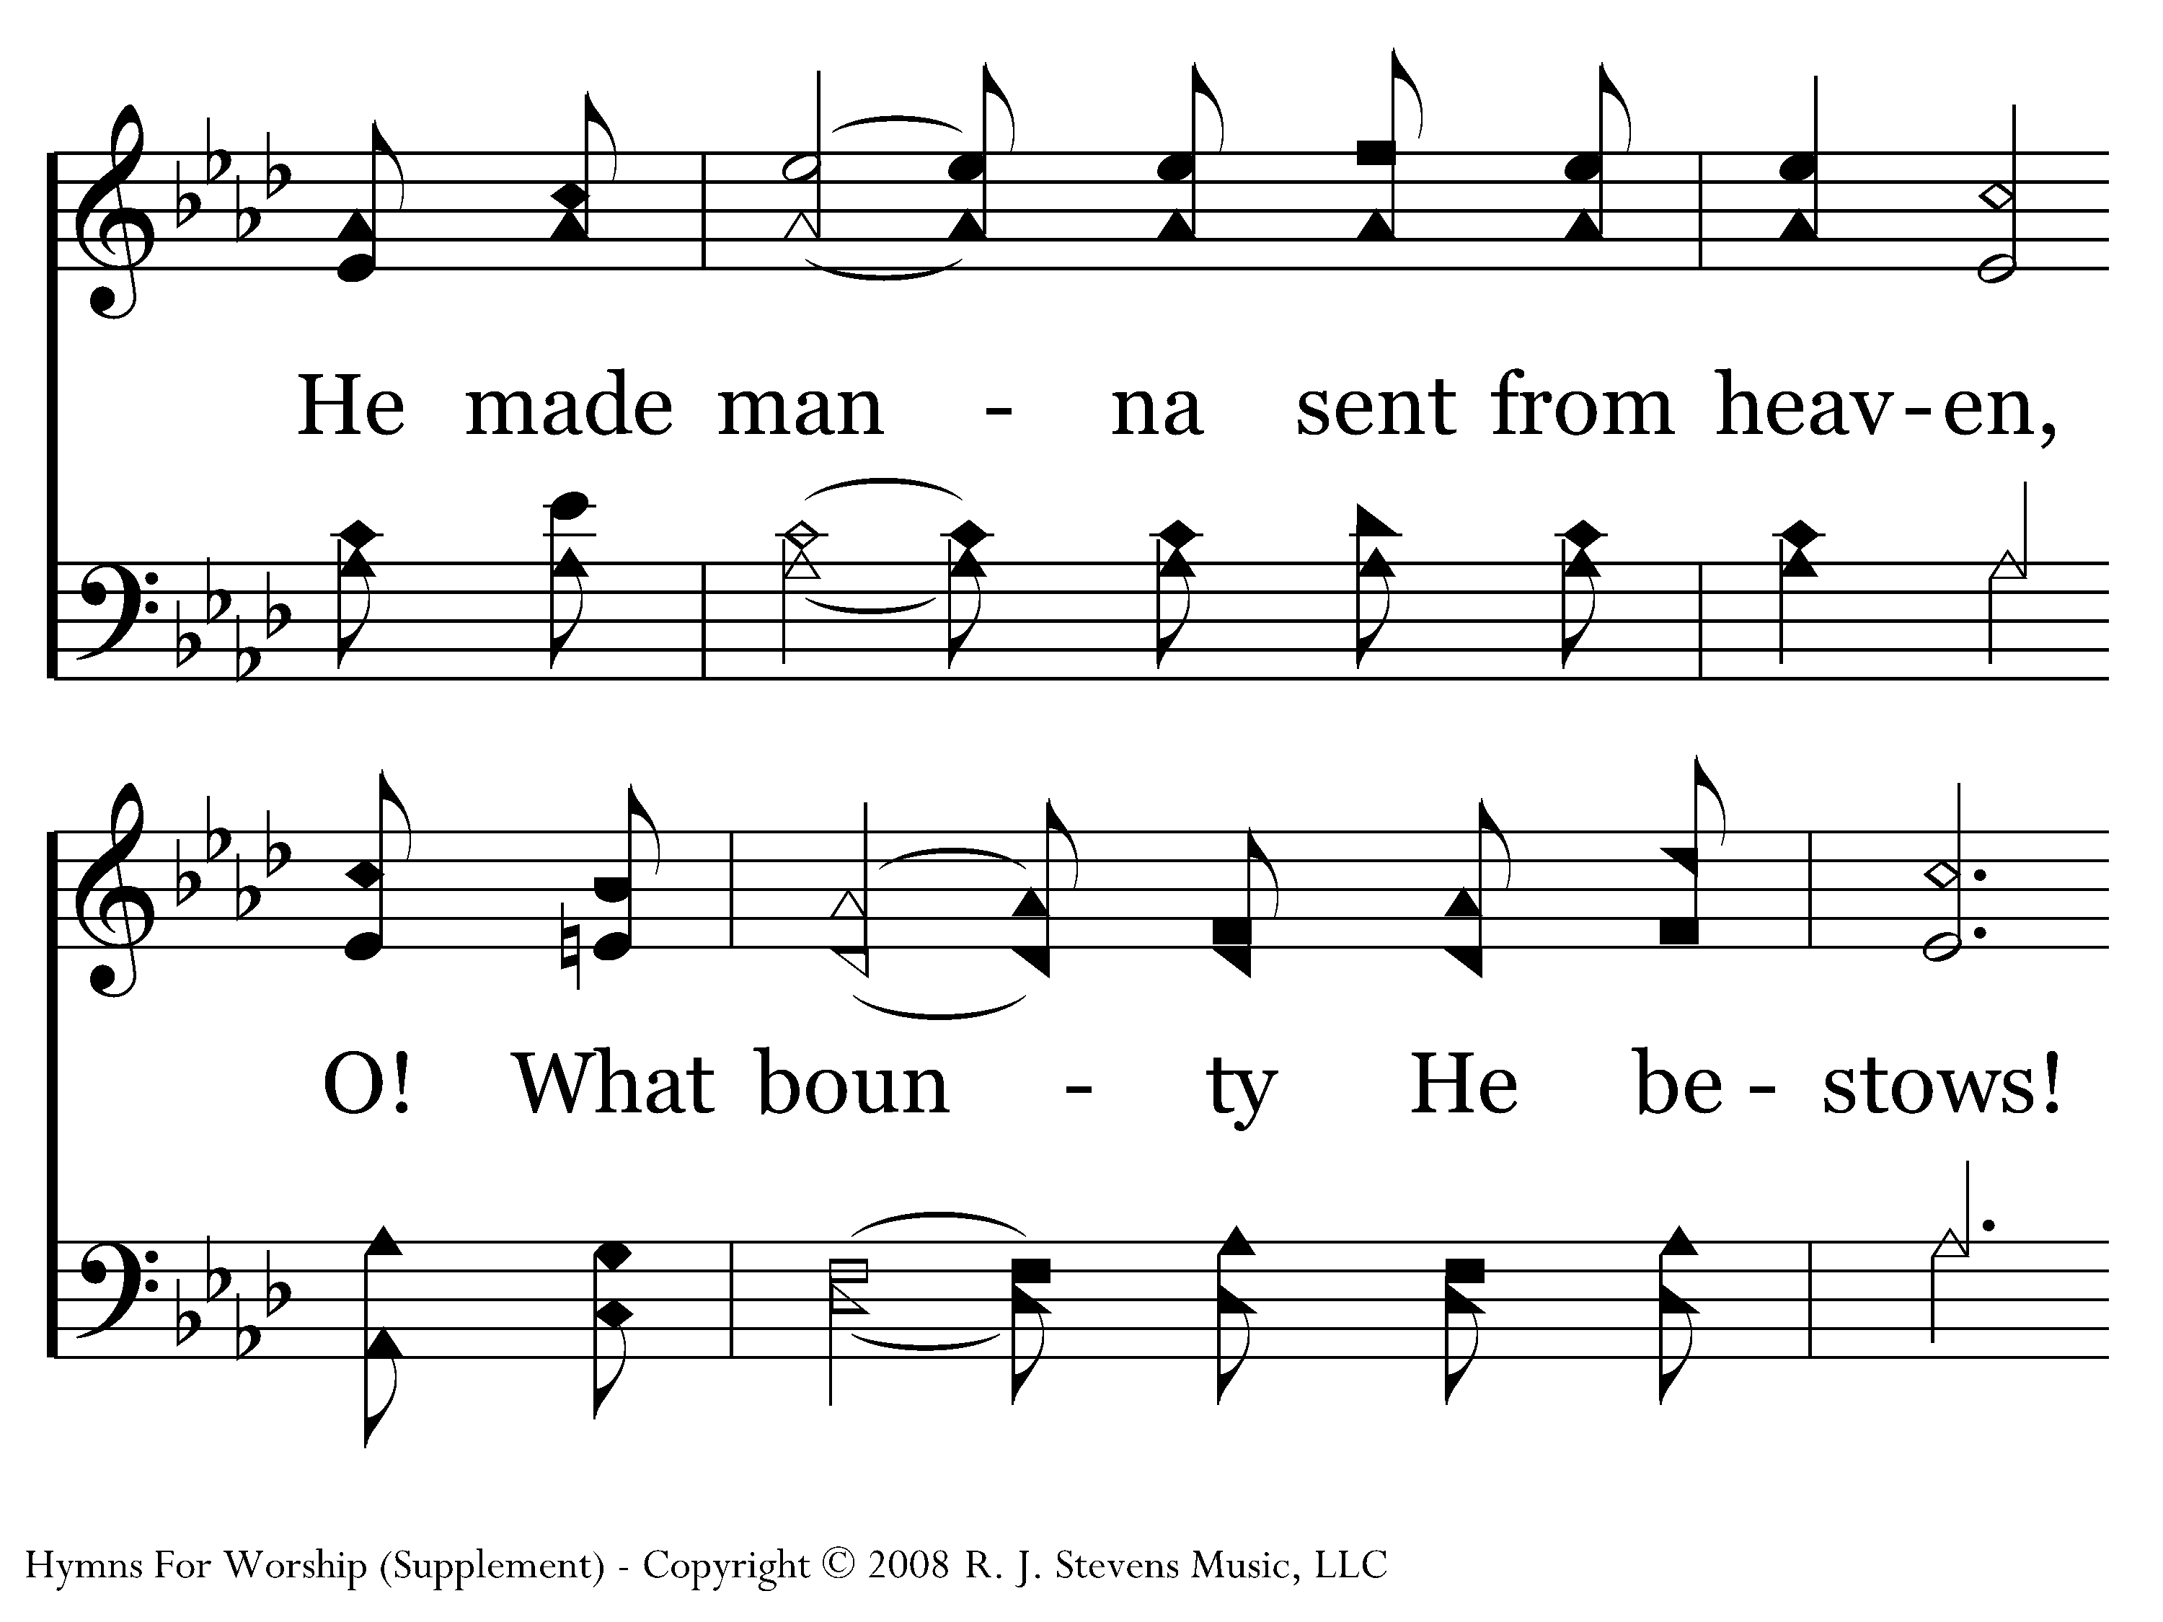
1049 - Living Water, Bread Of Life - 2.3

Slide 19
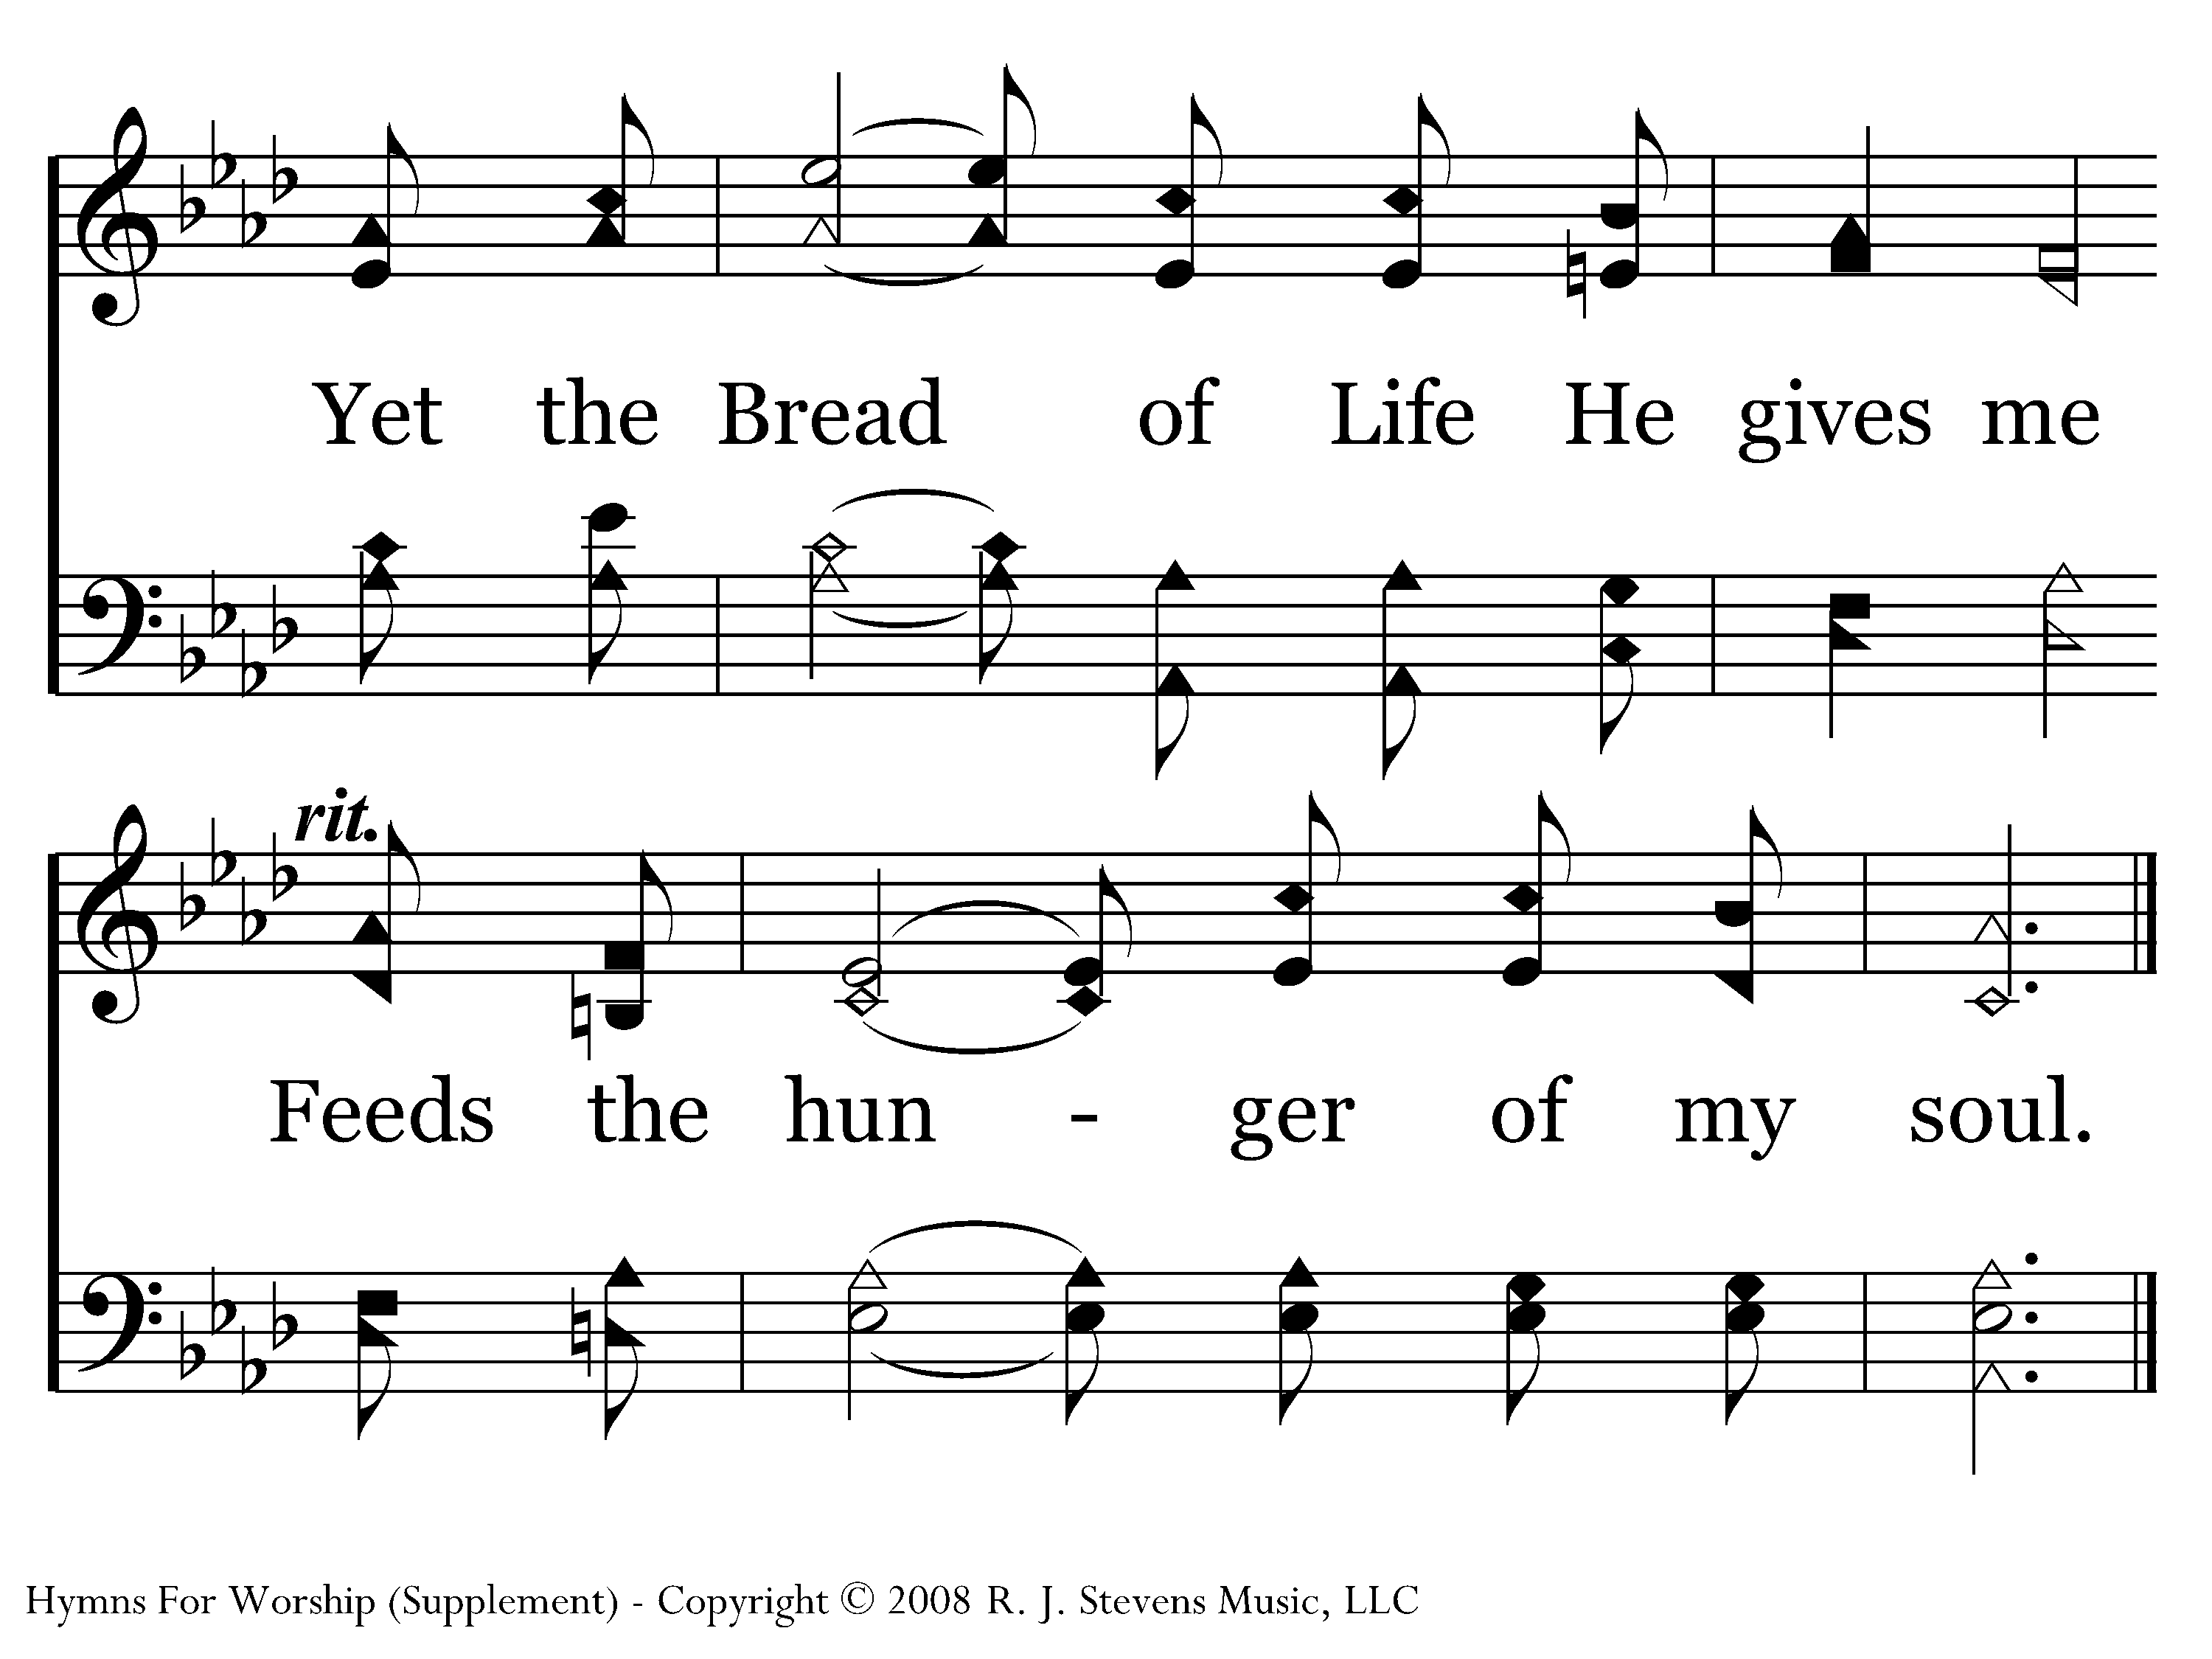
1049 - Living Water, Bread Of Life - 2.4
End of Verse 2

Slide 20
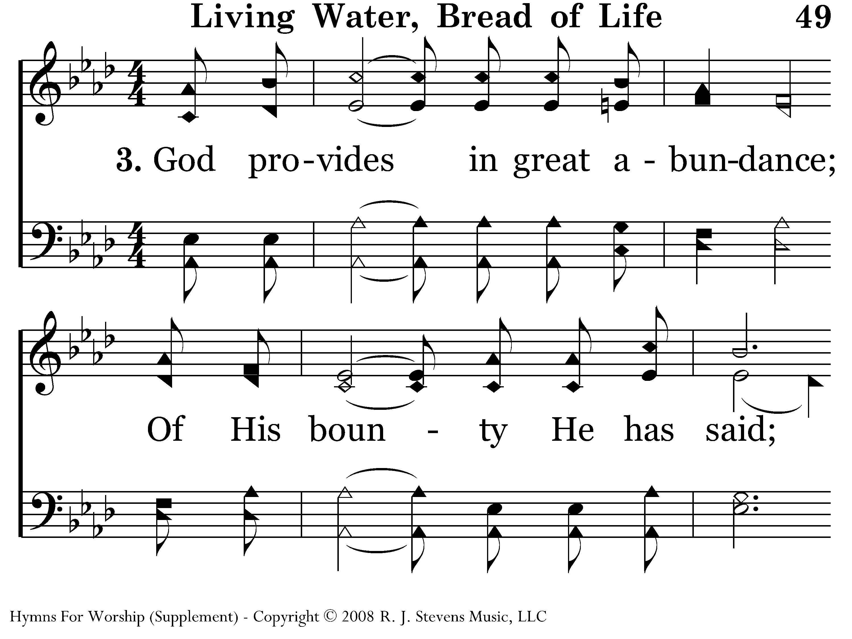
1049 - Living Water, Bread Of Life - 3.1

Slide 21
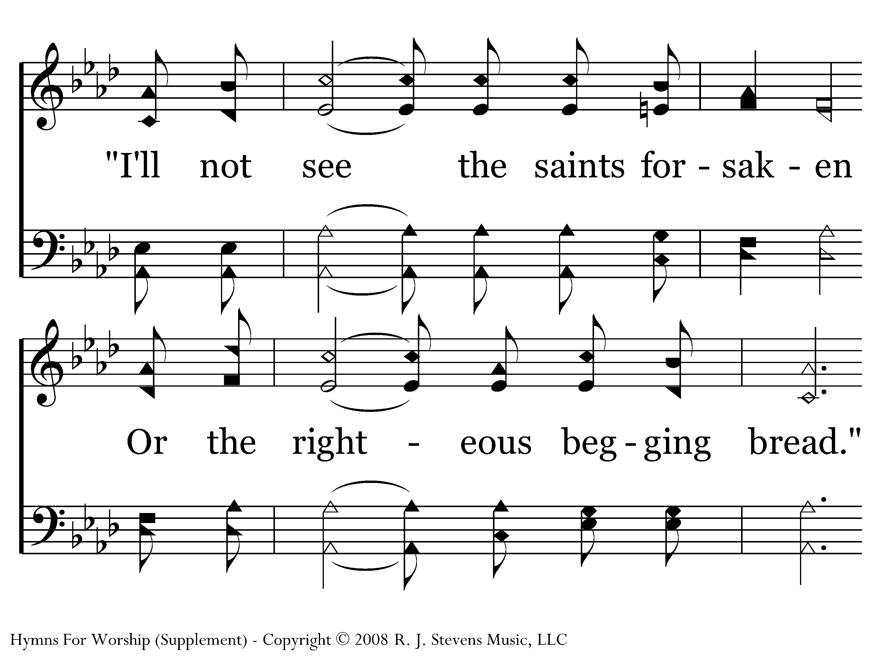
1049 - Living Water, Bread Of Life - 3.2

Slide 22
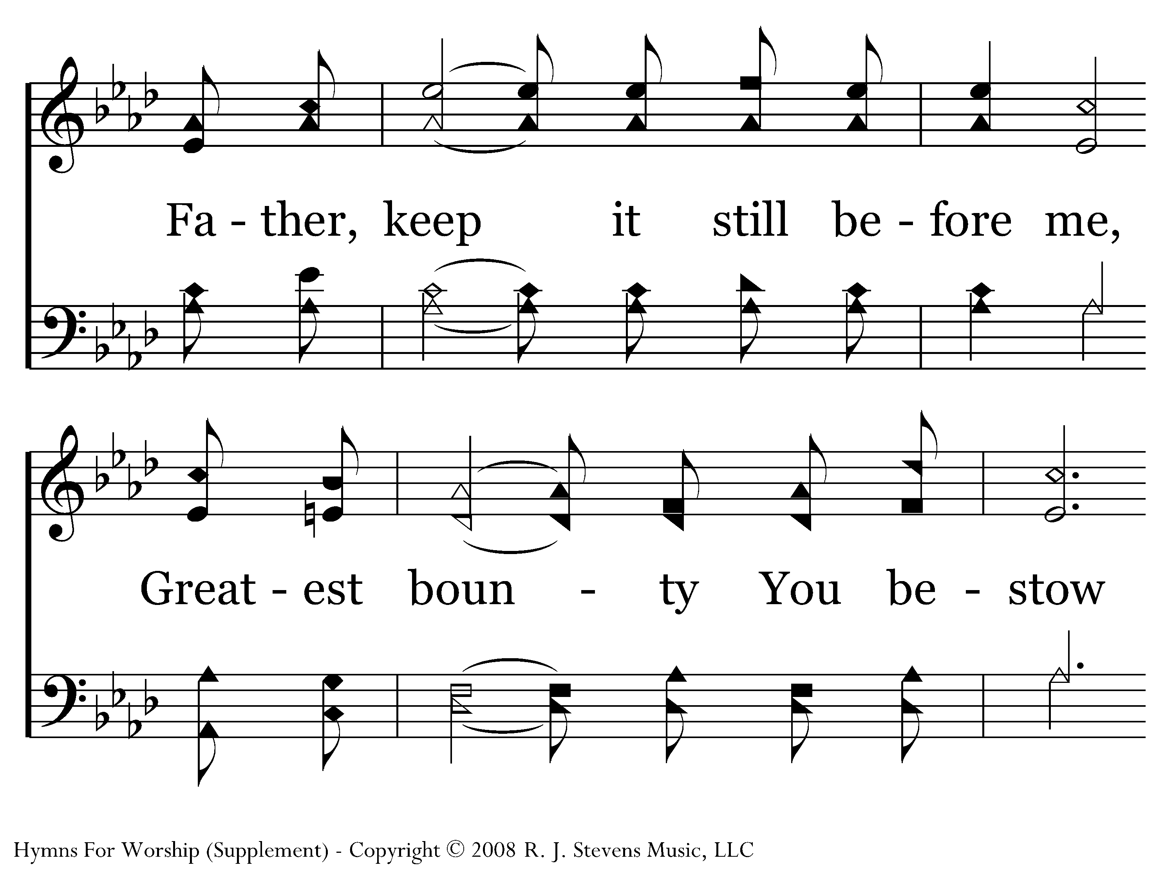
1049 - Living Water, Bread Of Life - 3.3

Slide 23
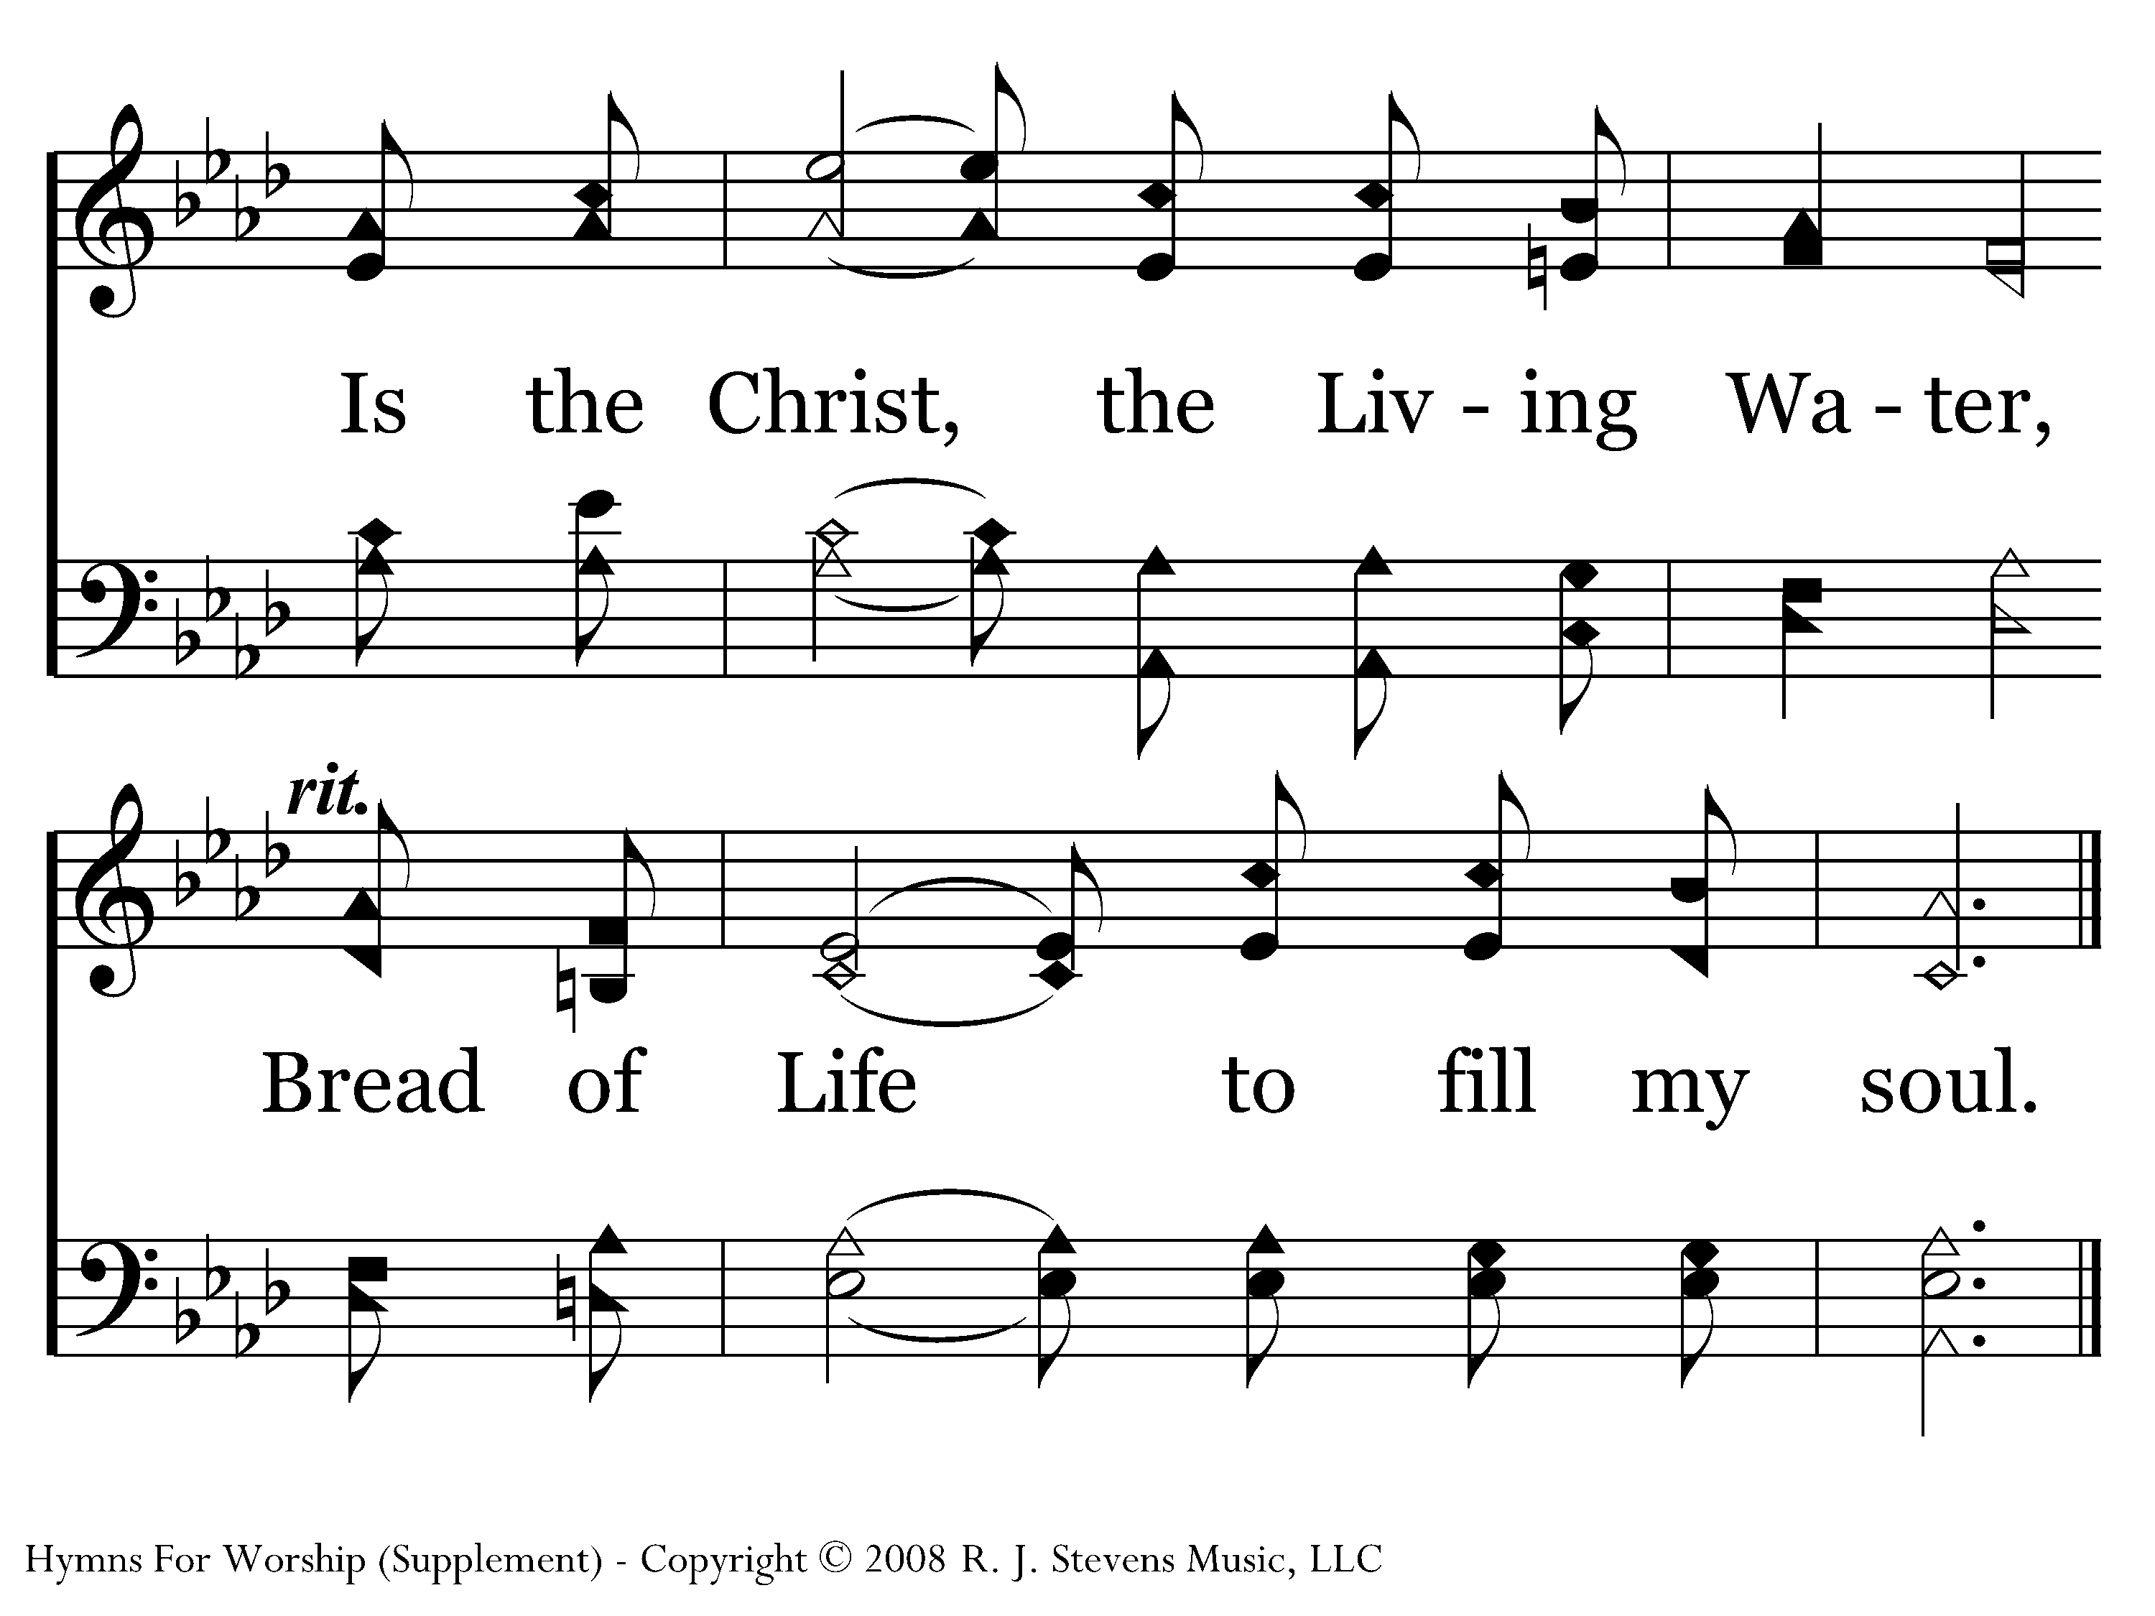
1049 - Living Water, Bread Of Life - 3.4
End of Song

