Slide 1
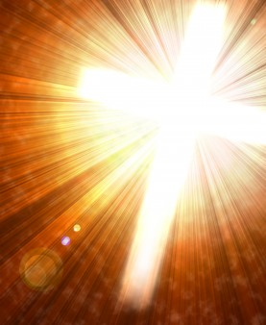
Life in the Son
Walking Daily as a Child of God
Born of God – Beginning a New Life

Slide 2
John 3:1-7 Being Born Again
Jesus said…
“Unless one is born again he cannot see the kingdom of God.”
“Unless one is born of water and the Spirit, he cannot enter the kingdom of God.”
“You must be born again.”

Slide 3
John 3:1-7 Being Born Again
“Water” refers to baptism!
Presbyterian scholar Albert Barnes wrote, “By water, here, is evidently signified baptism.”
Methodist scholar Adam Clarke said, “Baptism by water, into the Christian faith, was necessary to every Jew and Gentile that entered into the kingdom of the Messiah.”
Anglican priest William Wall observed concerning Jesus’ reference to “water” in John 3 that, “There is not any one Christian writer of any antiquity in any language but what understands it of baptism....I believe Calvin was the first that ever denied this place to mean baptism. He gives it another interpretation, which he confesses to be new.”

Slide 4
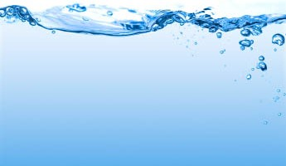
John 3:1-7 Being Born Again
“Water” refers to baptism!
The book of Acts repeatedly shows that baptism in water initiated believers into their new life in Christ (Acts 8:36-39; 10:47; cf. 2:38; 8:12; 16:12, 33; 18:8; 19:4-5; 22:16).

Slide 5
John 3:1-7 Being Born Again
There is more to the new birth than baptism
Every perspective & relationship is changed. (2 Corinthians 5:14-17)
Being born again is a result of the work of the Holy Spirit. (Titus 3:5; 1 Peter 1:23)
Our trust in God’s word, exhibited in baptism, enables the Spirit to change us from within, and we become new creatures.

Slide 6
1 John Your New Life!
You practice righteousness. (1 John 2:29; 3:10; Ephesians 5:1)
You do not sin. (1 John 3:9; Ephesians 4:20)
You keep yourself! (1 John 5:18, 21; 1 Timothy 5:22; James 1:27)
You love your Father and your family. (1 John 4:7; 5:1)
You overcome the world (1 John 5:4; Colossians 3:1-3; John 3:8)

Slide 7
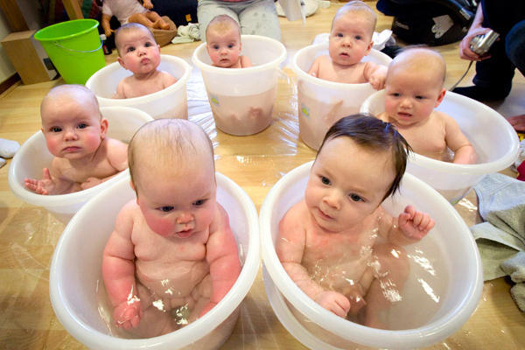
These babies began life clean and fresh. They will grow to resemble their siblings. As newborn children of God, let us grow up to be like Jesus!

Slide 8
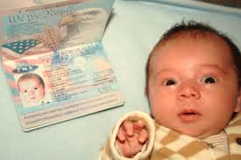
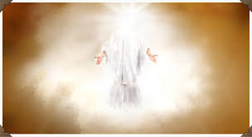
Grow to Resemble Jesus!
“Beloved, now we are children of God; and it has not yet been revealed what we shall be, but we know that when He is revealed, we shall be like Him, for we shall see Him as He is.” (1 John 3:2)

