Slide 1

Life in the Son
Walking Daily as a Child of God
Loving God in obedience
(1 John 2:3-5; 5:3)

Slide 2

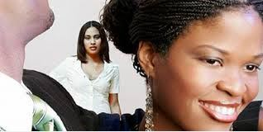
I Love You!
You’re the only woman for me!
Do You Believe Him?

Slide 3
Sobering Comparison
The Greatest Commandment
Matthew 22:35-40
The Liars of 1 John
1st: You shall love the Lord your God with all your heart, with all your soul, and with all your mind.
2nd: You shall love your neighbor as yourself
2:4-6 He who says, “I know Him,” and does not keep His commandments, is a liar, and the truth is not in him
4:20 If someone says, “I love God,” and hates his brother, he is a liar;
Does my action (obedience) equal my words (“I Know Him”)?

Slide 4
Consistent From the Beginning
I will be your God, if you will be my people (Lev. 26:12)
If you will diligently obey the voice of the Lord your God to observe carefully all His commandments (Lev. 26 & Deut 28)
  Blessed shall you be in the city, country, fruit of your body, flocks, storehouses, etc…
1 John 2:5-6 But whoever keeps His word, truly the love of God is perfected in him. By this we know that we are in Him.

Slide 5
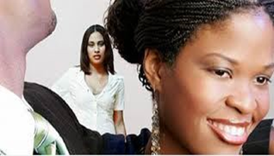
Examples
Can you think of some examples in the Old Testament where the people‘s actions (obedience) didn’t match their words (we worship Jehovah)?
Now think to yourself on a few examples where your actions (obedience) don’t match your words of "I love God," and set your mind to correct these disconnects.

Slide 6
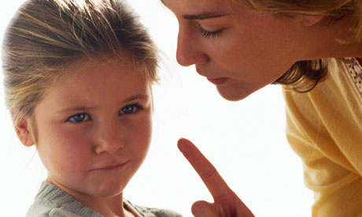
We Learn Early
Thank Your Parents
1. Why? (Does it make sense to me?)
No
Because I Said So!
2. I don’t want too!
Could anything illustrate this better than Abraham offering Isaac? (Gen. 22, Heb. 11)

Slide 7
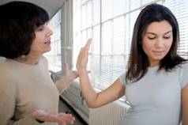
As We Grow, the Battle Grows
Childhood whys or “does this make sense to me?” grows into arrogance.
“Do I want to do this” grows into selfishness
Can I do this and still fit in (peer pressure)?
Even adults in the workforce fear facing ridicule
2 Cor. 10:5 Bring every thought into captivity to
the obedience of Christ.

Slide 8
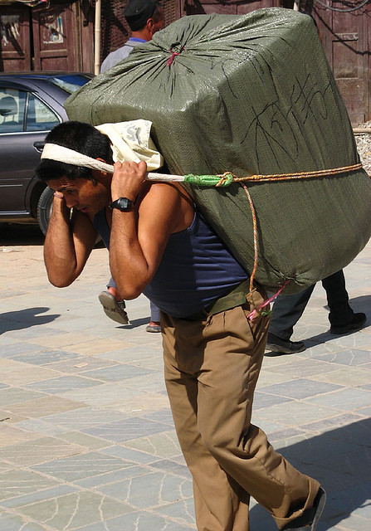
His Commandments Are Not Burdensome
Heb 12:1 Therefore we also, since we are surrounded by so great a cloud of witnesses, let us lay aside every weight, and the sin which so easily ensnares us, and let us run with endurance the race that is set before us
You can choose to be a leader or a follower
This country needs you to be great

Slide 9
We Can Make it Hard
Heb 12:1 Therefore we also, since we are surrounded by so great a cloud of witnesses, let us lay aside every weight, and the sin which so easily ensnares us, and let us run with endurance the race that is set before us
Why? Does it have to make sense to me?
I don’t want to (lust of the flesh)
Peer Pressure

Slide 10
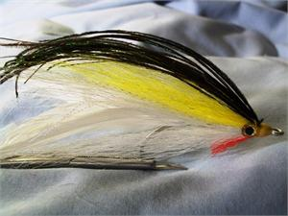
Do Not Love The World
(1 John 2:15-17)
Satan is the great deceiver
Sin is fun
  “Desires of the flesh” or “lust of the flesh”
Satan used everyone around you to destroy you
  School, work, teams, etc…
Satan will even use family member or church members to destroy you
  Conflict can cause us to think and act emotionally rather than soberly

Slide 11


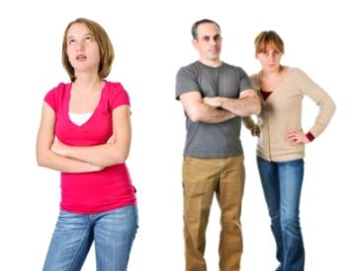
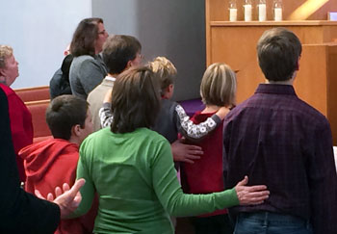
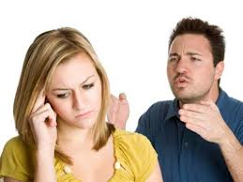
Do my actions (obedience) match my words (I Know Him)
God give us Christian Homes, Homes where the Bible is loved and taught …

Slide 12
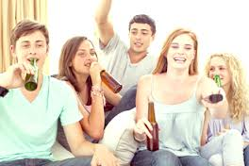
Do my actions (obedience) match my words (I Know Him)
More Purity Give Me …

Slide 13
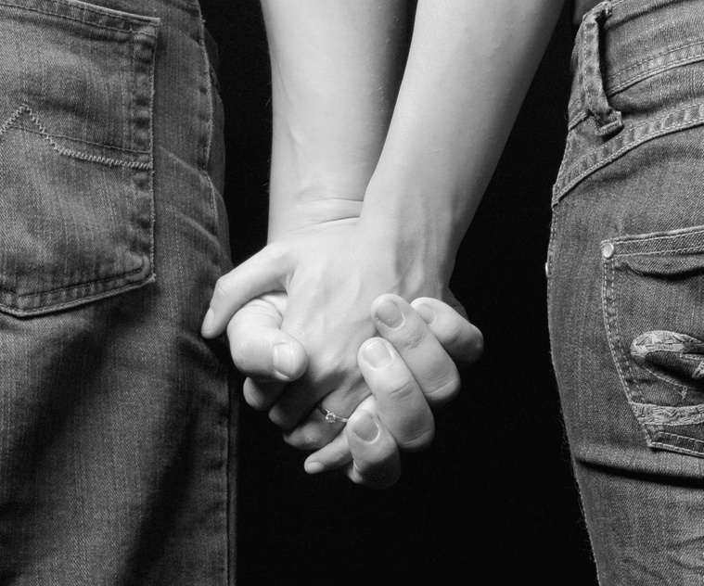
Do my actions (obedience) match my words (I Know Him)
More Purity Give Me …

Slide 14

Do my actions (obedience) match my words (I Know Him)
More Purity Give Me …

Slide 15
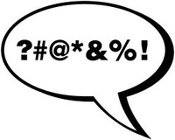
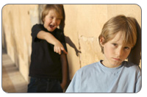
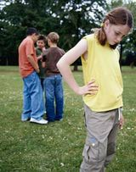
Do my actions (obedience) match my words (I Know Him)
More Purity Give Me …

